Slide 1
AGC of America Member Orientation
WELCOME TO AGC!
Getting the Most Out of
Your AGC of America Membership

Slide 2
AGC Structure
Company
(and employees)
Local AGC Chapter(s)
AGC of America
To join AGC, a company must first join a local chapter. Upon joining at the chapter level, your company also becomes a member of AGC of America. All company employees are eligible to access member benefits from both the local chapter and AGC of America.

Slide 3
Value of Membership
Your Chapter
Training Programs
Regional Networking
Safety or Job Site Services
Health Insurance
Local & State Advocacy
Business Development
Plan Room/
Bidding
401K or Workers’ Comp Programs
AGC of America
Virtual Education
Member Discounts
Industry Forecasts
Workforce Develop-ment
National Advocacy
Net-working
National Meetings
Industry News/
Analysis

Slide 4

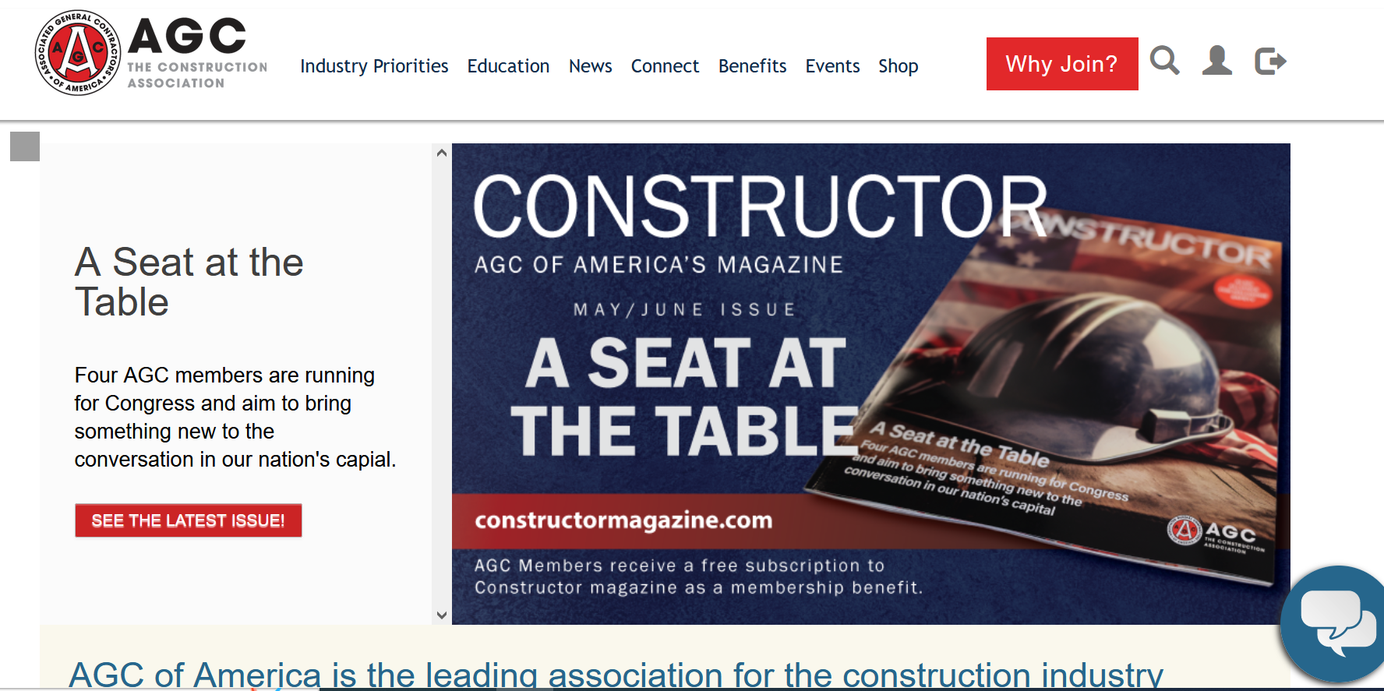



Creating your member profile
Start taking advantage of your company’s membership in 3 easy steps…
Visit the AGC of America website.
Click on the profile icon at the top right.
Click on “New Account”.
Complete your profile to sign up for newsletters, set your preferences, and identify your areas of interest.
www.agc.org

Slide 5
The Value of AGC
Industry Voice for Construction
Network and Connect with Peers
Professional Development/
Education
Member Discounts
News, Information & Resources

Slide 6

The Voice of Construction
Stay Informed
  Sign up for the latest legislative, political, and regulatory news affecting the construction industry.
  Take Action
  Make your voice heard. Tell your members of Congress how their actions will affect you and your company.
  Contribute
  AGC PAC and the Construction Advocacy Fund are affecting positive change for the industry. Learn how to get involved today.
advocacy.agc.org

Slide 7

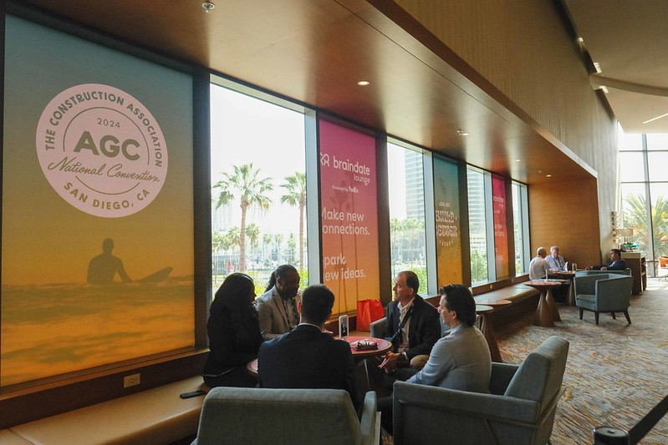




Networking Opportunities
AGC Conferences
AGC Annual Convention
Focused Management Conferences
Divisions
Building, Federal & Heavy Construction, Highway & Transportation, and Utility Infrastructure
Member Forum Communities
HR Forum, Business Development Forum, Specialty Contractors Forum, etc.
Volunteer Opportunities

Slide 8
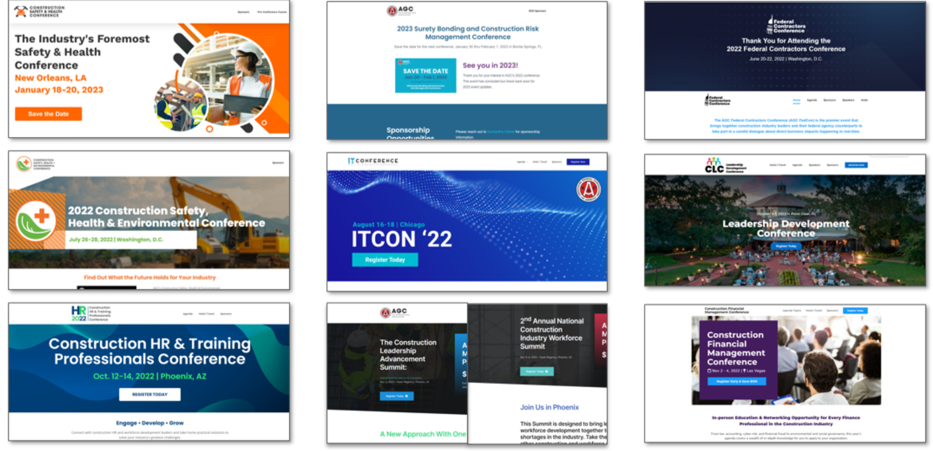
AGC National Events
Leveraging AGC’s Value Proposition to Help Engage Members

Slide 9
Training & Education
AGC of America offers a number of educational programs designed to enhance career development opportunities for individuals and improve the performance of construction companies and the industry.
Through webinars, workshops, conferences and education programs, AGC of America education programs and training resources address core topics essential to any construction professional and company.
BIM & CM BIM
Lean & CM Lean
Supervision Fundamentals
Supervisory Training
Project Management
Emerging Contractors Webinar Series
FREE Webinars
Advanced Management
Safety Management
Supervisory Fundamentals
CEUs
agc.org/learn

Slide 10

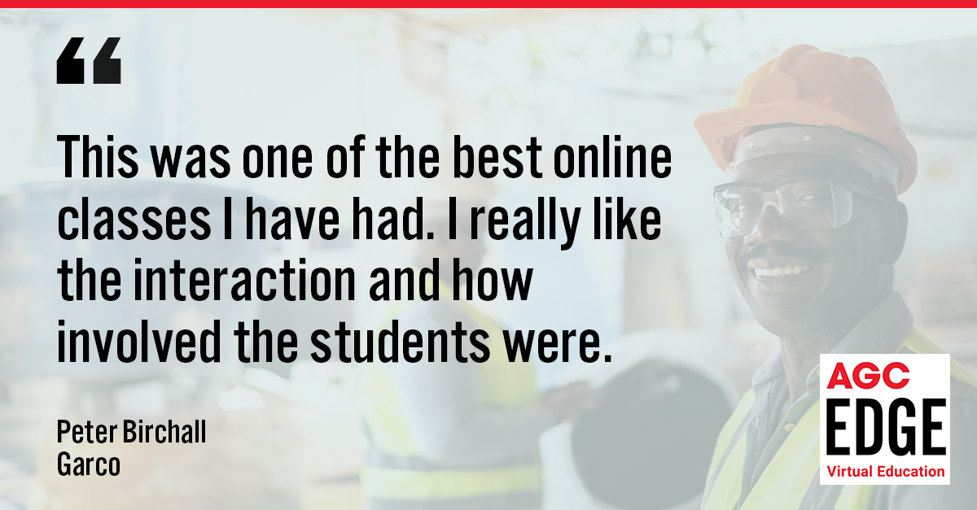




Introducing AGC’s Live Virtual Training. The same high-quality learning experience and expert instruction you expect from AGC in-person classroom training from the comfort of your home or work computer.

Slide 11
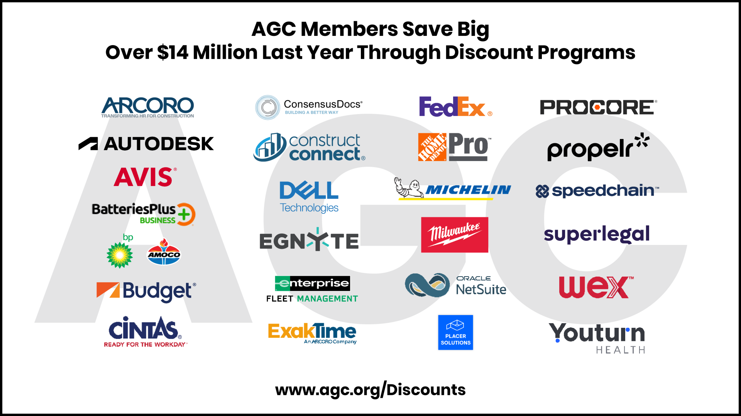
  AGC Member Discount Programs
Visit agc.org/save to view and access all discount programs

Slide 12

Construction Data
Employment Data
Material Pricing
Spending
Data DiGest
State Fact Sheets, Presentations, Surveys
https://www.agc.org/learn/construction-data

Slide 13
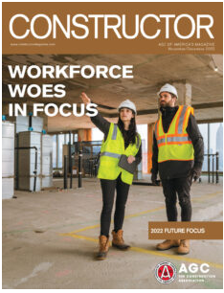
Constructor Magazine
Bi-Monthly
Print and Digital
https://www.constructormagazine.com/

Slide 14

AGC of America Newsletters
Building Material
Business Development
CLC Leadership-Link
Construction Law in Brief
Construction Advocacy in Action
Constructor Monthly
Data Digest
Environmental Observer
Federal Contractor Report
Highway Facts Bulletin
Human Resource & Labor News
News & Views
Utility INFO-Structure
Construction Safety and Health News
TechBrief
Smartbrief
https://www.agc.org/news/newsletter

Slide 15


Recent Podcast Topics:
Behind the Bench: AGC’s Litigation Strategy
Value Every Voice: Construction Safety Week 2024
Concrete Commitments: How to Create a Culture of CARE
2024 Outlook: Economic Insights for Builders
Constructing Cyber Resilience
Digging Deeper: Unearthing the Risks of Trenching & Excavation
Building Tomorrow’s Heroes
And more….
https://www.agc.org/ConstructorCast

Slide 16
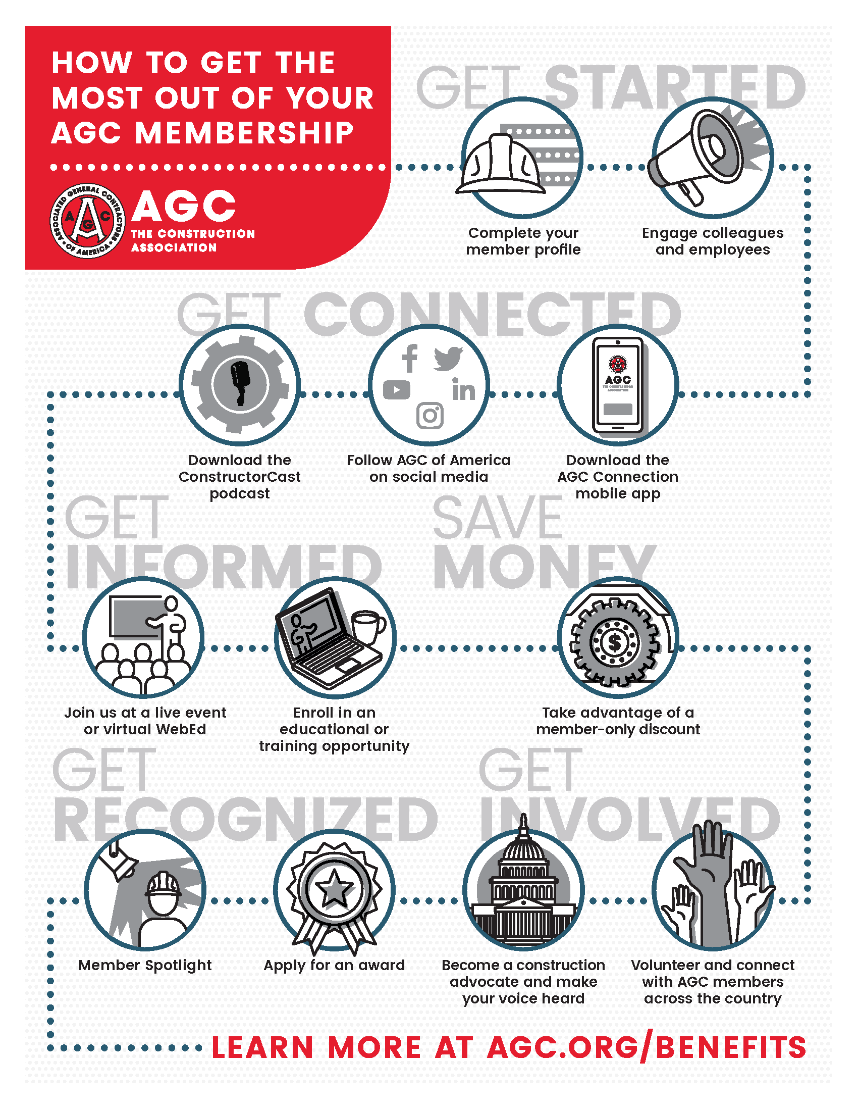
Member
Roadmap

Slide 17
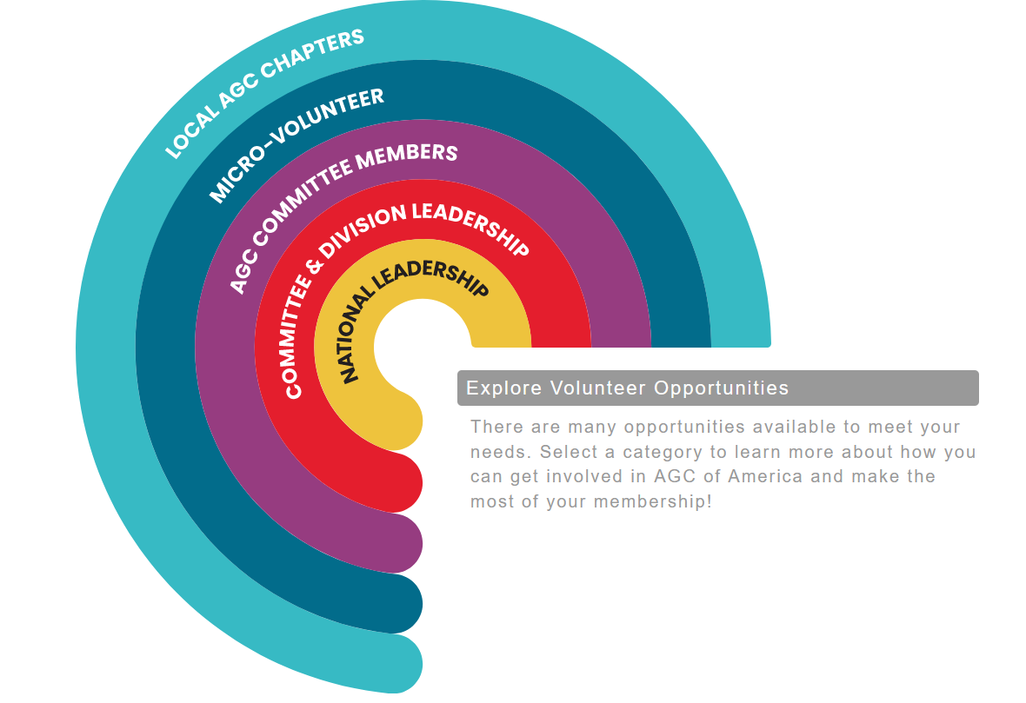
Volunteer Engagement
Network
Collaborate and work together with fellow members, make lasting connections, and find new professional opportunities.
Learn
Stay on top of issues that affect the industry and learn more about different topic areas.
Gain new skills
AGC can help you develop crucial leadership skills, public speaking, writing, and more.
Share your knowledge
Make a difference by sharing your expertise.
www.agc.org/volunteer
Leveraging AGC’s Value Proposition to Help Engage Members

Slide 18
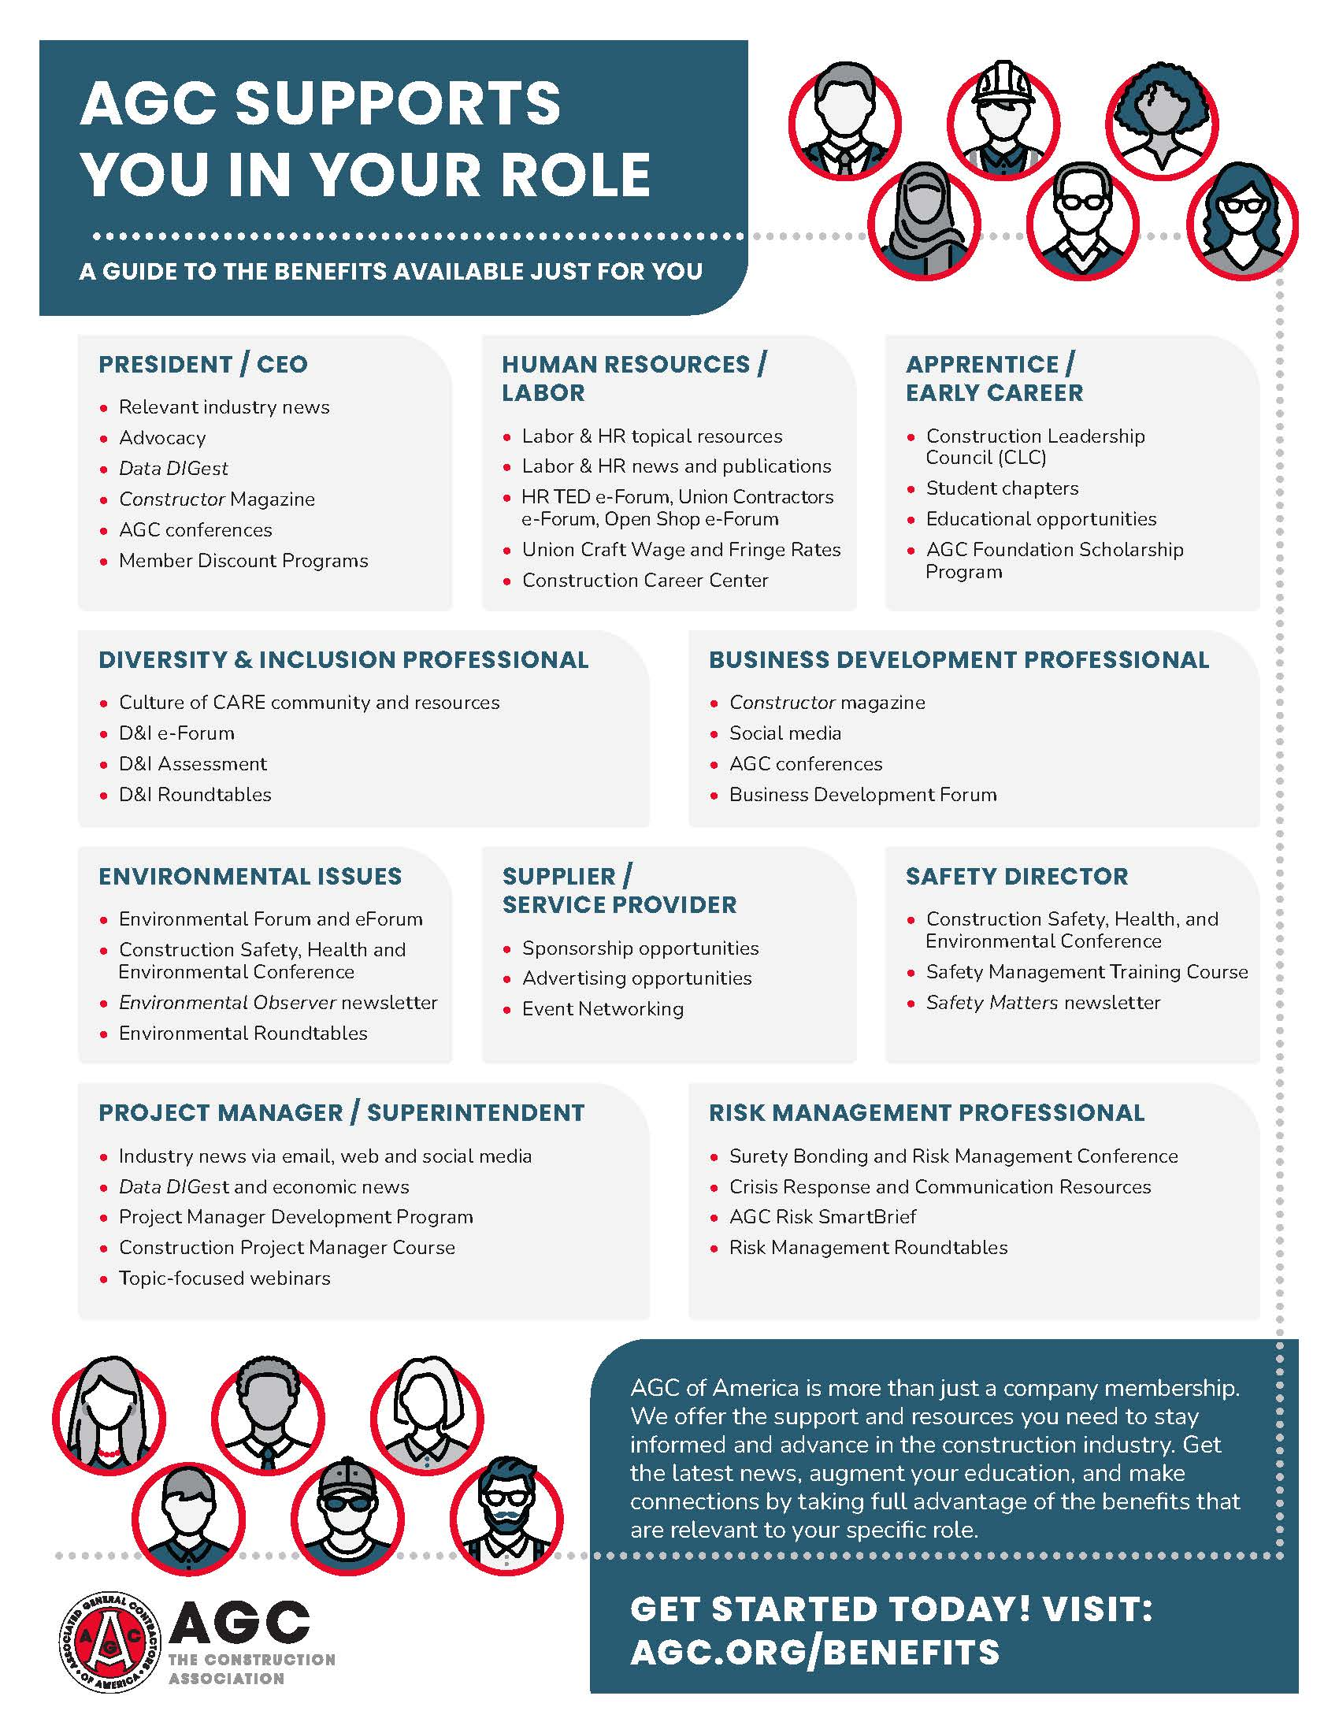
What’s your role?
AGC is for
EVERYONE!
Did you know every employee is eligible to take advantage of AGC member benefits?

Slide 19
Questions?
Contact membership@agc.org

