Slide 1
January 2026
Construction Outlook:
What’s in the Mix for ‘26?
Ken Simonson
Chief Economist, AGC of America
ken.simonson@agc.org
©2026 The Associated General Contractors of America, Inc.

Slide 2
Contractors have generally lower expectations for 2026 than in 2025
Net % expecting higher value - % expecting lower value of available projects than in previous year
2026:
Net change
from 2025
15%
2%
-3%
-4%
-18%
-10%
-18%
-14%
-9%
-17%
-8%
-13%
-14%
-17%
-14%
-11%
-13%
Source: AGC Outlook Surveys. 2026: 951 total respondents; 2025: 1,109
©2026 The Associated General Contractors of America, Inc.

Slide 3
Fewer firms than a year ago expect to add employees
% of respondents who:
Increase
Source: AGC Outlook Surveys. 2026: 951 total respondents; 2025: 1,109
©2026 The Associated General Contractors of America, Inc.

Slide 4
Construction job growth has tailed off sharply in 2025
Year-over-year % change in employment, Jan. 2022-Dec. 2025, seasonally adjusted
% change since:
Dec. 2024
Jan. 2022
Nonresidential Construction
1.1%
12%
Total Nonfarm
0.4%
6.3%
Total Construction
0.2%
9.5%
Residential Construction
-1.2%
5.4%
Source: BLS current employment statistics, https://www.bls.gov/ces/
©2026 The Associated General Contractors of America, Inc.

Slide 5
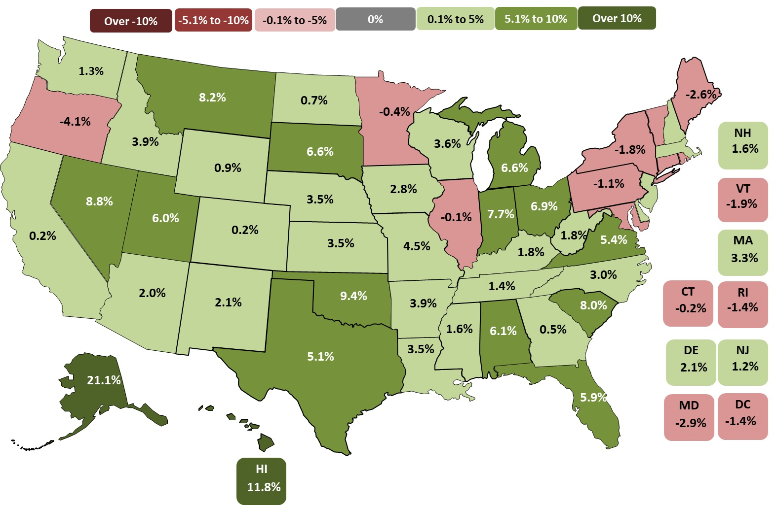
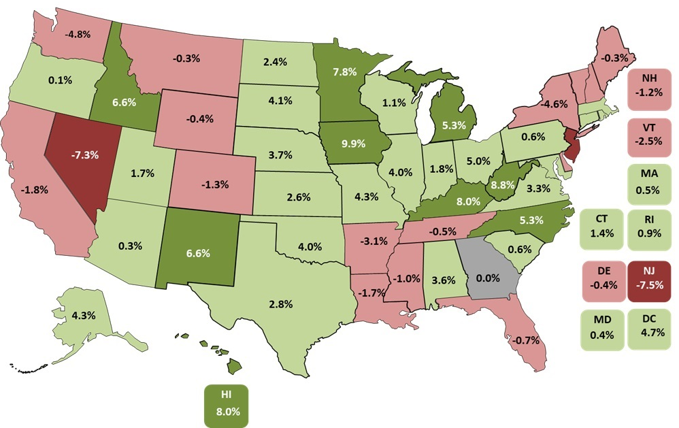
Construction Job Growth Is Uneven Across States
32 states & DC up & 17 states down & 1 state unchanged Nov. 2024-Nov. 2025 (U.S.: up 0.7%)
188 metros (52%) up, 122 (34%) down, 50 unchanged
Top 5
IA | 9.9%
WV | 8.8%
HI | 8.0%
KY | 8.0%
MN | 7.8%
Bottom 5
NJ | -7.5%
NV | -7.3%
WA | -4.8%
NY | -4.6%
AR | -3.1%
Source: Bureau of Labor Statistics, state and area employment, www.bls.gov/sae
©2025 The Associated General Contractors of America, Inc.

Slide 6
Low rates for hires and job openings but also layoffs (“low hire, low fire”)
Construction job openings, hires, quits, and layoffs as % of Nov. employment, 2001-25
Nov. 2025
Nov.
2024
Hires
4.1%
4.1%
Job openings
3.4%
3.2%
Quits
1.8%
1.7%
Layoffs
1.7%
1.7%
Source: Bureau of Labor Statistics, www.bls.gov/jlt, Job Openings & Labor Turnover Survey (JOLTS)
©2026 The Associated General Contractors of America, Inc.

Slide 7
Private construction is declining; public remains positive but weak
Year-over-year % change in current dollars, seasonally adjusted, Oct. 2023-Oct. 2025
Oct. 2025
(billion $)
year-over-year % change
Oct. 2023- Oct. 2024-Oct. 2024 Oct. 2025
Public
$524
7%
2%
Total construction
$2,175
3%
-1%
Private residential
$914
5%
-1%
Private nonresidential
$737
- 3%
-3%
Source: Author, from U.S. Census Bureau, www.census.gov/constructionspending
©2026 The Associated General Contractors of America, Inc.

Slide 8
Spending trends: mix of increases and decreases
current dollars, seasonally adjusted annual rate (billion $), Oct. 2024-Oct. 2025
$2,175B Total -1.0%: $926B Residential -1% (Private single-family -6%; multi -3%; improvements 4%); public 13%
$1,249B Nonresidential -1% (private -3%, public 2%)
Nonresidential segments (in descending order of October 2025 spending; combined new & renovation spending)
$214B Mfg. -10% (computer/electronic -22%; chemical 13%; food/beverage/tobacco -6%; transportation equipment -13%)
$158B Power 3% (electric 3%; oil/gas fields & pipelines 6%)
$143B Highway and street -1% (pavement -4%; bridge 13%)
$141B Educational -1% (primary/secondary -4%; higher ed -4%; other 23%)
$122B Commercial -2% (warehouse -6%; retail 0.5%; farm -4%)
$106B Office including data centers -1% (data centers 18%; other private office -12%; public office -8%)
$69B Health care -0.5% (hospital 0.5%; medical building -7%; special care 17%)
$69B Transportation 4% (air 8%; private rail/truck -2%; transit -9%)
$227B Other 6%:
Sewage/waste 16%; Amuse/recreation 4%; Water supply 5%; Communication 0.3%; Lodging -1%; Public safety 0.3%; Conserv/dev 7%; Relig 15%
Source: Author, from U.S. Census Bureau, www.census.gov/constructionspending
©2026 The Associated General Contractors of America, Inc.

Slide 9
Firms’ major concerns for 2026
% of respondents who listed as a major concern:
Source: AGC 2026 Outlook Survey; 951 total respondents
©2026 The Associated General Contractors of America, Inc.

Slide 10
Price changes for construction inputs as of November 2025
producer price indexes (PPIs), 1 - & 12-mo. change (not seasonally adjusted)
November 2025 change from:
Oct. 2025 Nov. 2024 Feb. 2020
(1 month) (12 months) (67 months)
Overall input costs are rising again and have outpaced the CPI since 2020
PPI for inputs to new nonresidential construction |  | 0.4% | 3.6% | 42%
Consumer price index (CPI) |  | - | 2.7% | 26%
...and some input prices remain volatile
Steel mill products |  | -3.2% | 4.6% | 55%
Aluminum mill shapes |  | 3.1% | 28% | 67%
​Copper and brass mill shapes |  | -0.2% | 3.0% | 77%
Construction machinery and equipment |  | 0% | 4.7% | 36%
Source: Bureau of Labor Statistics, www.bls.gov/ppi
©2026 The Associated General Contractors of America, Inc.

Slide 11
Construction pay increases continue to outpace the private sector
BLS: Average hourly earnings for production and nonsupervisory employees (Dec. 2024-Dec. 2025):
Construction 4.5% Private sector 3.8%
BLS: Wages and salaries (employment cost index, Q3 2024-Q3 2025):
Construction 4.1% Private sector 3.8%
CLRC: First-year settlements for construction union contracts: 4.7% (through Sep. 2025)
PAS: Construction firm wage increases for support staff: 4.0% (Oct. 2025)
Source: Author
©2026 The Associated General Contractors of America, Inc.

Slide 12
Tariff announcements & dates affecting construction (as of Jan. 22)
(more at AGC Tariff Resource Center: www.agc.org/tariff-resources-contractors)
10% “baseline” tariff on nearly all imports
Additional country-specific “reciprocal” tariffs on Aug. 7
China 30%: 10% tariff Feb. 4; changed to 20% March 4; 54% April 5, 145% April 9, reduced to 30% May 12 under “truce” until Nov. 10; truce extended for a year Oct. 30
Canada: 35% on Aug. 1 if not covered by USMCA; higher rate threatened on Oct. 24; 10% on energy, “critical minerals”
Mexico: 25% if not covered by USMCA; 30% threatened but date not certain
EU: 15% on Aug. 1
Japan, South Korea: 15% on Aug. 7
Brazil: 50% on Aug. 1, with exceptions
Steel & aluminum: 25% on March 12; 50% on June 4
Copper: 50% on Aug. 7 for copper products, not unprocessed copper
Lumber: 10% on Oct. 1; duties on Canadian lumber raised from 14.5% to 35% in early August
Cars & light trucks: 25%; medium and heavy trucks: 25% on Nov. 1; lower rate for parts, USMCA
Fee on Chinese ships calling on U.S. ports: began on Oct. 14; suspended as of Nov. 10
Source: White House and media reports
©2026 The Associated General Contractors of America, Inc.

Slide 13
Actions taken in response to actual or proposed tariffs
(% of firms - some respondents reported multiple actions):
Raised bid prices
Passed most or all tariff costs on to project owner
Source: AGC 2026 Outlook Survey; 951 total respondents
©2026 The Associated General Contractors of America, Inc.

Slide 14
Immigration enforcement affected rising share of firms in past 6 months
(% of firms - some respondents reported multiple types of effects):
Total affected by immigration enforcement actions
Subcontractors lost workers
Source: AGC 2026 Outlook Survey; 951 total respondents
©2026 The Associated General Contractors of America, Inc.

Slide 15
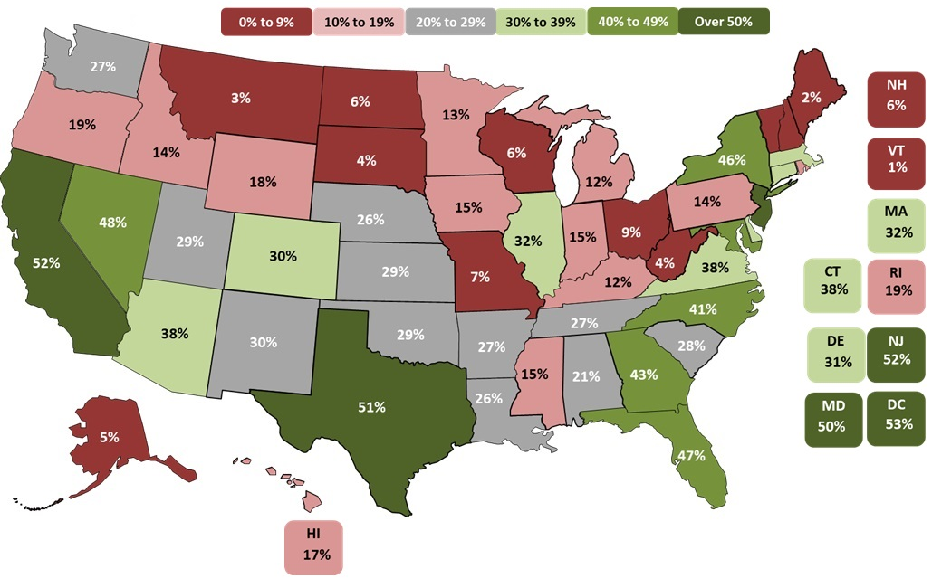
Construction trades rely heavily on immigrants (34% vs. 18% for all workers); impact varies greatly by state (1-53%)
Share of construction trade workers who are foreign born by state, 2023
Source: Harvard Joint Center for Housing Studies from Census Bureau, 2024 American Community Survey 1-Year Ests.
©2026 The Associated General Contractors of America, Inc.

Slide 16
Foreign-born share of construction trade workers varies greatly by trade
Occupation | Foreign born | Occupation | Foreign born
Plasterers & Stucco Masons | 61% | Pipelayers | 26%
Drywall Installers, Ceiling Tile Installers, & Tapers | 61% | Plumbers, Pipefitters, & Steamfitters | 18%
Roofers | 52% | Glaziers | 18%
Painters & Paperhangers | 51% | Solar Photovoltaic Installers | 17%
Carpet, Floor, & Tile Installers and Finishers | 45% | Sheet Metal Workers | 17%
Construction Laborers | 43% | Boilermakers | 16%
Insulation Workers | 34% | Electricians | 16%
Carpenters | 32% | Structural Iron & Steel Workers | 15%
Cement Masons, Concrete Finishers, Terrazzo Workers | 31% | Construction Equipment Operators | 15%
Source: Harvard Joint Center for Housing Studies from Census Bureau, 2023 American Community Survey 1-Year Ests.
©2026 The Associated General Contractors of America, Inc.

Slide 17
Likely policy impacts on construction
Higher tariffs will raise costs, invite retaliation, may disrupt supply chains
Harsh immigration/deportation actions will worsen construction labor shortages
Expectation of larger deficits may push interest rates higher
Less support for renewables may slow solar and EV-related projects
However, lessened federal regulatory hurdles may help projects start sooner
OBBBA adds certainty about corporate taxes; may lead to speedup of some investments
Source: Author
©2026 The Associated General Contractors of America, Inc.

Slide 18
Medium-term outlook: growing risk of decline
Economic growth is close to stalling; risks of inflation and recession are high
Single-family: gradual pickup if mortgage rates don’t spike; multifamily close to bottoming out
Warehouse, office: declines likely throughout 2026 given high costs, weak demand
Data center, power, infrastructure, specialty health care: best bets for growth
Mfg. construction: canceled & deferred projects likely to outweigh new starts
Materials costs: up 2-4%, much more if tariffs last; lead times: few problems except electrical gear
Labor costs: up 4-5%; ICE actions make availability a challenge
Source: Author
©2026 The Associated General Contractors of America, Inc.

Slide 19
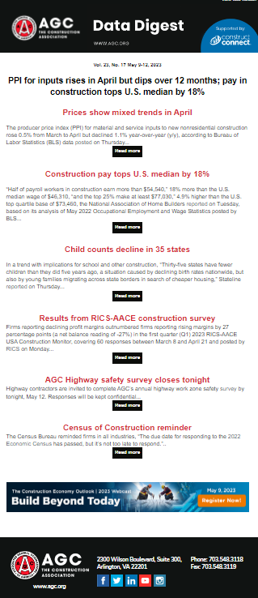
AGC economic resources
(email ken.simonson@agc.org)
Data DIGest: weekly email summary of construction economic news (subscribe)
AGC Tariff Resource Center
AGC/Sage Construction Hiring and Business Outlook Survey
State and metro data, fact sheets
Monthly press releases: construction spending; producer price indexes; national, state, metro employment with rankings
Construction impact model: www.agc.org/agc-construction-impact-model
ConsensusDocs Price Escalation Resource Center
Source: Author
©2026 The Associated General Contractors of America, Inc.

