Slide 1
January 2025
Will U.S. Construction Thrive or Dive in ‘25?
Ken Simonson
Chief Economist, AGC of America
ken.simonson@agc.org
©2025 The Associated General Contractors of America, Inc.

Slide 2
Total nonfarm & construction employment, Jan. 2022-Dec. 2024
Year-over-year change, seasonally adjusted
% change since:
Dec. 2023
Jan. 2022
Nonresidential Construction
3.0%
11%
Residential Construction
1.5%
7.3%
Total Nonfarm
1.4%
6.3%
Source: BLS current employment statistics, https://www.bls.gov/ces/
©2025 The Associated General Contractors of America, Inc.

Slide 3
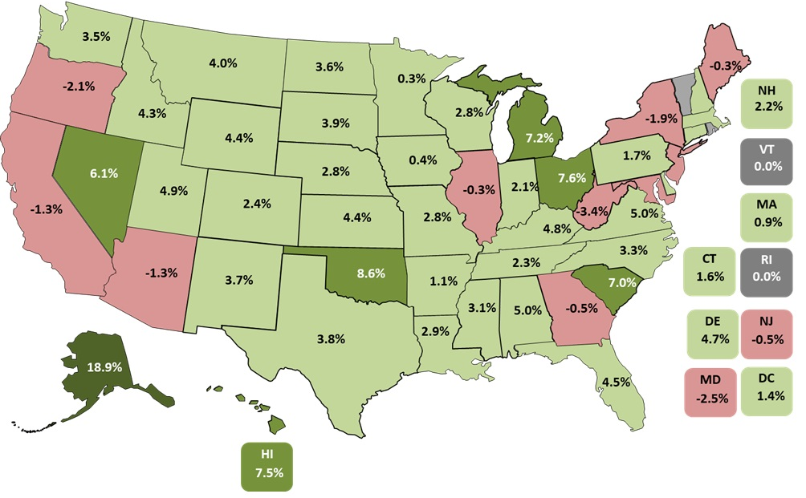
Construction employment is increasing in most states
38 states & DC up & 10 states down, & 2 unchanged Dec. 2023-Dec. 2024 (U.S.: 2.4%)
Top 5
AK | 19%
OK | 8.6%
OH | 7.6%
HI | 7.5%
MI | 7.2%
Bottom 5
WV | -3.4%
MD | -2.5%
OR | -2.1%
NY | -1.9%
AZ | -1.3%
Source: Bureau of Labor Statistics, state and area employment, www.bls.gov/sae
©2025 The Associated General Contractors of America, Inc.

Slide 4
Net* % who expect value of projects to be higher/lower than in previous year
* Net = % expecting higher value - % expecting lower value than in previous year
2025 vs. 2024:
Source: AGC 2025 Outlook Survey; 1,109 total respondents
©2024 The Associated General Contractors of America, Inc.

Slide 5
IIJA’s impact on firms’ business
% of respondents who reported:
Source: AGC 2025 Outlook Survey; 1,109 total respondents
©2024 The Associated General Contractors of America, Inc.

Slide 6
Firms’ expectations regarding their headcount and hiring hourly craft workers over next 12 months
% of respondents who:
Source: AGC 2025 Outlook Survey; 1,109 total respondents
©2024 The Associated General Contractors of America, Inc.

Slide 7
Firms’ major concerns for 2025
% of respondents who listed as a major concern:
Source: AGC 2025 Outlook Survey; 1,109 total respondents
©2024 The Associated General Contractors of America, Inc.

Slide 8
Wage “premium”: Construction subsector vs. total private sector
“Premium”=average hourly earnings for production & nonsupervisory employees in construction compared to private sector, Jan 2020- Nov 2024, seasonally adjusted
November
2024
Nonresidential construction building
27%
Heavy and civil
24%
Construction
18%
Specialty trade
17%
Residential building
11%
Source: BLS current employment statistics, https://www.bls.gov/ces/
©2025 The Associated General Contractors of America, Inc.

Slide 9
Change in construction materials and labor costs, 2020-2024
Year-over-year change in producer price index (PPI) for nonresidential inputs and average hourly earnings (AHE) for construction, Feb. 2020 – Dec. 2024
December 2024
% change since:
Dec. 2023
Feb. 2020
AHE for all employees*
4.4%
24%
PPI for nonresidential inputs**
0.3%
37%
*Seasonally adjusted (SA)
**Not seasonally adjusted (BLS does not post SA data for this series)
Source: Bureau of Labor Statistics, PPI, www.bls.gov/ppi ; AHE, https://www.bls.gov/ces/
©2025 The Associated General Contractors of America, Inc.

Slide 10
Input and bid price changes, December 2024
producer price indexes (PPIs), 1 - & 12-mo. change (not seasonally adjusted)
December 2024 change from:
Nov. 2024 Dec. 2023 Feb. 2020
(1 month) (12 months) (58 months)
Overall input costs and bid prices have moderated
PPI for inputs to new nonresidential construction |  | -0.1% | 0.3% | 37%
Output (bid price) PPI for new nonresidential buildings |  | 0.2% | 1.6% | 38%
Consumer Price Index (CPI) (through November 2024) |  | -0.1% | 2.7% | 22%
...but some input prices remain volatile
Copper and brass mill shapes |  | -2.3% | 11% | 68%
Steel mill products |  | -3.0% | -11% | 44%
​Diesel fuel |  | -5.5% | -14% | 52%
Source: BLS, producer price indexes, www.bls.gov/ppi
©2025 The Associated General Contractors of America, Inc.

Slide 11
Change in construction spending: November 2023-November 2024
Year-over-year % change in current (not inflation-adjusted) dollars, seasonally adjusted
Source: Author, from U.S. Census Bureau, www.census.gov/constructionspending
©2025 The Associated General Contractors of America, Inc.

Slide 12
Change in construction spending by subcategory
current dollars, seasonally adjusted, November 2023-November 2024
Total 3%: Private residential 3% (single-family -1%; multi -9%; improvements 13%); public residential 12%)
Nonresidential 3% (private 2%, public 4%)
Nonresidential segments (in descending order of November 2024 spending; combined new & renovation spending)
Mfg. 11% (computer/electronic 7%; chemical 12%; transportation equipment 25%; food/beverage/tobacco -4%)
Power 5% (electric 7%; oil/gas fields & pipelines -11%)
Highway and street -4%
Education 3% (primary/secondary 2%; higher ed 5%)
Commercial -8% (warehouse -13%; retail -9%; farm 11%)
Office including data centers 0.1% (data centers 43%; other private office -17%; public office 10%)
Transportation 8% (air 18%; private rail/truck 3%; transit -14%)
Health care -1% (hospital 6%; medical building -13%; special care 14%)
Sewage/waste 5%; Amuse/recreation 9%; Water supply 14%; Communication -1%; Lodging -5%; Public safety 19%; Conserv/development -4%
Source: Author, from U.S. Census Bureau, www.census.gov/constructionspending
©2025 The Associated General Contractors of America, Inc.

Slide 13
Medium-term outlook for construction
Economic growth will continue but policy uncertainty has risen:
- higher tariffs will raise costs, invite retaliation, may disrupt supply chains
- harsh immigration/deportation actions will worsen construction labor shortages
- expectation of larger deficits may push interest rates higher
- less support for renewables may slow solar and EV related projects
- lessened federal regulatory hurdles may help projects start sooner
Single-family: gradual pickup but vulnerable to higher mortgage rates
Multifamily, warehouse, office: steep drops likely as vacancies and costs climb
Data center, power, infrastructure: strong growth; mfg construction: slower growth
Materials costs: up 1-3%; lead times: few problems except electrical gear
Labor costs: up 4-5%; availability remains the #1 challenge for many contractors
BUT costs could rise much more, depending on tariffs and immigration policies
Source: Author
©2025 The Associated General Contractors of America, Inc.

Slide 14
Population change by state, July 2023–July 2024
(U.S.: 0.98%)
Decrease
0-0.49%
0.5-0.99%
1.0-1.49%
1.5%+
Top 6
DC | 2.2%
FL | 2.0%
TX, UT | 1.8%
SC, NV | 1.7%
1.3%
1.5%
0.5%
0.4%
0.4%
1.0%
0.7%
NH 0.5%
0.5%
0.7%
VT
-0.03%
0.4%
0.7%
0.6%
0.6%
1.7%
0.7%
0.5%
MA
1.0%
1.8%
0.9%
0.5%
0.5%
1.0%
0.6%
-0.03%
0.6%
0.6%
0.9%
CT 0.9%
RI 0.8%
0.8%
Bottom 5
WV, VT | -0.3%
MS | -0.004%
LA | 0.2%
HI | 0.3%
1.5%
1.5%
0.4%
0.8%
1.1%
DE 1.5%
NJ 1.3%
1.8%
0.6%
1.7%
-0.004%
0.8%
1.1%
MD
0.7%
DC
2.2%
AK
0.5%
0.2%
2.0%
HI 0.3%
Note: Shading is based on unrounded %s.
Source: U.S. Census Bureau, Dec. 2024 population estimates, www.census.gov/popest
©2025 The Associated General Contractors of America, Inc.

Slide 15
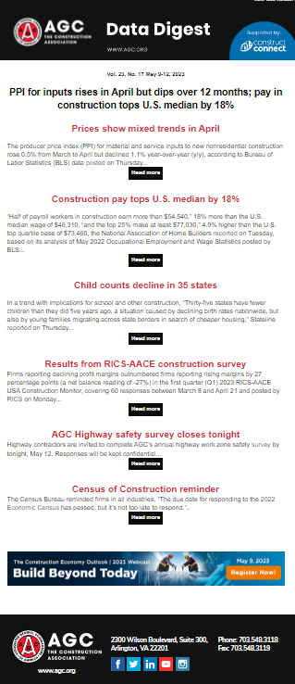
AGC economic resources
(email ken.simonson@agc.org)
Data DIGest: weekly email summary of construction economic news (subscribe: https://marketplace.agc.org/Store/ItemDetail?iProductCode=4401&OrderLineId=901649fd-c733-4103-93e0-a251778cd084)
AGC/Sage 2025 Outlook Survey:
https://www.agc.org/2025-construction-hiring-and-business-outlook
State and metro data, fact sheets: www.agc.org/learn/construction-data
Monthly press releases: construction spending; producer price indexes; national, state, metro employment with rankings: https://www.agc.org/newsroom
Construction impact model: https://www.agc.org/agc-construction-impact-model
ConsensusDocs Price Escalation Resource Center: https://www.consensusdocs.org/price-escalation-clause/
Source: Author
©2025 The Associated General Contractors of America, Inc.

