Slide 1
Lean Construction for Trades Toolbox Talk Series

Slide 2
Lean Construction for Trades Toolbox Talk Series Goals
Introduce Lean Construction concepts in the field through conversational learning
Recognize opportunities to review and improve current processes
Describe how to empower each other to identify and eliminate waste, work safely, and reduce overproduction
Adopt a Lean culture
Toolbox Talk: Weekly Work Planning
Notes:
Bringing Lean construction principles to your teams:
Present the following scenarios to your team.
Prompt them for responses for how they would approach each situation – the goal is to develop a dialog.
Give feedback on their responses and provide recommended solutions.
Emphasize the action items to implement lean construction principles that can eliminate waste and increase capacity.

Slide 3
Lean Construction for Trades Toolbox Talk Session Goals: Weekly Work Planning
Understand the purpose of the weekly work planning
Understand the roles and actions in weekly work planning
Learn some weekly work planning best practices
“Weekly Work Planning” developed by Colin Milberg, ASKM & Associates
Toolbox Talk: Weekly Work Planning

Slide 4
Weekly Work Planning
What is it and what is the goal?
What is your role in weekly work planning and what do you need to do?
How should you behave when weekly work planning?
Toolbox Talk: Weekly Work Planning

Slide 5
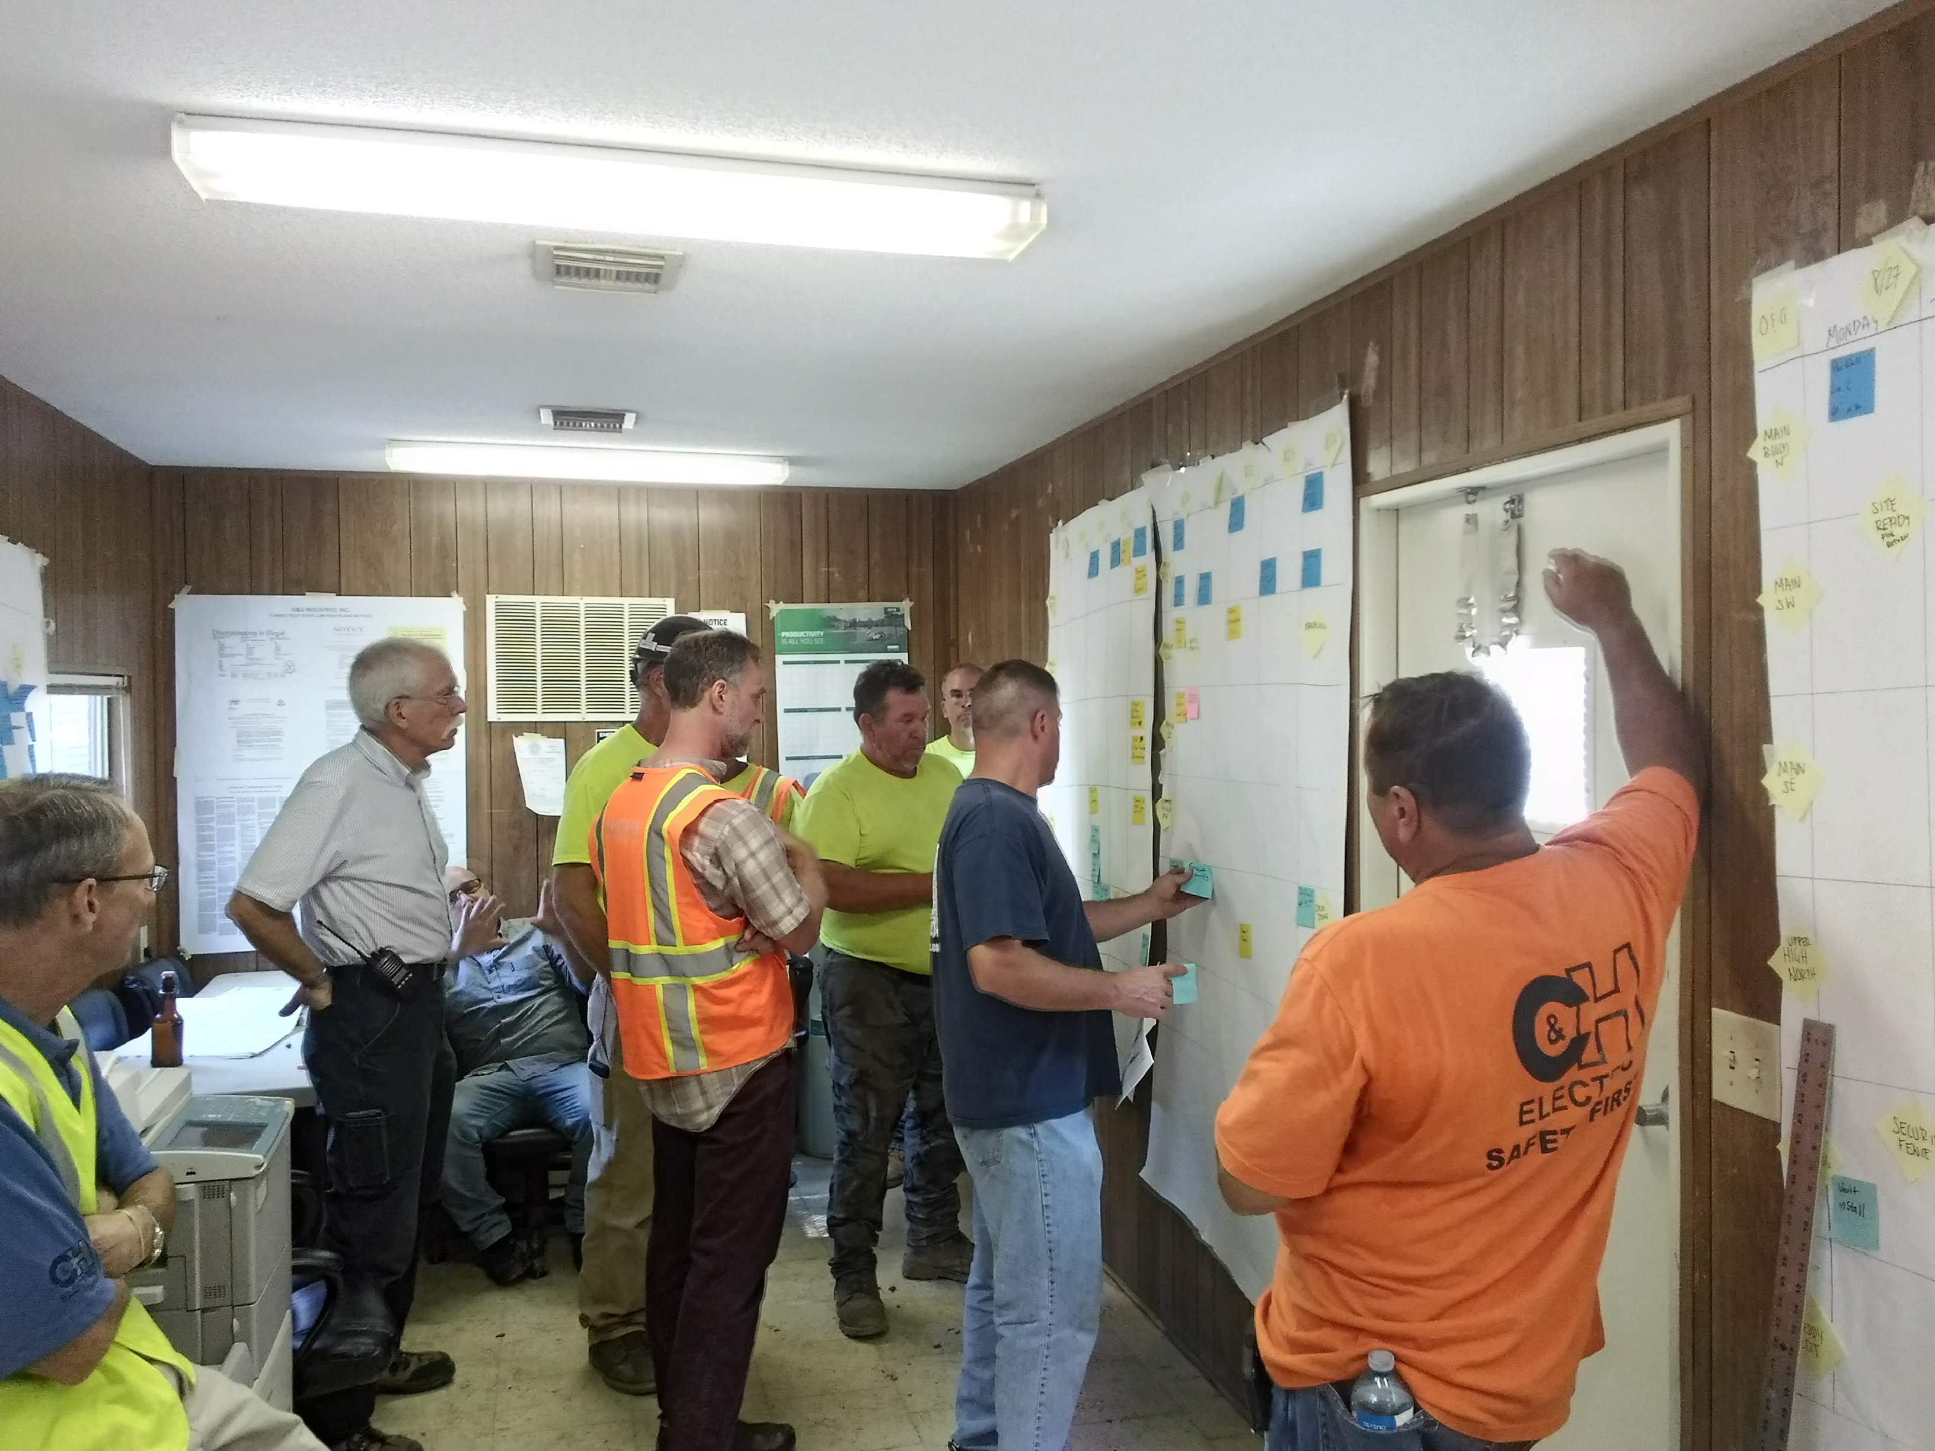
What is Weekly Work Planning?
A collaborative planning session where Last Planners (typically foremen) make commitments to each other and coordinate their work for the next 5 working days.
Toolbox Talk: Weekly Work Planning

Slide 6
What is the goal?
Fully Commit to & Coordinate the next 5 days work that can be done.
Set a baseline for & measure team reliability.
Learn and Improve team reliability.
100% Reliability
Don’t over commit or under commit. Either can throw off a teams coordination. Instead commit to what you really think you will accomplish.
The Weekly Work Plan Rule
Only Plan Ready Work
Work for which you get a commitment to the predecessor during the Weekly Work Plan is considered ready work.
Toolbox Talk: Weekly Work Planning
Notes:
Explain the main goals of weekly work planning from the short term to the larger overall goal.

Slide 7
Basic Agenda
In advance of the meeting each trade posts their detailed daily plan for the upcoming 5 days, verifying the work is ready and based on available manpower.
Calculate last weeks Percent Plan Complete (if not already done).
Coordinate and commit to the next 5 days work across all trades.
As a team, spend time to review last weeks PPC & reasons for misses, select and discuss specific reasons for misses and their root causes, identify& share countermeasures; and make commitments to execute countermeasures.
Conduct a Plus / Delta on the meeting
Toolbox Talk: Weekly Work Planning
Notes:
Briefly review the basic elements of the weekly work plan. With the main activity being coordinating and committing to the next 5 days.

Slide 8
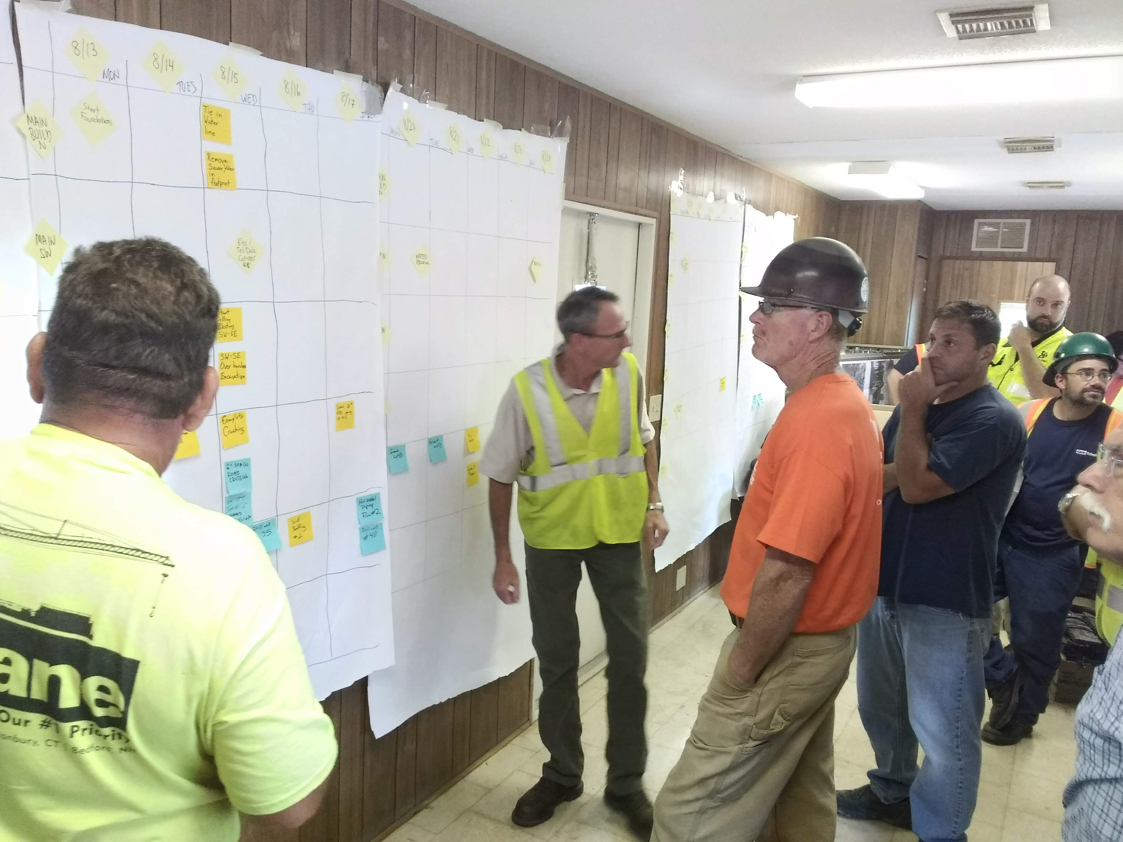
What Does that Look Like?
Each Last Planner stands up and addresses the rest of the trades. They explain in detail for each of the next five days:
What work their crews plan to do, where and what other areas or activities it could impact;
What work areas they are committing to make available to other crews;
What commitments they need from other crews to meet their commitments for this week and currently planned work for next week; and
What back-up work they have and what could trigger using it.
The other trades’ roles are to: listen; interrupt with questions if they don’t understand; evaluate if the plan works with their own; negotiate and coordinate any conflicts while updating the plan; and confirm any requested commitments.
The Supers role becomes facilitating to ensure that the needed communication is happening.
Toolbox Talk: Weekly Work Planning
Notes:
Review the major roles and responsibilities of the Last Planners. Ask what concerns they have in participating in this way.

Slide 9
What can you take away from this image? (FYI: Those are only the trades)
Toolbox Talk: Weekly Work Planning
Notes:
Key point is to truly collaborate: It is the responsibility of the trades as a team to negotiate with each other to coordinate their work in a way that supports the overall goals of the project as well as their own immediate needs.
If you get the question or comment about the trades having free rain. Point out that although at the weekly work planning level no one should press a sub to commit to more than they can with the resources they have ready and available, that does not mean no action is taken if the work being committed to is less that what is needed to meet the schedule. The CM/GC should take immediate action with the trade(s) involved to figure out how to adjust to meet the project needs. However, that should happen outside the weekly work planning session.

Slide 10
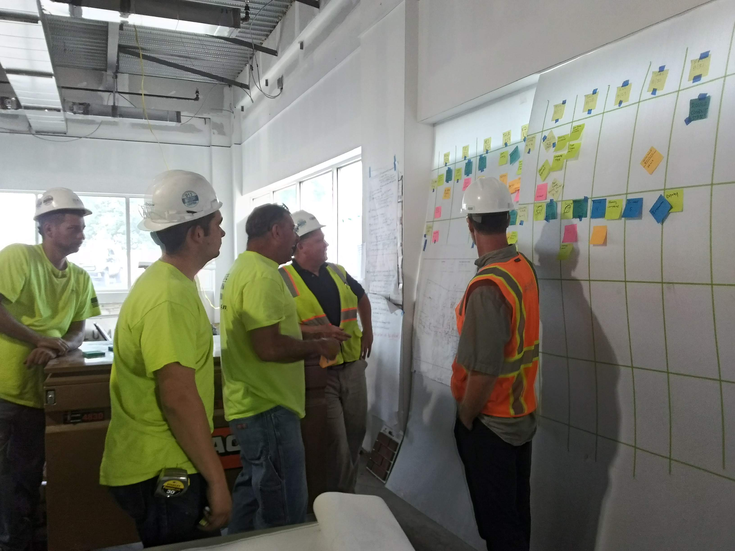
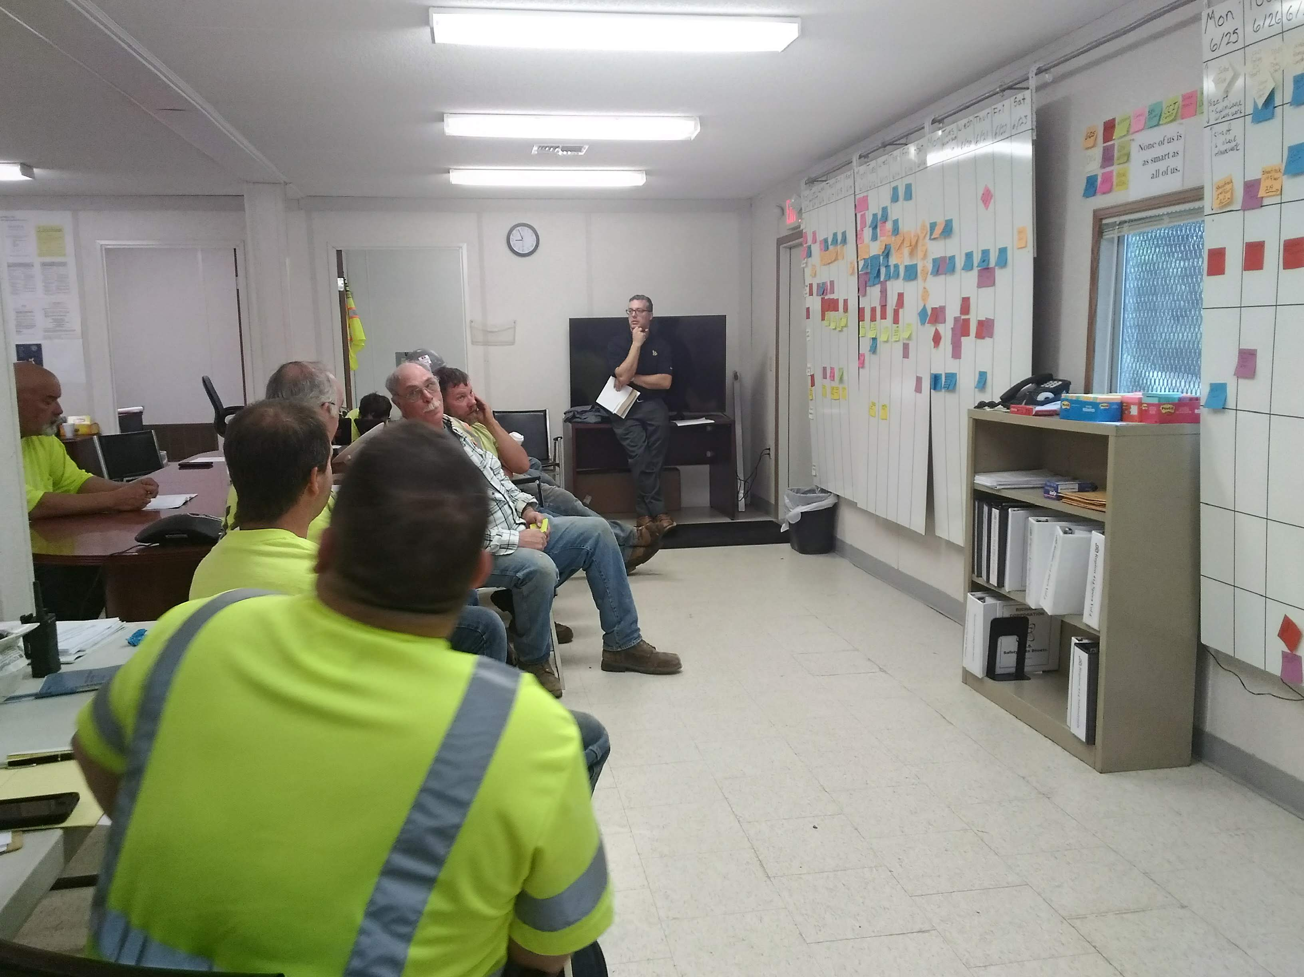
Good Set-up Practices
What do you like about the set-up on the left?
Compare the two pictures below.
What do you see that is supporting team collaboration and accountability?
Toolbox Talk: Weekly Work Planning
Notes:
Ask your team the questions in the slide and solicit feedback and discussion:
Emphasize the following:
Making it simple and visual with drawings as well as weekly plans and other important information at hand. Swim lanes help you see overcrowding or conflicts in an area.
Standing meeting keeps people engaged.
Coral the planning space with everyone inside.

Slide 11
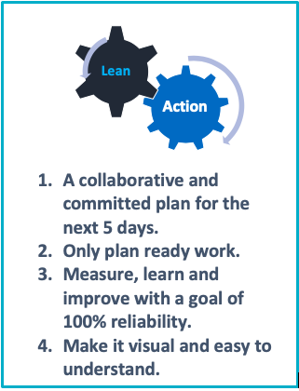
Printable Card
Toolbox Talk: Weekly Work Planning

