Slide 1
Hand Off’s – Phase Scheduling
Lean Construction for Trades:
Toolbox Talk Series

Slide 2
Lean Construction for Trades Toolbox Talk
Series Goals:
Introduce Lean Construction concepts in the field through conversational learning
Recognize opportunities to review and improve current processes
Describe how to empower each other to identify and eliminate waste, work safely, and reduce overproduction
Adopt a Lean culture
Notes:
Bringing Lean construction principles to your teams:
Present the following scenarios to your team.
Prompt them for responses for how they would approach each situation – the goal is to develop a dialog.
Give feedback on their responses and provide recommended solutions.
Emphasize the action items to implement lean construction principles that can eliminate waste and increase capacity.

Slide 3
Lean Construction for Trades Toolbox Talk
Session Goals: Hand-off Commitment Cycle
Illustrate the flow of a hand-off cycle at the Phase Scheduling level of Last Planner System
Explain how buy-in can be achieved
Understanding the value of why reliable hand offs are important
Presentation provided by

Slide 4
What is a “Hand Off”?
With respect to Phase Planning in the Last Planner system, a handoff is the release of the physical work space to the next trade partner who needs to perform their work activity while including clear communication of the turn over conditions of satisfaction.

Slide 5
Hand Off Example:
For example, a grading trade partner will have hand-offs that must occur before the asphalt trade partner can do their work. Likewise, the rebar trade partner will have hand-offs that must occur before the formwork trade partner can do theirs.
Identifying and understanding the conditions of satisfaction for each handoff is critical to coordinating and maintaining a reliable work flow in the field.

Slide 6
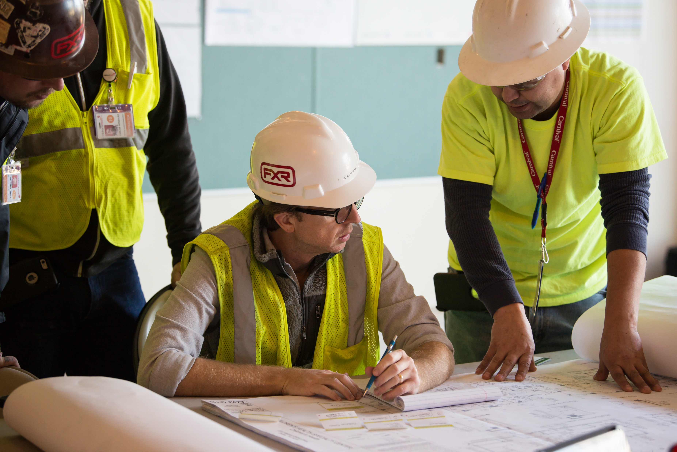
When are Sequences, Hand-Off, and Durations agreed to?
The ideal time is during a pull plan session, where trade partners, foremen, project managers, and superintendents work together to identify phasing/sequencing, hand-offs, and their durations to create a reliable plan together as a team. This collaboration achieves buy-in and certainty around planning construction activities.
A pull plan starts at the END of a milestone and works BACKWARDS, to the beginning. Visit www.leanconstruction.org to learn more.

Slide 7
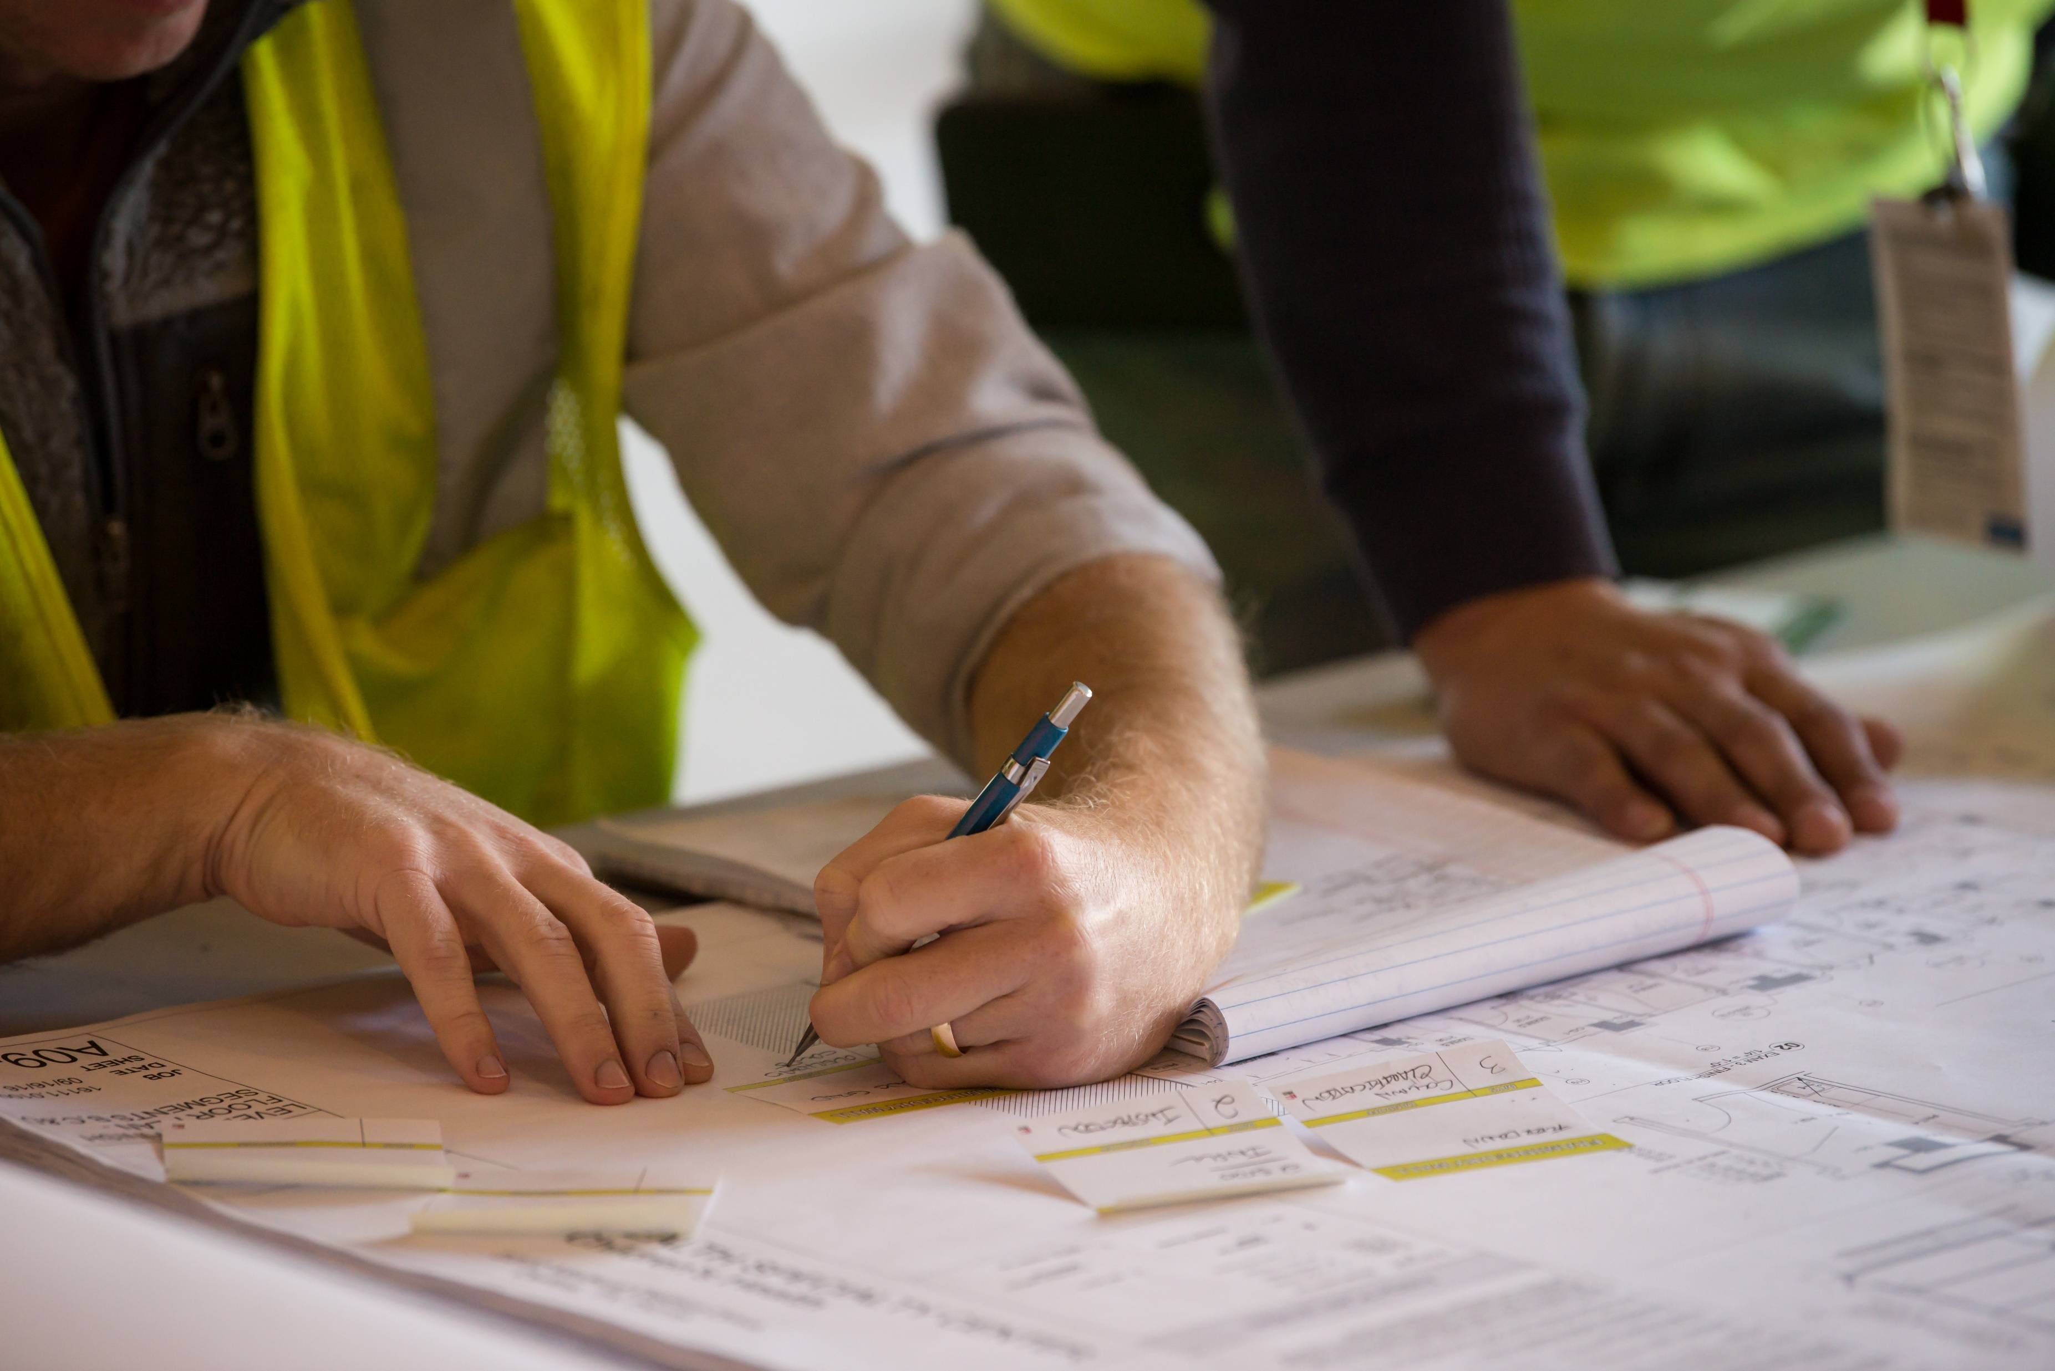
Why is identifying hand-offs important?
For a few reasons. One, understanding hand-offs and their durations provides clarity across all disciplines and a better understanding of each trade’s work.
Two, identifying hand-offs provides opportunities to change, overlap, or move activities to expedite those activities and/or the schedule.
And three, allowing trade partners to discuss their hand-offs and durations makes planning easier and more accurate.

Slide 8
Printable Card
Notes:
This page can be printed as a jobsite aid to remind people to implement lessons learned from the Toolbox Talk.

