Slide 1
Getting the Most Out of Your AGC Membership

Slide 2
AGC Structure
Member Company
Local AGC Chapter(s)
AGC of America
Company
Employees
To join AGC, a company must first join a local chapter. Upon joining at the chapter level, our company also becomes a member of AGC of America. All company employees are eligible to access member benefits from both the local chapter and AGC of America!

Slide 3
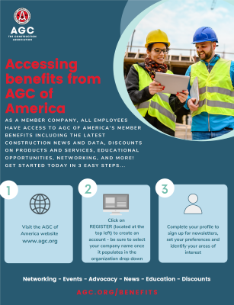
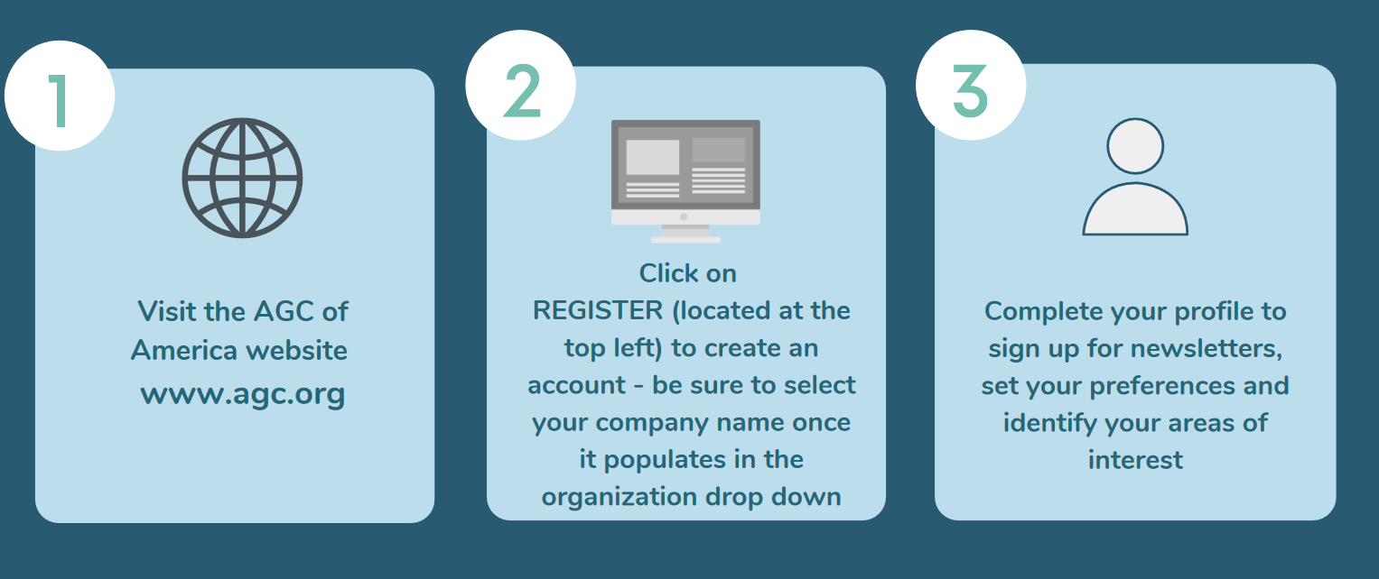
Engaging colleagues
Every employee is eligible to take advantage of AGC member benefits!
Create your profile (and tell your colleagues) by following these easy steps…
www.agc.org

Slide 4
The Value of AGC
Industry Voice for Construction
Network and Connect with Peers
Professional Development
Member Discount Programs
News and industry updates

Slide 5
The Voice of Construction
Stay Informed
Sign up for the latest legislative, political, and regulatory news affecting the construction industry.
Take Action
Sign up for the latest legislative, political, and regulatory news affecting the construction industry.
Contribute
AGC PAC and the Construction Advocacy Fund are affecting positive change for the industry. Learn how to get involved today.
advocacy.agc.org

Slide 6
Networking Opportunities
AGC Conferences
AGC Annual Convention
Management Conferences
Divisions
Building, Federal & Heavy Construction, Highway & Transportation, and Utility Infrastructure
Councils, Forums & Committees
HR Forum, Business Development Forum, Specialty Contractors Forum, etc.
https://www.agc.org/connect/agc-groups
Emerging Leaders
Construction Leadership Council
Student Chapters

Slide 7
Training & Education
No matter the size of your firm or the type of work you do, AGC of America has education and training programs designed for you and your employees.
BIM & CM BIM
Lean & CM Lean
Supervision Fundamentals
Supervisory Training
Project Management
FREE Webinars
Advanced Management
Safety Management
Supervisory Fundamentals
CEUs

Slide 8
AGC Member Discount Programs
AGC Members Saved Over 13.8 Million Dollars Last Year Using AGC Member Discount Programs
Visit agc.org/save to view and access all discount programs

Slide 9
Discounts Available to Individual Employees
General Motors (Chevrolet, Buick, & GMC) :
Save $500 on New 2020 and 2021 Vehicles
Batteries Plus Blubs:
Save Up to 73% off Regular Retail Pricing
Dell Technologies:
Save Up to 10% on Dell Products
Office Depot and OfficeMax:
Save Up to 75% on Office Supplies
Budget Rental Car:
Save Up to 25% on Vehicle Rentals
AVIS Rental Car:
Save Up to 25% on Vehicle Rentals

Slide 10
AGC Member Roadmap
Follow these easy steps to take advantage of all AGC of America benefits and opportunities…
Visit agc.org/benefits!

Slide 11
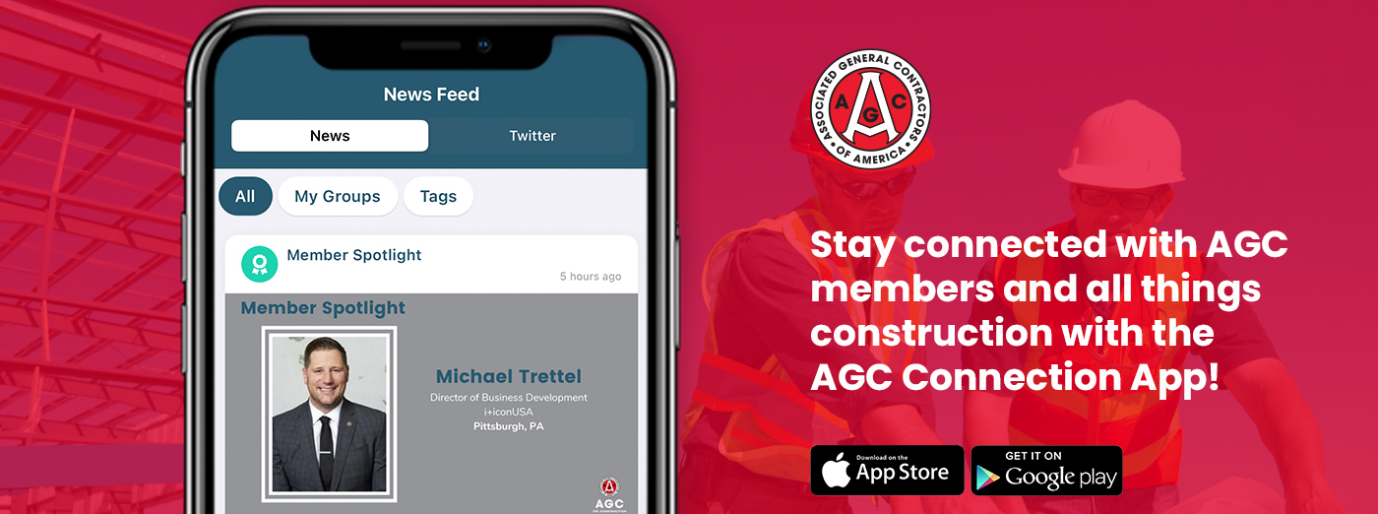
Download AGC Connection
www.agc.org/connect/agc-connection

Slide 12
Questions?
Contact AGC of America
membership@agc.org

