Slide 1
Lean Construction Education Program: Project Team Course

Slide 2
Welcome
Your instructor
Orientation
Participant introductions
  Your name, company, and position
  What is your Lean Construction experience?
What is Lean Construction?
Goal of Today’s class

Slide 3
AGC’s Lean Construction
Education Program Overview
A series of courses that progressively cover a range of topics in Lean Construction including:
  Variation and pull in production
  Lean workstructuring, supply chains, and assembly
  Production management
  Management by values
  Problem-solving principles and tools
For more information, including information on credentialing, visit www.agc.org/LCEP.

Slide 4
Course Schedule
Time | Session | Topic/Activity
120 minutes | 1 | Workflow
120 minutes | 2 | Planning and Evaluating the Plan

Slide 5
Session 1

Slide 6
Today’s Course Schedule
Time | Session | Topic/Activity
 | 1 | Workflow
60 minutes | - | Variation in Production Systems
60 minutes | - | Pull in Production
Notes:
Start and end times, and number of breaks should be consistent.

Slide 7
Session 1 Learning Objectives
Following this session, you will be able to:
Describe the impact of variation on workflow
Explain the benefits of variation reduction on construction operations
Identify the effect of batching on production systems
Identify the effect of pull on a production system

Slide 8
Parade of Trades Simulation:
Getting Started
Your instructor will split you into groups of seven
  Identify who will receive each role, beginning with Concrete and continuing counterclockwise with Mason, Facade, Carpenter, Plumber, Electrical, and Paint
    Select the correct score sheet from the Parade of Trades Simulation Worksheets provide by the instructor
  Place 35 chips, which signify pieces of work, to the left of Concrete.
  Provide the die to Concrete
  The Painter will total the summary score sheet
As a group, consider the following questions:
  With each role equaling one week, how many weeks will it take to pass all 35 pieces through the construction operation?
  How many construction workers will be required on site to complete all of the work? (The number on the die indicates how many people the contractor brings on site that week.)
  The instructor will come around to get your “bid” and they will not be revealed until all teams have determined theirs.
All content related to the Parade of Trades is ©Lean Construction Institute (1999). For more information on the Parade of Trades, refer to Tommelein, I.D., D,R. Riley, & G.A. Howell. 1999. Parade game: Impact of work flow variability on succeeding trade performance. Journal of Construction Engineering and Management 125: 304–310.

Slide 9
Parade of Trades Simulation Setup
Die
35
Painter
Concrete
Chips & Group
Score Sheet
Die
Electrical
Mason
Plumber
Facade
Carpenter

Slide 10
Week 1 Example
Week | Capacity (Number on the Die) | Work Executed (Moved Chips) | Inventory (Available-Used=Remaining)
1 | 3 | 3 | 32
2
3
Concrete
After rolling, note your totals and pass the die to the left (clockwise) and chips to the right (counterclockwise)
Moving one chip through one station requires one “crew” work unit.
A die has an average production of 3.5 units per roll (week)

Slide 11
Week 2 Example
Week | Capacity (Number on the Die) | Work Executed (Moved Chips) | Inventory (Available-Used=Remaining)
1
2 | 2 | 2 | 1
3
Mason
3
Pass the Die to the Left!
Week | Capacity (Number on the Die) | Work Executed (Moved Chips) | Inventory (Available-Used=Remaining)
1 | 3 | 3 | 32
2 | 2 | 2 | 30
3
Concrete
Pass the Die to the Left!

Slide 12
Week 3 Example
Week | Capacity (Number on the Die) | Work Executed (Moved Chips) | Inventory (Available-Used=Remaining)
1
2 | 2 | 2 | 30
3 | 5 | 2 | 0
Facade
2
Week | Capacity (Number on the Die) | Work Executed (Moved Chips) | Inventory (Available-Used=Remaining)
1
2 | 2 | 2 | 1
3 | 5 | 3 | 0
Mason
Week | Capacity (Number on the Die) | Work Executed (Moved Chips) | Inventory (Available-Used=Remaining)
1 | 3 | 3 | 32
2 | 2 | 2 | 30
3 | 1 | 1 | 29
Concrete

Slide 13
When Work Is Complete…
Using your score summary sheet the painter should:
  Record the week each trade finishes
  Add and record the available capacity for all trades.
  Add and record the total remaining inventory for all trades except Concrete.
    Note the highest amount of inventory in any week for each trade.

Slide 14
Parade of Trades
Wrap-up Discussion
What are the key points or lessons for you?
How is this like the real world?
Why does this matter?
How can lessons learned from this simulation be applied to construction projects?

Slide 15
Results Example
# Weeks to Complete
1.1.1.6.6.6
1.2.2.5.5.6
1.2.3.4.5.6
2.2.3.4.5.5
2.3.3.4.4.5
3.3.3.4.4.4

Slide 16
Workflow
Workflow is the progression of work within a trade or from one trade to another.
Predictable workflow vs. reliable workflow
  Predictable: The ability to consistently foretell something in advance
  Reliable: The long-term consistency of a system

Slide 17
Variation
Inconsistent
Process
Inconsistent
Results
Variation is caused by fluctuations in the process and results from pre-determined standards.
  It arises when people do whatever they can to get results.
  It results in interrupted workflow - workers waiting for work and work waiting for workers.

Slide 18
Types of Variation
Variation refers to random or non-random differences in a production process.
Deming identified two types of variation⁵
  Common cause variation: Random, a property of the process or procedure
  Special cause variation: Non-random, caused by external influences to the defined process
Variation of either kind in production systems is bad.
  Special cause variation must be addressed before common cause variation

Slide 19
Variation Discussion
What kind of variation do you see in your company or on your jobsite?
  Is it common or special cause? Try to list two of each type.

Slide 20
Variation, Lead Time, and Capacity Utilization
Wait Time

Slide 21
Common Strategies for
Variation Mitigation
Buffer
Variation
Reduce/
Remove Variation
1
2

Slide 22
Light Fixture Assembly Simulation:
Getting Started¹
Your instructor will split you into groups of six.
  Within your group identify an individual for each role:
    Timekeeper
    Facilitator
    Apprentice — Assembly
    Journeyworker — Installation
    Journeyworker — Wire and Clip
    Journeyworker — Lamp and Finish
  Each person should carefully review his/her role’s worksheet, found in the Reference Section
¹Abdelhamid, Tariq. “Michigan State University, Center for Construction Project Performance Assessment and Improvement.” www.c2p2ai.msu.edu (2008-2010)

Slide 23
How You Play
Roles
  Timekeeper: Times the overall simulations, cueing the facilitator
  Facilitator: Introduces new fixtures into the process, providing them to the apprentice
  Apprentice: Completes the assembly and passes the batch
  Installation journeyworker: Completes the installation and passes the batch
  Wire and Clip journeyworker: Completes the wire-and-clip operation and passes the batch
  Lamp and Finish journeyworker: Completes the lamp-and-finish operation, completing the batch
You will be running three, five-minute simulations that will have batches of:
  Eight light fixtures
  Four light fixtures
  One light fixture
Your instructor will tell you when to start each simulation

Slide 24
How to Play
(Continued)
The apprentice takes one piece of paper at a time, writes the batch number on it, and makes the designated marks.
    When the number designated for the batch size is met, paper clip them together and put them in the queue for the next role
    From time to time the facilitator will provide the apprentice with a different color of paper to use in their batch. This does not change any processes.
The first journeyworker takes the batch, unclips it, and makes their designated marks
  When the number designated for the batch is met, paper clip them together and put them in the queue for the next role
This process continues through all roles, with each role beginning work on the next batch (if available) when they have finished the previous
When time runs out for each simulation you will mark your results on your worksheet, calculate your cash flow, and report your results.

Slide 25
Rules to Keep in Mind
If a fixture is damaged during any phase of the production sequence (i.e. is mismarked), you must fix it before you pass it on to the next unit
We will evaluate each individual’s performance based on output. No specific quality measures exist; each team member needs to use his or her own discretion for any quality decisions
While performing the pull instance of the simulation, you can begin working on the product only when the queue to the right is empty
To calculate WIP, if you have started on a batch, the entire batch must be calculated as WIP

Slide 26
Predict Your Performance
Before beginning each simulation consider as a group:
  How many fixtures will your team produce in each simulation?
  How long will it take for the first batch of light fixtures to be completed?
  How much WIP will be generated (subassemblies left on the table)?
  How many specially ordered fixtures will you complete?
Note your predictions on your worksheet. The instructor will also come around to get your predictions and they will not be revealed until all groups have determined theirs.

Slide 27
Light Fixture Assembly Discussion
How did your actual results vary from your predictions?
What are the key points or lessons for you?
How is this like the real world?
Why does this matter?
Suggest ways to use what you learned from this simulation on projects.

Slide 28
Important Concepts and Definitions
Work in progress (WIP):
  The amount of work in the production process at a given time.
Throughput:
  The amount of finished material/product coming out of the production process in a given amount of time
  The real measure of speed in the system
Cycle time:
  The time it takes to complete one finished unit of a process

Slide 29
Types of Production Systems
Either based on product mix or process pattern
The two types are:
  Batch-and-queue
  Continuous-flow

Slide 30
Batch-and-Queue
Each production stage creates or completes more than one piece of an item
  A “batch” of units is created
  That end up in a “queue”
  Where they wait until the downstream function needs them
Commonly used in construction to create buffers
Some examples are:
  Assembling light fixtures in batches to create a stockpile to feed installation
  Excavating all foundation pads, then sequentially installing rebar

Slide 31
Hidden Inefficiencies in
Batch-and-Queue Systems
Batch-and-queue systems help cope with variation, but they hide inefficiency through more:
  Unfinished items in stages of production at any time
  Cost due to more materials
  Space
  Labor
  Transportation
  Storage
  Security

Slide 32
Batch-and-Queue
Systems Discussion
What batches have you encountered in construction?
What has been your experience with batching on your projects?

Slide 33
Continuous-Flow
A unit undergoes each stage of production sequentially; no batching of units occurs. This yields:
  A reliable workflow
  Lower costs due a reduced need for:
    Material, space, labor, transportation, storage, and security
  Quick identification of quality issues
Also called single-piece flow or just in time/justified for time.
Production with customer demands; only what is needed, when it is needed, in the quantity needed.
Complete continuous-flow is only an ideal because of variation.

Slide 34
Continuous-Flow System Examples
Some examples are:
  Installing, wiring and clipping, and finishing light fixtures one by one.
  Hanging doors and completing the hardware installation at the same time.

Slide 35
Push vs. Pull
Batch-and-queue production systems are referred to as push systems
Continuous-flow production systems are referred to as pull systems

Slide 36
Push Production Systems
In a push production system:
  Work is released based on a preset schedule
    The schedule is based on projected demand
    The schedule is the only control for production
  Work in progress is considered to be unavoidable and can create a buffer
  Optimization only occurs locally, with no consideration for the whole
  There may be excess inventory in the system

Slide 37
Push System Examples
Some examples of push in construction are:
  Delivery of material regardless of space constraints on site
  Installing drywall based on a master schedule but with limited or no coordination with mechanical, electrical, and plumbing (MEP) trades.

Slide 38
Pull Production Systems
In pull production:
  Work is released based on downstream demand.
  The system controls the work in progress levels
  The system monitors throughput
  There is a reliable workflow in the process
  A pull system is necessary, but not sufficient to realize continuous-flow

Slide 39
Pull System Examples
Delivery of material when the site is ready to receive it
Scheduling trade work using the weekly work plan of the Last Planner® System
Pulling nails from a tool belt one at a time to hammer in place

Slide 40
Pull Strategies in Construction
Example 1: Using a Supermarket
Using a warehouse or stockyard (called a supermarket) in a strategic location in the supply chain to store materials and subassemblies
  Allows the pull of materials onsite
  Facilitates just in time deliveries to the site
  Helps mediate price fluctuations that can work against just in time delivery
  Can be a designated area of the building

Slide 41
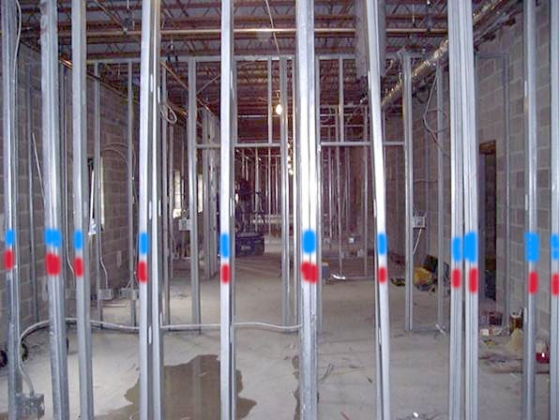
Pull Strategies in Lean Construction
Example 2: Shared Work as a Trigger
Coordination of trade work (downstream and upstream) using shared work as trigger
  Base of studs is color
  coded to indicate wall
  utilities needs
  Work proceeds if
  there is a color code

Slide 42
Push vs. Pull Discussion
Share and discuss examples of push and pull related to construction projects.
What practices exist today that promote push in production systems?
What limits our ability to use pull in construction?

Slide 43
Session Summary
Workflow is the progression of work within a trade or from one trade to another
To improve the total system performance, we must improve the throughput of the system, not just improve individual pieces
Reducing workflow variation:
  Makes project outcomes more predictable
  Simplifies coordination between trades
  Reveals new opportunities for improvement

Slide 44
Session Summary
In a batch-and-queue system each production stage creates more than one piece at a time, creating a queue.
Batch-and-queue systems are a form of push systems.
  In a push system everything is “pushed” through at a predetermined schedule.
In continuous-flow systems each stage of production is done sequentially.
Continuous-flow systems are a form of pull systems.
  In a pull system work releases based on downstream demand.

Slide 45
Session 2

Slide 46
Today’s Course Schedule
Time | Session | Topic/Activity
 | 2 | Pull in Production
5 minutes | - | Session 2 Introduction, Schedule and Learning Objectives
15 minutes | - | Push and Pull Planning Defined
55 minutes |  | Pull Planning Simulation
30 minutes | - | The Last Planner System
10 minutes | - | Communicating the Plan
5 minutes | - | Course Summary

Slide 47
Session 2 Learning Objectives
Following this session, you will be able to:
Describe the basic characteristics of the push planning approach
Describe the pull planning process
Distinguish pull planning from push planning

Slide 48
What We’ve Learned So Far
The goal of Lean Construction is to eliminate:
  Workers waiting for work
  Work waiting for workers
The way to do this is to:
  Reduce variation
  Eliminate waste
  Improve workflow reliability

Slide 49
Push Planning Defined
The traditional planning system is a push system.
  In this system work is pushed into production:
    Based on predetermined completion dates
    Regardless of whether workers are ready to start work
  It is an assumption-based vision of how the work will take place
  It confuses planning with prediction, leading to local optimization

Slide 50
Push Planning Discussion
Share and discuss your company’s push planning practices:
  When is planning typically done for projects?
  Who is involved?
  What format does your company use to communicate the plan?
  Is the plan typically followed?
  How are updates typically managed?

Slide 51
Pull Planning Defined
Pull planning depends on an understanding of the levels of readiness of downstream activities.
Work is scheduled for when it can be properly performed, not based on predetermined dates, by those who will execute the work.
Pull planning is used heavily in creating phase schedules in the LPS.
In pull planning you start from a milestone and work your way backward

Slide 52
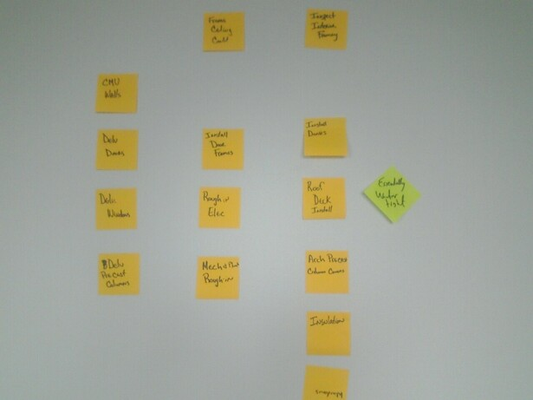
Pull Planning Process
Water- tight
Mechanical & Plumbing
Rough-in
What do we need completed
in order to reach the watertight milestone?
Milestone
Pulled Activities
Direction of
planning
z

Slide 53
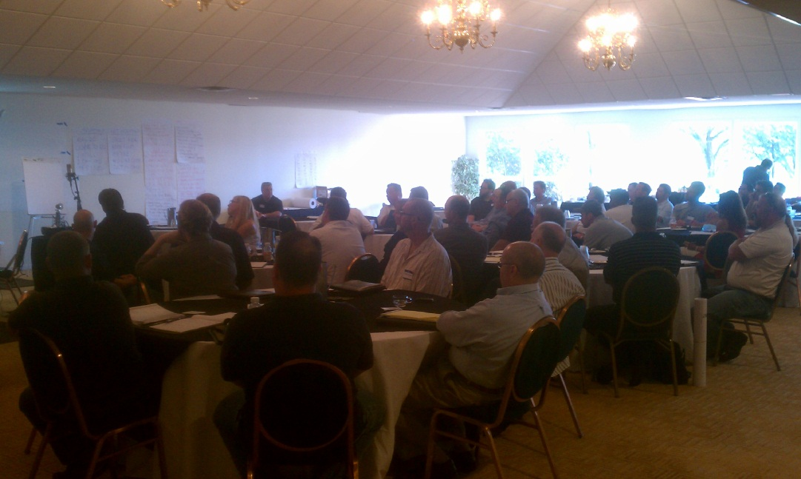
Pull Planning Process:
Collaborative Planning Sessions

Slide 54
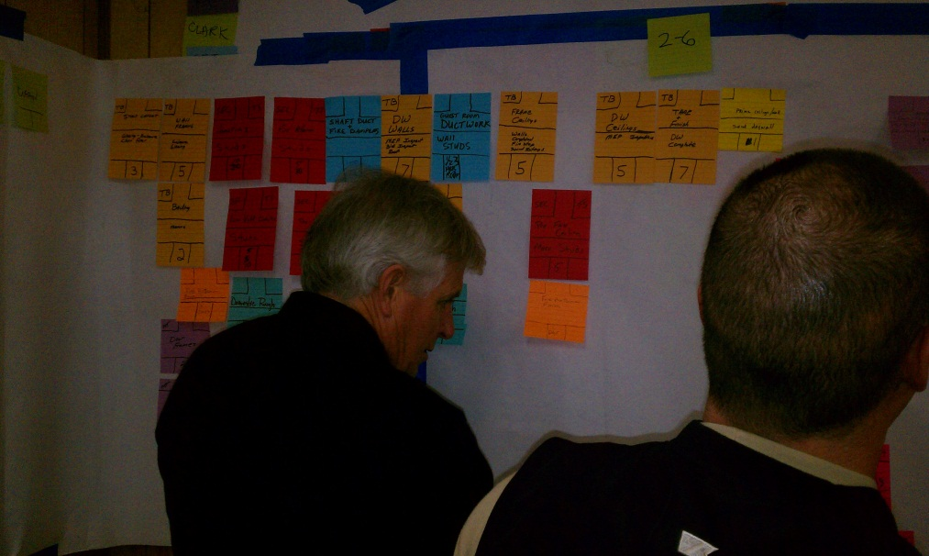
Pull Planning Process: Discussions

Slide 55
Pull Planning Simulation²:
Before You Begin
We will plan, and then build, a structure using a pull planning process.
Your facilitator will divide you into groups of four
  Each person will be assigned:
    Blocks of a specific color
    An “I Get/I Give” card, matching your assigned block color
  Each group gets a site plan and milestone note
    The site plan is used to indicate which side of the building is the front
    The milestone note is used to indicate the end of the building process where the building is complete.
Clear off your tables to have room for building
²DPR Pull Planning Game, ©DPR Construction, www.dprstore.com, Item 2431

Slide 56

Pull Planning Simulation:
Projects as Networks of Commitments
Team members
  Ask for what they need from their suppliers
  Commit to provide what their customers need
GET
GIVE
GET
Architect
GIVE
GET
HVAC
GIVE
GET
Plumbing
GIVE
GET
Framer
GIVE
PRODUCTION
TARGET
Electrical

Slide 57
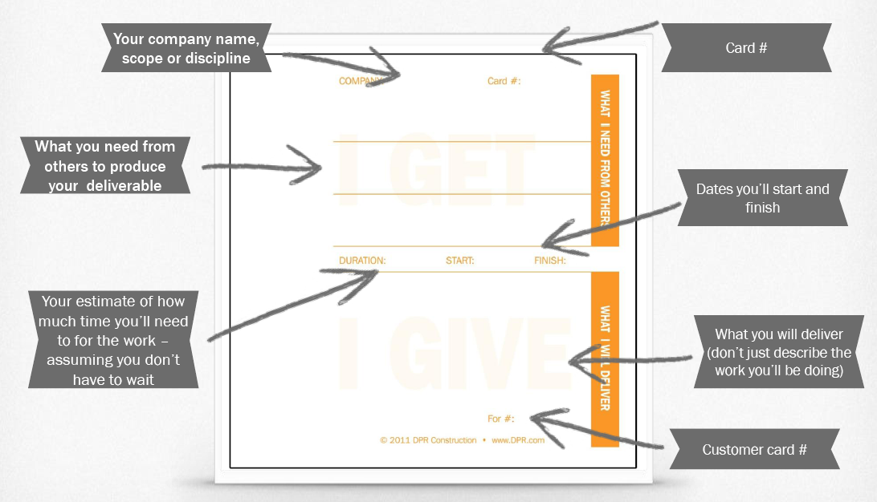
Pull Planning Simulation:
“I Get/I Give” Card
“I get” = what you need to begin
“I give” = what you will give to the next person
Each card can only have one “give”
You may need more than one “give” to achieve your “get”
  A “get” can be a constraint of the “TIMMESS” type
    Time, information, material, manpower, equipment, safety, and space

Slide 58
Card Numbering and Placement
Maintain order and clarity
  Always place the supplier card to the left of the customer card
  Keep the cards visible by placing them in columns
Build the network as you go
  Give each card a unique number as it is placed
    You may want to count down from the milestone
  Write the number of the customer card which you are supplying in the “For #” space

Slide 59
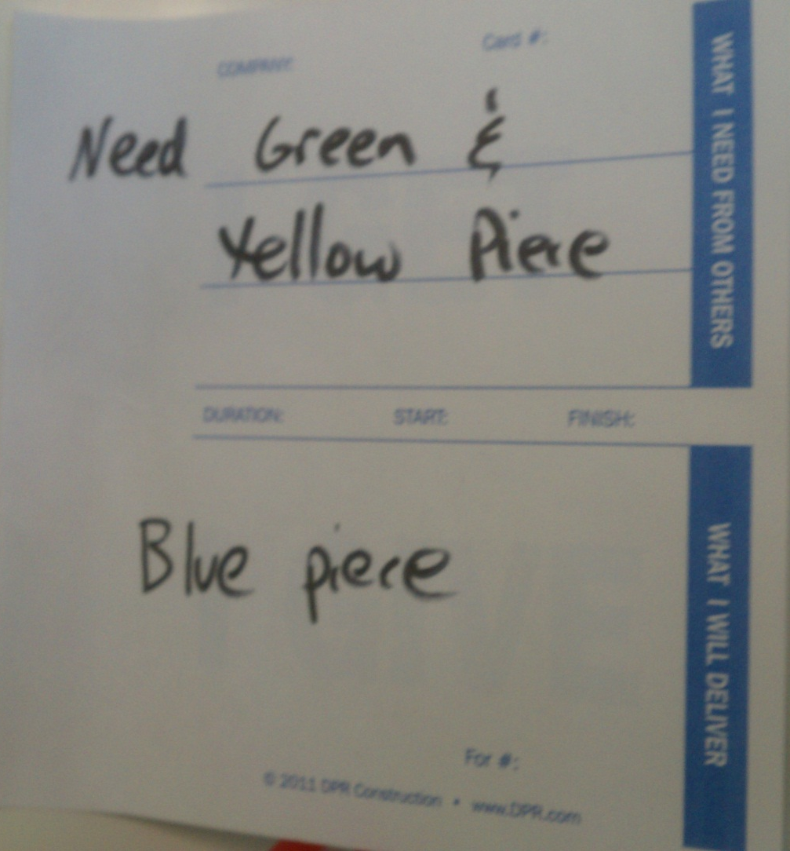
Pull Planning Simulation:
Example “I Get/I Give” Card

Slide 60
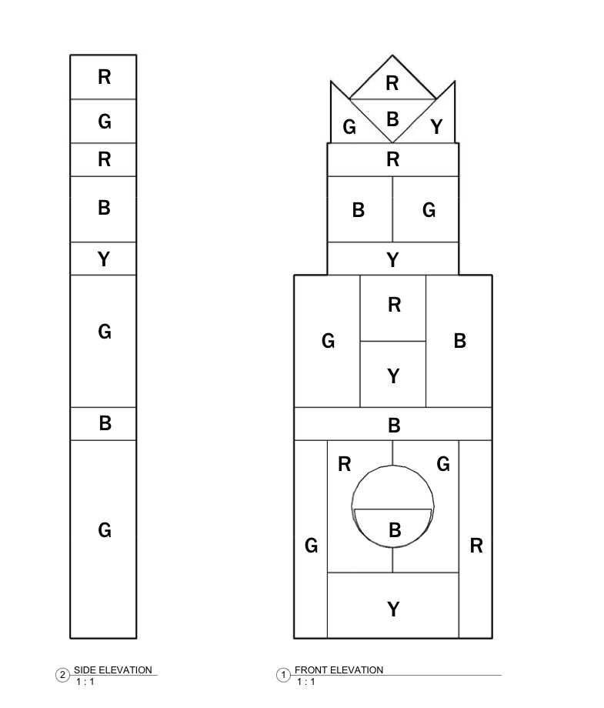
Pull Planning Simulation:
Building Schematic

Slide 61
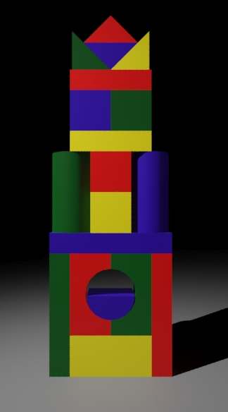
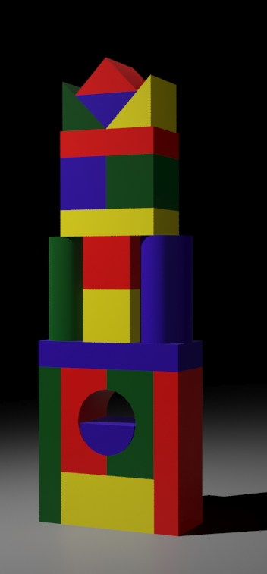
Pull Planning Simulation:
The Building

Slide 62
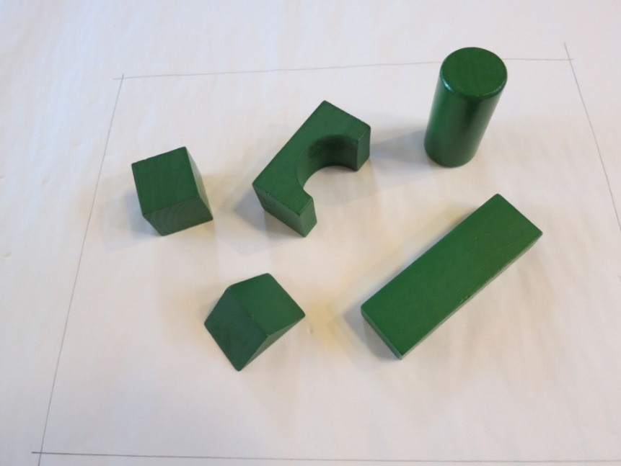
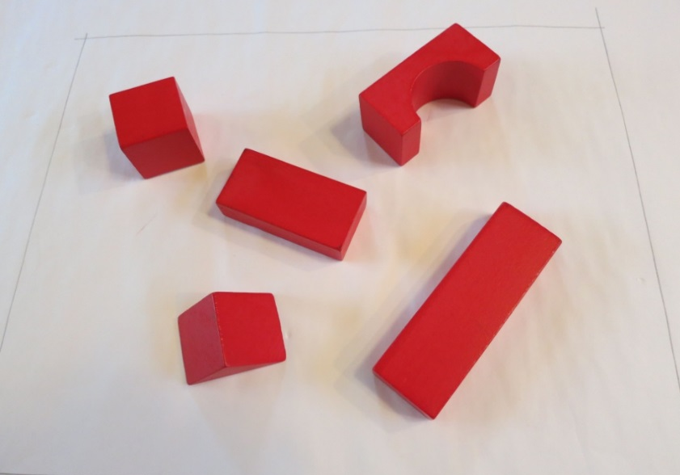
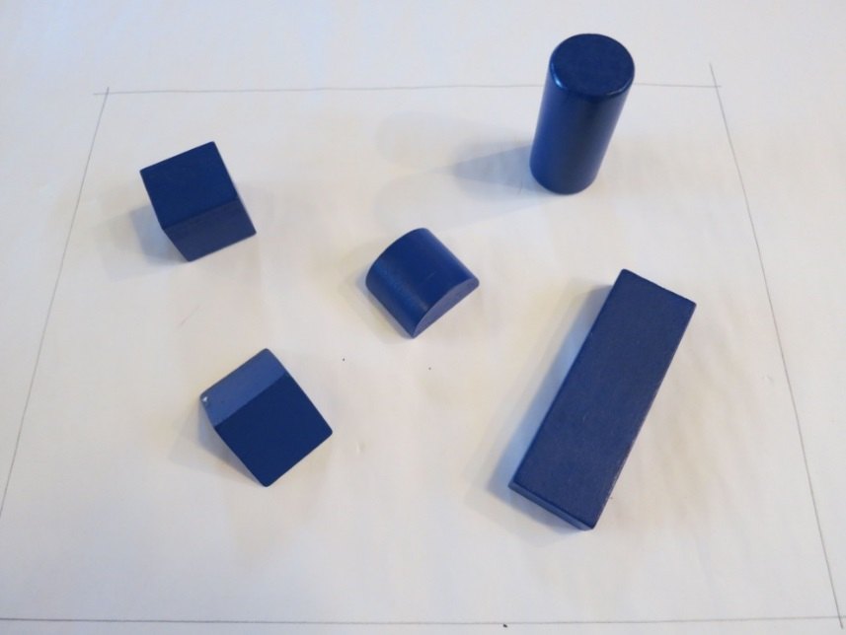
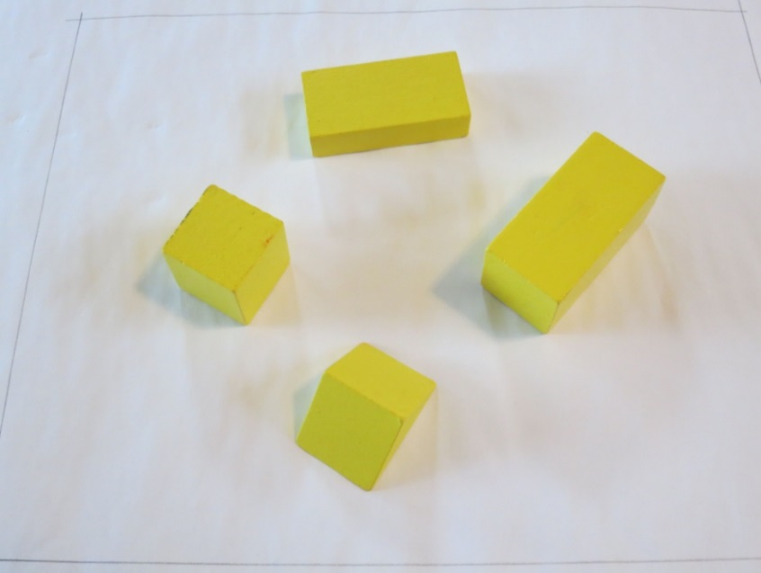
Blocks for the Simulation

Slide 63
Pull Planning Simulation:
The Customer Invitation Method
The customer invites their supplier(s) to place a card representing delivery of what they need when they need it
The customer signs off when they have everything they need to deliver their work
Each supplier becomes the customer and does the same thing

Slide 64
Pull Planning Simulation:
Pre-Planning Discussion
Who should go first?
What is the best sequence — building from the inside or outside?
Where and how should the pieces be placed? Quality?
What if a piece is delivered late? What can you do?

Slide 65

Pull Planning Simulation:
Planning
The red contractor lays the last block on the structure so he/she completes the first “I Get/I Give” card, placing it on the far right of the table.
The red contractor invites the next contractors to fill out their cards.
  They place their cards to the left of the red contractor’s, and the process continues.
  Each contractor must be invited by the previous
The plan is complete when all the blocks are accounted for.
Do not begin the building process

Slide 66
Pull Planning Simulation:
Building
The facilitator will signal groups to begin.
Build using the “I get/I give” cards you created during the planning process, ending at the milestone sticky note.
Use the site plan to orient your building
You can only touch your blocks
You must build only from your plan. You cannot look at the pictures of the building

Slide 67
Pull Planning Simulation:
Post-Building Discussion
What are some of the issues that came up as you began building?
  How could you have avoided some of these issues?
How is this like the real world?
What are the key points or lessons for you?
Can this process be used during the design phase to plan for construction? Why?

Slide 68
Levels of the Last Planner System
Master Scheduling
Milestones
Are we confident we can deliver the project within the set limits?
Who holds the promise to make this happen?
Phase Scheduling
Specify handoff
Do we understand how we are going to do the work?
Have we designed the network of commitments to make it happen?
Are we confident we can deliver the milestones?
6-week Look-ahead/Make-ready Planning
Rolling look ahead & launch
Is the network of commitments active?
Are reliable promises in place to make work ready in the right sequence and amounts to deliver the milestone?
Are we confident the work will begin and end as planned?
Weekly Work Planning
Measure PPC, act on reasons for failure to keep promises
How will we coordinate and adjust?
Have we promised our tasks will be done as planned or said no?
Daily Huddles
Confirming your weekly plan and adjusting as required
What have we learned?
What needs changing so we can improve our performance?

Slide 69
Master Schedules
Activity | Jan. |  |  |  |  | Feb. |  |  |  |  | March |  |  |  |  | April |  |  |  | May |  |  |  |  | June |  |  |  |  | July |  |  |  |  | Aug. |  |  |  |  |  | Sept. |  |  |  | Oct. |  |  |  |  | Nov. |  |  |  |  | Dec.
Site Utilities |  | x | x | x | x |  | x | x
Excavation |  |  |  |  |  |  | x | x | x | x |  | x | x
Foundations |  |  |  |  |  |  |  |  |  |  |  |  | x | x | x | x | x | x | x
Structural Steel |  |  |  |  |  |  |  |  |  |  |  |  |  |  |  |  |  |  | x |  | x | x | x | x |  | x
Exterior Framing |  |  |  |  |  |  |  |  |  |  |  |  |  |  |  |  |  |  |  |  |  |  |  |  |  | x | x | x | x |  | x | x | x | x
Roof |  |  |  |  |  |  |  |  |  |  |  |  |  |  |  |  |  |  |  |  |  |  |  |  |  |  |  |  |  |  |  |  | x | x |  | x | x | x | x
Doors & Windows |  |  |  |  |  |  |  |  |  |  |  |  |  |  |  |  |  |  |  |  |  |  |  |  |  |  |  |  |  |  |  |  |  | x |  | x | x | x | x
MEP Overhead Rough-in |  |  |  |  |  |  |  |  |  |  |  |  |  |  |  |  |  |  |  |  |  |  |  |  |  |  |  |  |  |  | x | x | x | x |  | x | x | x | x | x |  | x | x | x
Interior Framing |  |  |  |  |  |  |  |  |  |  |  |  |  |  |  |  |  |  |  |  |  |  |  |  |  |  |  |  |  |  |  |  |  |  |  |  | x | x | x | x |  | x | x | x
Drywall |  |  |  |  |  |  |  |  |  |  |  |  |  |  |  |  |  |  |  |  |  |  |  |  |  |  |  |  |  |  |  |  |  |  |  |  |  |  |  | x |  | x | x | x |  | x | x | x | x
Paint |  |  |  |  |  |  |  |  |  |  |  |  |  |  |  |  |  |  |  |  |  |  |  |  |  |  |  |  |  |  |  |  |  |  |  |  |  |  |  |  |  |  | x | x |  | x | x | x | x |  | x | x | x | x
Celings |  |  |  |  |  |  |  |  |  |  |  |  |  |  |  |  |  |  |  |  |  |  |  |  |  |  |  |  |  |  |  |  |  |  |  |  |  |  |  |  |  |  |  |  |  | x | x | x | x |  | x | x | x
MEP Trim out |  |  |  |  |  |  |  |  |  |  |  |  |  |  |  |  |  |  |  |  |  |  |  |  |  |  |  |  |  |  |  |  |  |  |  |  |  |  |  |  |  |  |  |  |  |  | x | x | x |  | x | x | x | x
Flooring |  |  |  |  |  |  |  |  |  |  |  |  |  |  |  |  |  |  |  |  |  |  |  |  |  |  |  |  |  |  |  |  |  |  |  |  |  |  |  |  |  |  |  |  |  |  |  | x | x |  | x | x | x | x
Casework |  |  |  |  |  |  |  |  |  |  |  |  |  |  |  |  |  |  |  |  |  |  |  |  |  |  |  |  |  |  |  |  |  |  |  |  |  |  |  |  |  |  |  |  |  | x | x | x | x |  | x | x | x | x
Punchlist |  |  |  |  |  |  |  |  |  |  |  |  |  |  |  |  |  |  |  |  |  |  |  |  |  |  |  |  |  |  |  |  |  |  |  |  |  |  |  |  |  |  |  |  |  |  |  |  |  |  |  |  |  |  |  | x | x | x
Substantial Completion |  |  |  |  |  |  |  |  |  |  |  |  |  |  |  |  |  |  |  |  |  |  |  |  |  |  |  |  |  |  |  |  |  |  |  |  |  |  |  |  |  |  |  |  |  |  |  |  |  |  |  |  |  |  |  |  |  |  | x
Figure 2.2

Slide 70
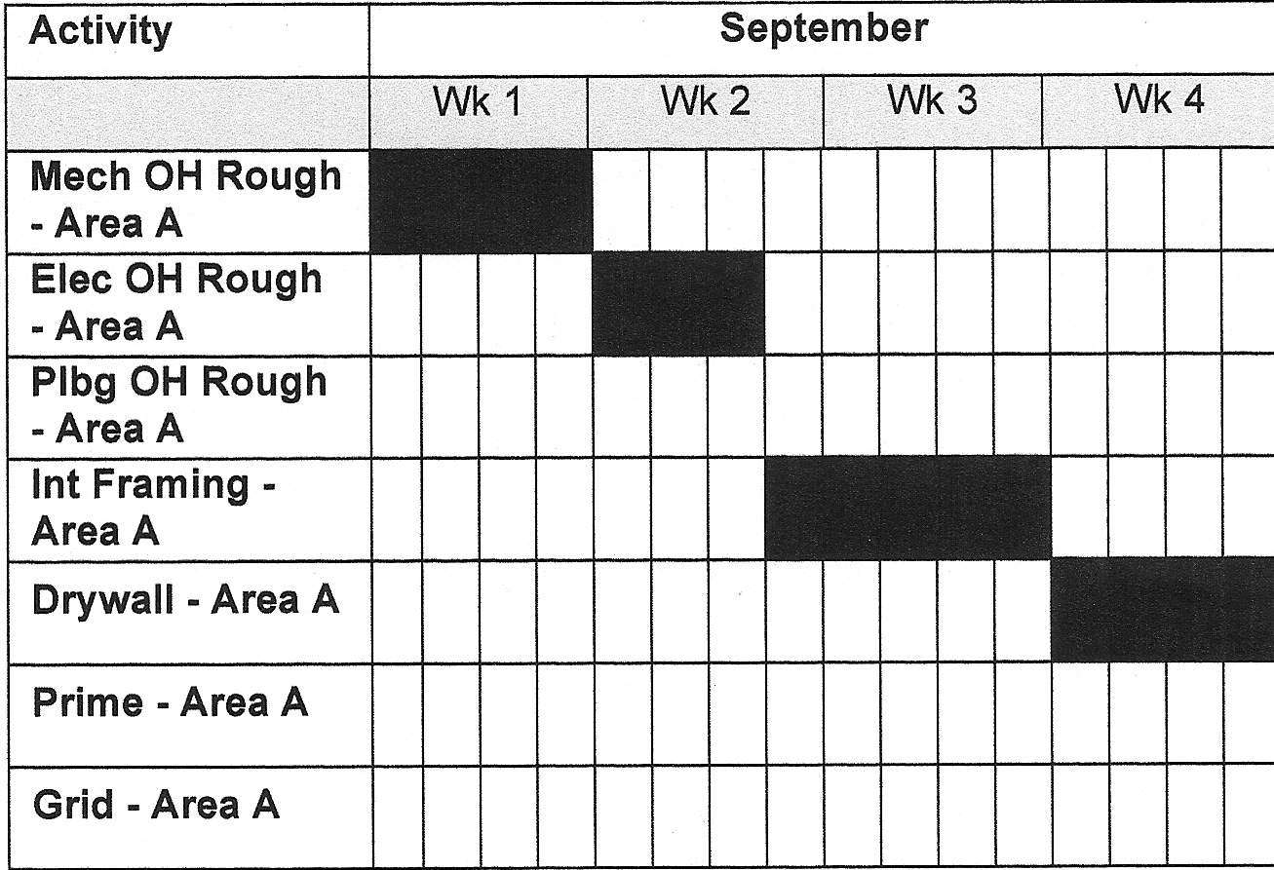
Phase Schedules

Slide 71
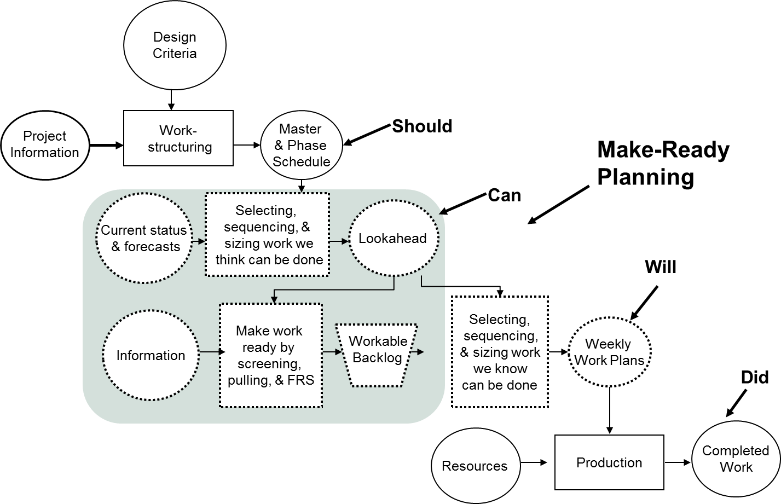
Six-week Look-ahead/Make-ready Planning

Slide 72
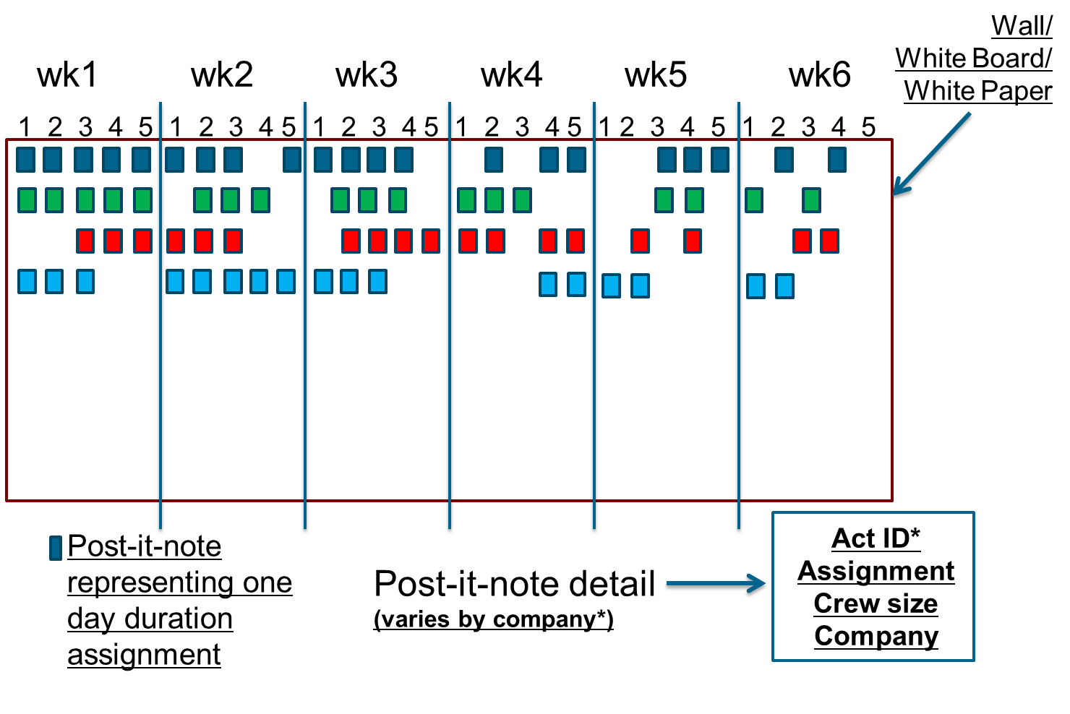
Six-week Look-ahead/Make-ready Planning

Slide 73
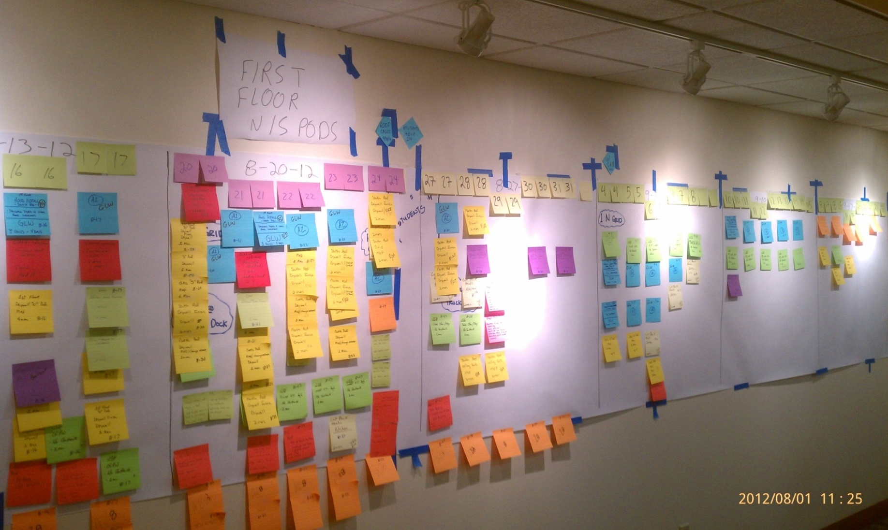
Six-week Look-ahead/Make-ready Planning
Week 1
Week 2
Week 3
Week 4
Week 5
Week 6
Less Detail
More
Detail

Slide 74
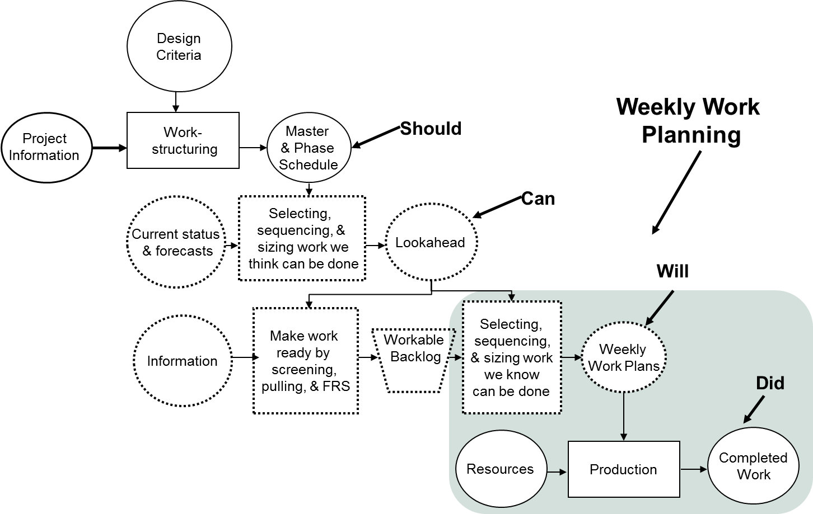
Weekly Work Planning
Handout 1
Notes:
---

Slide 75
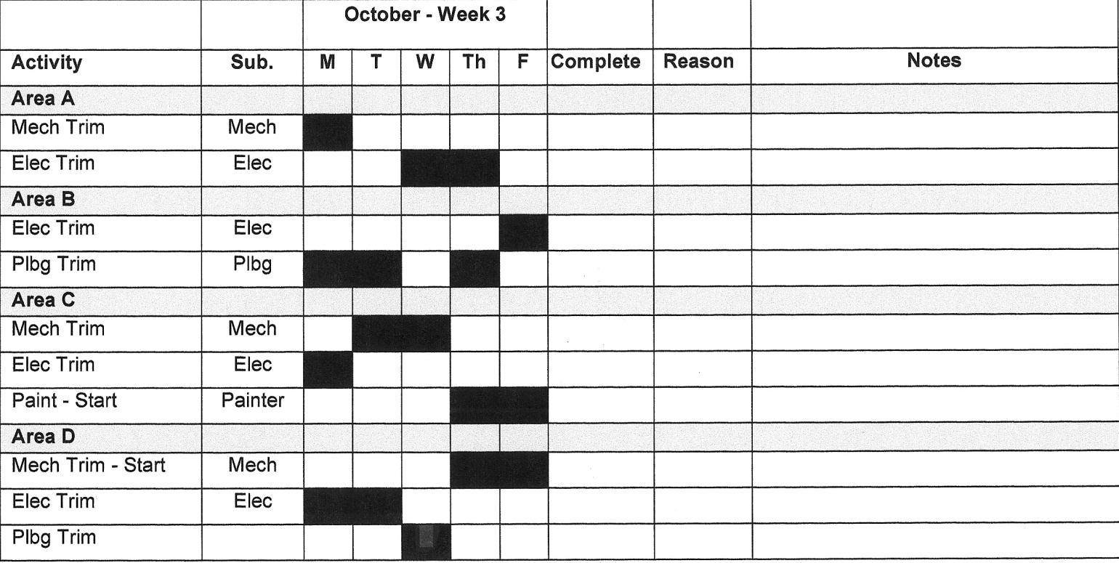
Weekly Work Planning

Slide 76
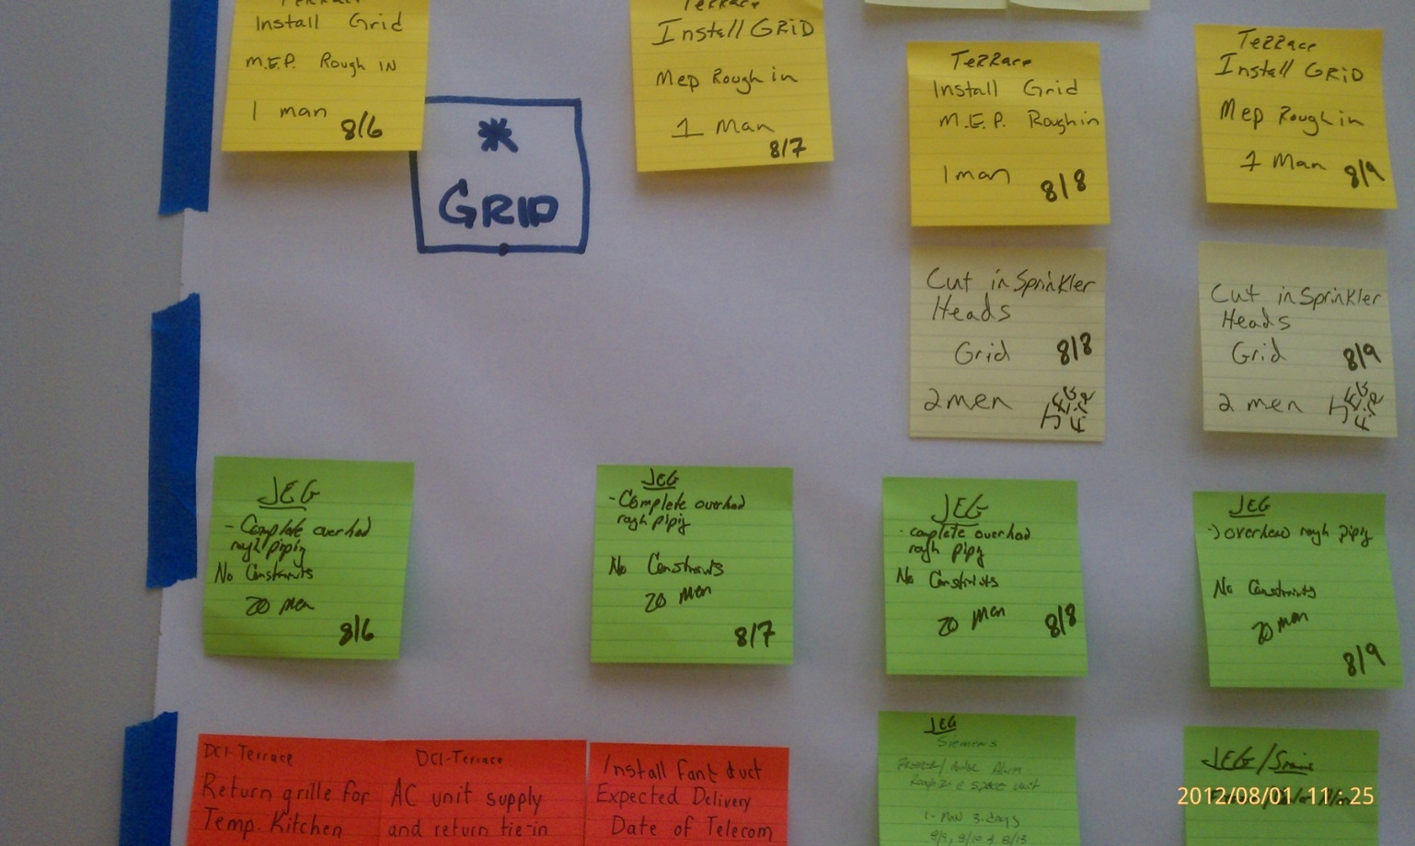
Weekly Work Planning

Slide 77
Weekly Work Planning

Slide 78
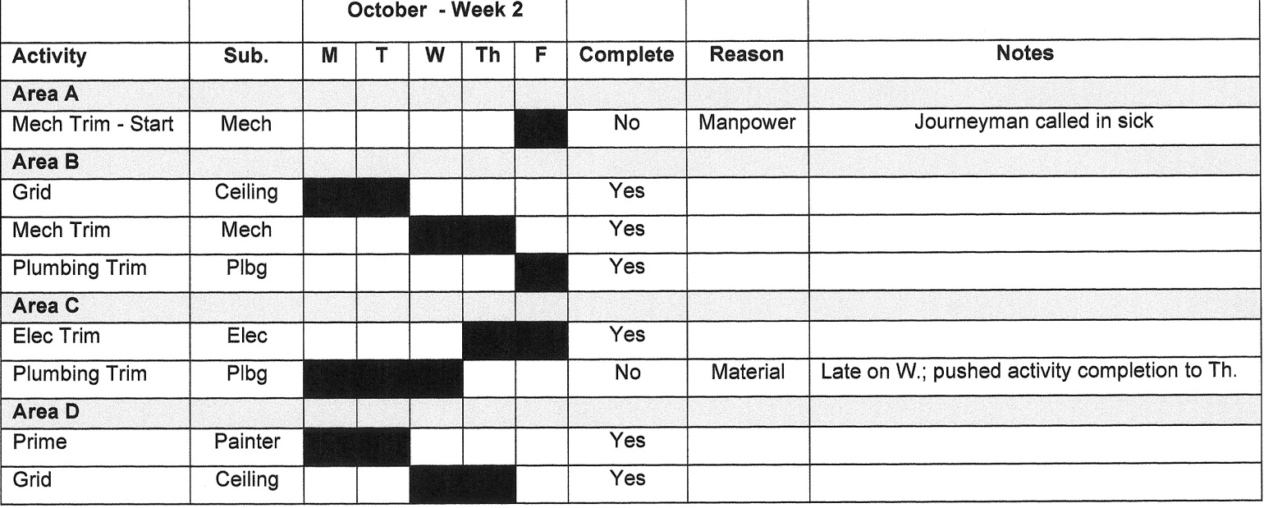
Weekly Work Planning

Slide 79
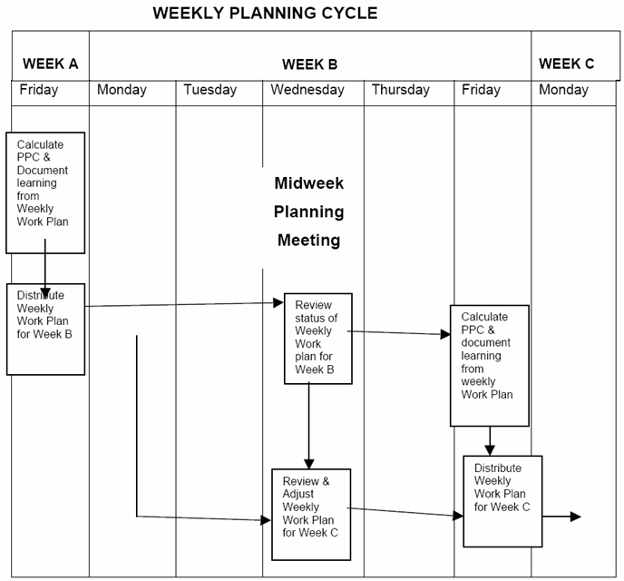
Weekly Planning Cycle

Slide 80
The Lean Commitment
Request
“Will you?”
Clarification
&
negotiation
Preparation for next request
Conditions of
Satisfaction
&
Date of Completion
Declare
Satisfaction
“Thank you”
Commit
“I will”
Assurance
Performance
Declare
Complete
“I’m done”
Handout 2

Slide 81
The Lean Commitment
  Elements of commitment:
  Definition – Assignments must be specific
  Soundness – Design and prerequisite work are complete; materials are on hand
  Safety – Promise to work safe and maintain a safe jobsite
  Sequence – Constructability has been reviewed to determine this task is necessary at this point
  Size – Planned task is achievable in time allotted by the crew in place
  Learning – Tracking of complete/incomplete assignments
Handout 3

Slide 82
Percent Plan Complete
Completed Weekly Assignments
PPC =
Total Weekly Promised Assignments

Slide 83
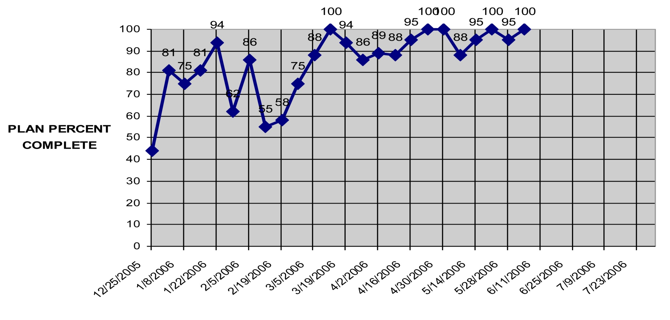
Percent Plan Complete

Slide 84
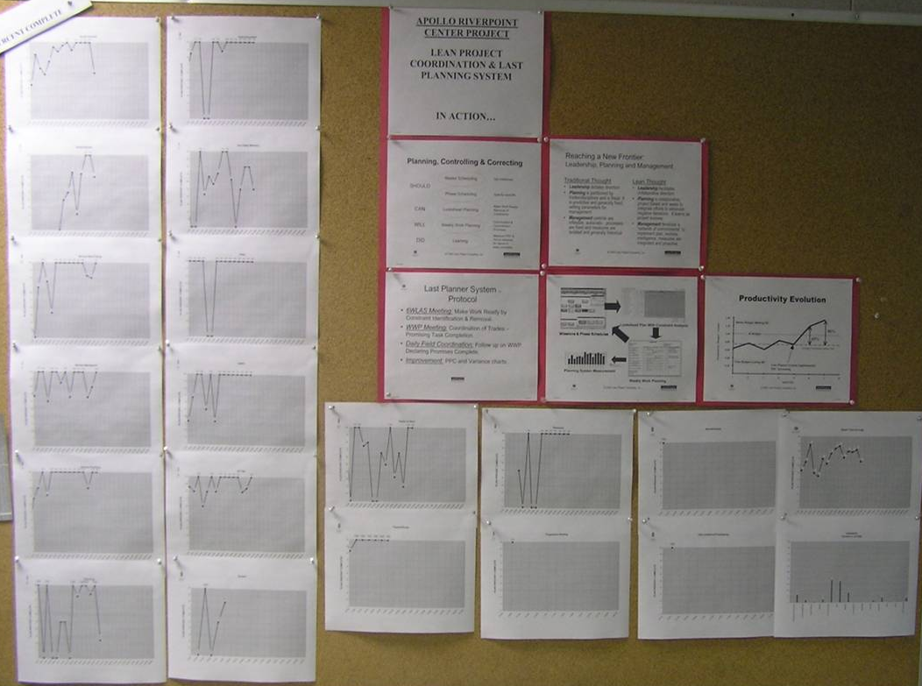
Percent Plan Complete

Slide 85
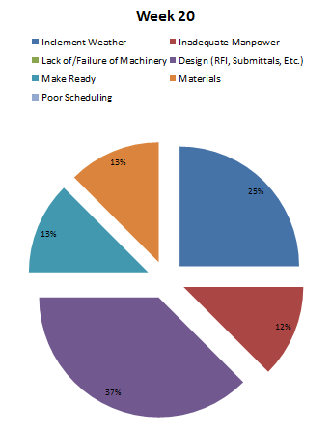
Reasons Analysis for PPC

Slide 86
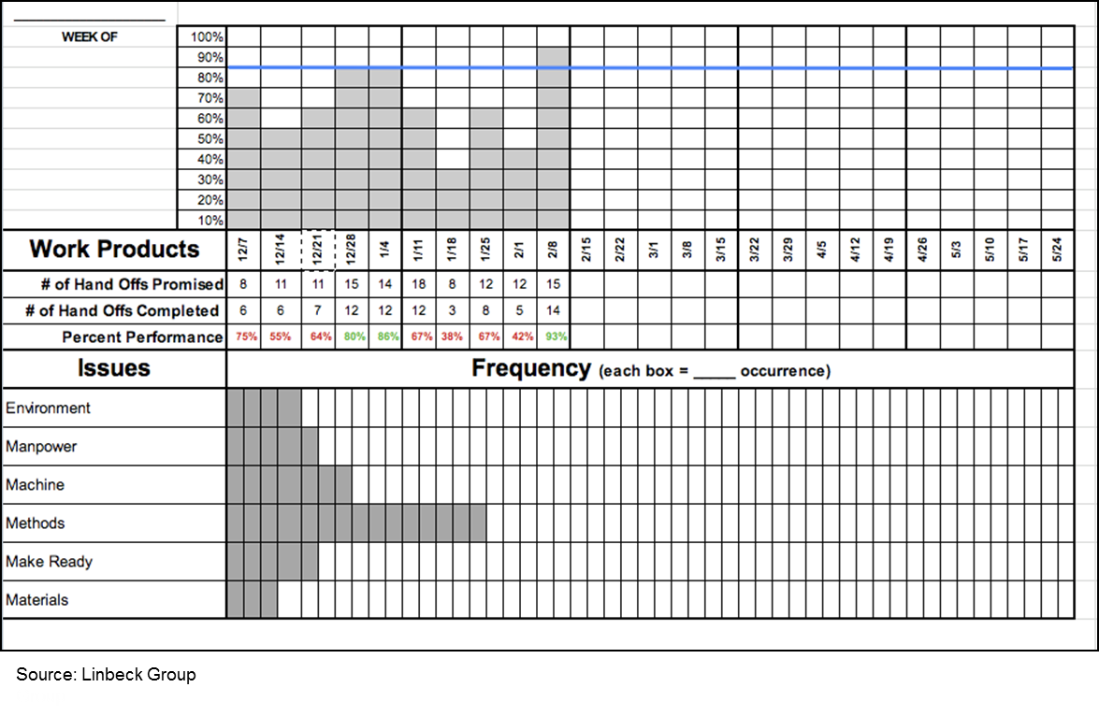
Reasons Analysis for PPC

Slide 87
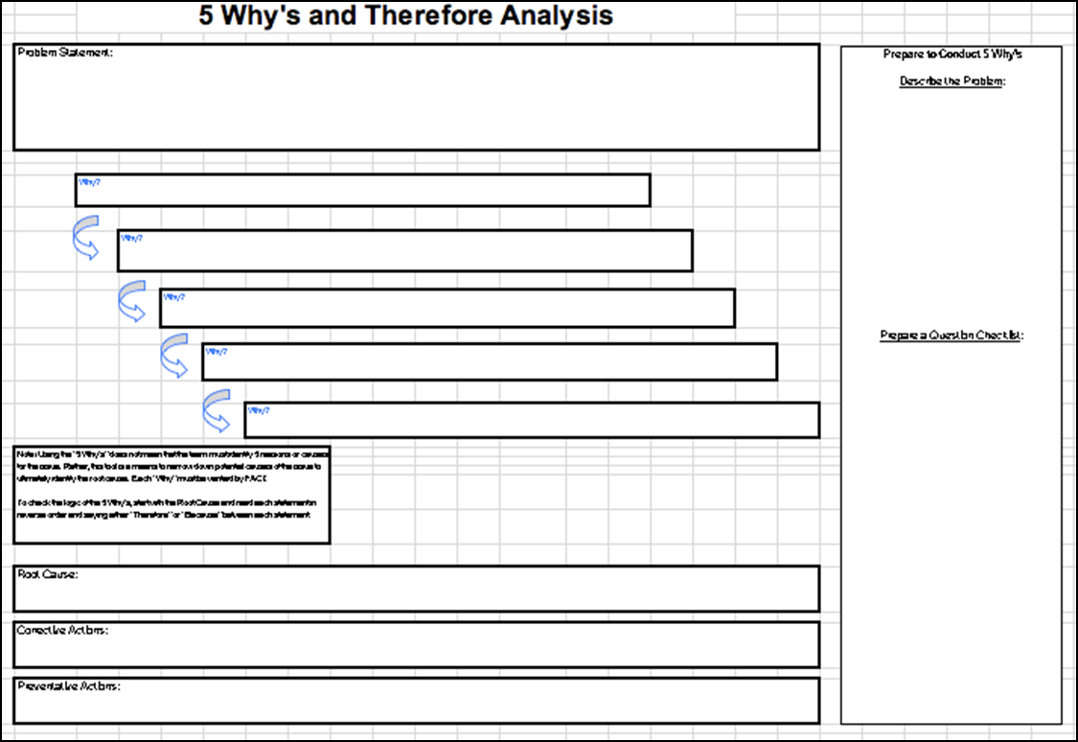
Reasons Analysis for PPC

Slide 88
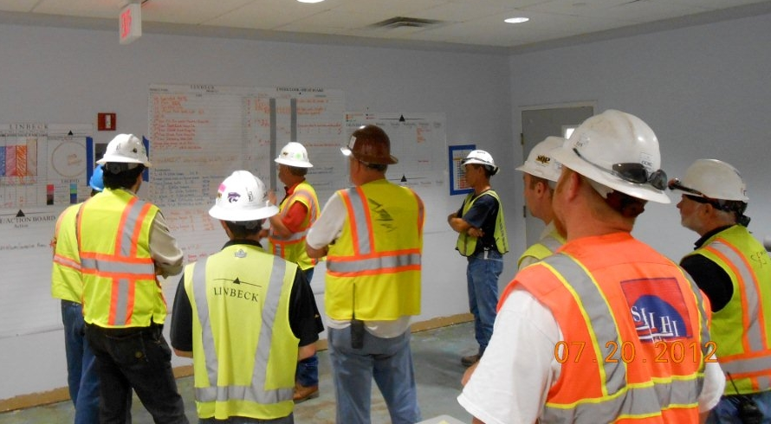
Daily Huddles

Slide 89
LPS Summary
Master Scheduling
Milestones
Lays out all milestones.
Establishes handoffs between milestones.
Takes handoffs, expands them and makes constraints visible.
Details the work to be done.
Confirms that daily commitments will be done.
Phase Scheduling
Specify handoff
6-week Look-ahead/Make-ready Planning
Rolling look ahead & launch
Weekly Work Planning
Measure PPC, act on reasons for failure to keep promises
Daily Huddles
Confirming your weekly plan and adjusting as required
Handout 4

Slide 90
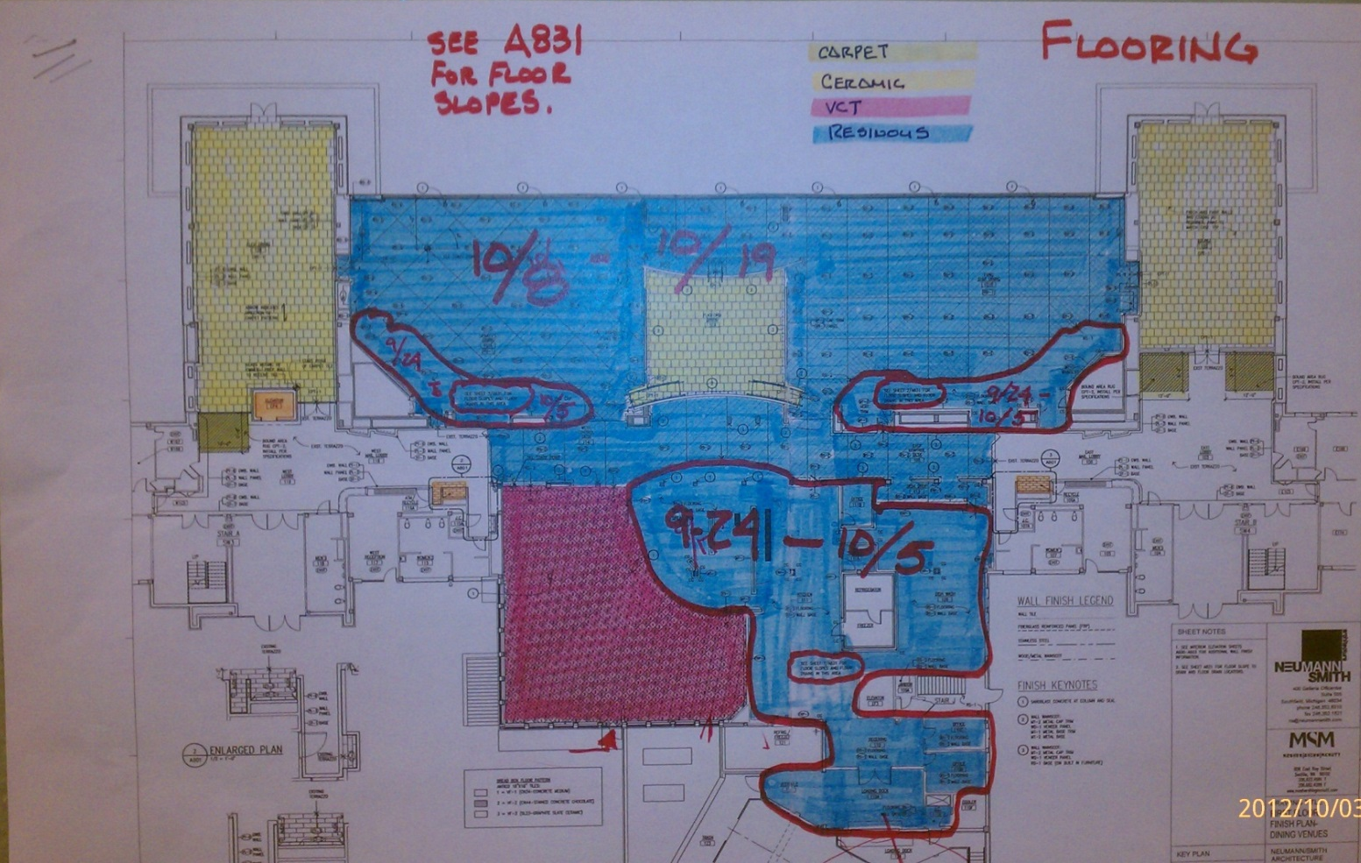
Communicating the Plan

Slide 91
Session 2 Summary
Many different ways to show the schedules – sticky notes, spreadsheets, etc.;
Collaborative process and dialogue among subcontractors is key;
GC no longer dictates the schedule.

Slide 92
Session 2 Summary
Push plans:
  Are typically produced by a single entity with little to no involvement of those executing the work
  Result in a plan full of assumptions about means and methods that usually is not reflective of what really will take place
Pull plans:
  Are produced by those who will execute the work
    The executors will engage in production system design by virtue of being present and the clear need for coordination.
  Are developed by working backward from a target completion date, with tasks defined and sequenced so that their completion releases work to begin on a subsequent task

