Slide 1
Unit 7: Problem-solving Principles and Tools

Slide 2
Today’s Course Schedule
Time | Session | Topic/Activity
8:00 – 8:15 a.m. | – | Welcome and Orientation
8:15 – 10:30 a.m. | 1 | Team Problem Solving
10:30 – 10:45 a.m. | – | Break
10:45 – 12:30 p.m. | 2 | Lean Construction Problem Solving Tools
12:30 – 1:30 p.m. | – | Lunch
1:30 – 3:00 p.m. | 3 | Using the Tools
3:00 – 3:15 p.m. | – | Break
3:15 – 4:20 p.m. | 3 - Activity | A3 Creation, Review of other Tools
4:20 – 4:35 p.m. | – | Unit 7 Summary and Closing Activities
1-2

Slide 3
Welcome to Unit 7: Problem-solving Principles and Tools
Your instructors
Participant introductions
  Your name, company, and what do you do?
  What is your level of Lean Construction experience?
  What you want to get out of this course?
1-3

Slide 4
AGC’s Lean Construction
Education Program Overview
A series of courses that progressively cover a range of topics in Lean Construction including:
  Variation and pull in production.
  Lean Workstructuring.
  The Last Planner® System.
  Lean supply chains and assembly.
  Lean design and pre-construction.
  Problem-solving principles and tools.
For more information, including information on credentialing, visit www.agc.org/LCEP.
1-4

Slide 5
AGC’s Lean Construction
Education Program Overview
The overall aims of the LCEP are to:
  Develop Lean Construction champions within construction firms.
  Advance the use of lean practices in construction through development of consistent nomenclature and practices.
  Provide an industry-recognized credential that creates a common standard of knowledge.
1-5

Slide 6
Course Learning Objectives
Following this course, you will be able to:
Explain the Lean Problem Solving Process.
Use tools to solve problems in a lean manner.
Describe how to solve problems in a team.
Use an A3 as a problem solving and communication tool.
Describe the use of the other tools available for problem solving.
1-6

Slide 7
Session 1: Team Problem Solving

Slide 8
Session 1 Learning Objectives
Following this session, you will be able to:
Define the difference between traditional and lean problem solving.
Describe how to create a team environment to solve problems.
Explain how to create trust to avoid problems.
Describe Observation Walks.
Identify root causes of problems.
1-8

Slide 9
What We’ve Learned So Far
The goal of Lean Construction is to eliminate:
  Workers waiting for work.
  Work waiting for workers.
The way to do this is to:
  Reduce variation.
  Eliminate waste.
  Improve workflow reliability.
1-9

Slide 10
Review of Unit 1: Variation in
Production Systems
Define the different types of variation.
Explain the concept of throughput.
Distinguish the concepts of throughput and work in progress.
Describe the role of variation in production operations.
List sources of variation in construction settings.
Explain variation mitigation techniques.
Contrast variation mitigation techniques.
1-10

Slide 11
Review of Unit 2: Pull in Production
Compare batch-and-queue and continuous-flow production systems.
Distinguish push systems from pull systems.
Describe the impact of pull on production systems.
Explain pull strategies in construction operations.
1-11

Slide 12
Review of Unit 3:
Lean Workstructuring
Apply the methods and tools utilized in pull planning.
Describe the concept of Lean Workstructuring.
Outline the desired products of Lean Workstructuring.
Describe the characteristics and application of the Last Planner® System.
1-12

Slide 13
Review of Unit 4:
The Last Planner® System
Apply the Last Planner® System on a project.
Hold make-ready and weekly work planning sessions.
Calculate, track and analyze percent plan complete for a project.
1-13

Slide 14
Review of Unit 5:
Lean Supply Chain and Assembly
Differentiate between traditional procurement practices and lean supply chain applications.
Identify waste and value-adding activities within the supply chain and assembly.
Evaluate the impact of using lean supply chain on waste elimination, continuous flow and site operations pull.
Identify strategies needed at the project and company levels to support the lean supply chain.
List examples of process improvements to the lean supply chain;
Expand lean beyond the individual project.
Create a value stream map to diagnose and improve the supply chain.
1-14

Slide 15
Review of Unit 6:
Lean Design and Pre-construction
Distinguish between the varying definitions for design.
Define value and commonly used methods to maximize it.
Discuss waste and commonly used methods to minimize it.
Distinguish between traditional project methods and lean design.
Explain the various lean tools that are used in design and how to deploy them.
1-15

Slide 16
Traditional Problem Solving
Focus on Solutions.
  Speed is more important than facts.
Focus on Individual Managers solving/dictating solution.
  Crews look to the Foreman/Superintendent to tell them what to do.
1-16

Slide 17

Traditional Problem Solving
Ready
Fire
Aim
Figure 1.1
1-17

Slide 18
Current Situation:
Trial and Error Problem Solving
Problem arises.
Jump to a solution before the cause of the problem is identified.
No time is spent assessing the solution to see if it fixes the problem.
This solution might actually cause another problem.
1-18

Slide 19
Examples of Traditional Problem Solving/Issues on Your Job
Describe an instance where you experienced traditional problem solving in solving issues on a project.
1-19

Slide 20
Common Issues in Construction
My List:
  Complete documents.
  Knowledgeable owner.
  Contractor staffing/performance.
  Safety.
  Laydown are/work access.
  Information access/accuracy.
  Payment/contractor viability.
  Tight schedules.
1-20

Slide 21

Einstein’s Definition of Insanity:
“Doing the same thing over and over again and expecting different results.”
So what will you do differently in solving your next issues?
1-21

Slide 22
Lean Problem Solving Model
Know What Questions to Ask
Understand What is of Value
Virtual Construction
Lean Project Delivery
Implement
Solution and
Review
Understand
Problem
Problem
Solving Culture
Office Procedures
Continuous
Improvement
Employee Development
Observe Walks
Figure 1.2
Image courtesy of the Lean Construction Institute, www.leanconstruction.org
1-22

Slide 23
Lean Problem Solving
Crews involved in understanding the problem.
Why would you want the crews to be involved?
How can you understand the history of the problem without their involvement?
How do you involve crews?
1-23

Slide 24
Merits of Team versus Individual Problem Solving
None of us is as smart as all of us.
There must be mutual trust amongst the team.
Observe Walks.
1-24

Slide 25
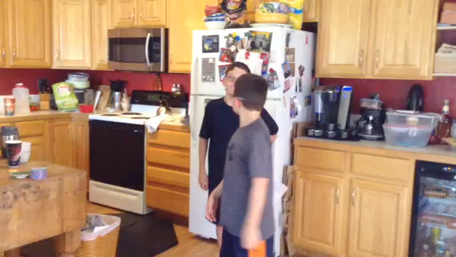
Using Trust
1-25
Notes:
Click on the image to start the video.

Slide 26
Trust
Where is trust important on your jobsite?
1-26

Slide 27
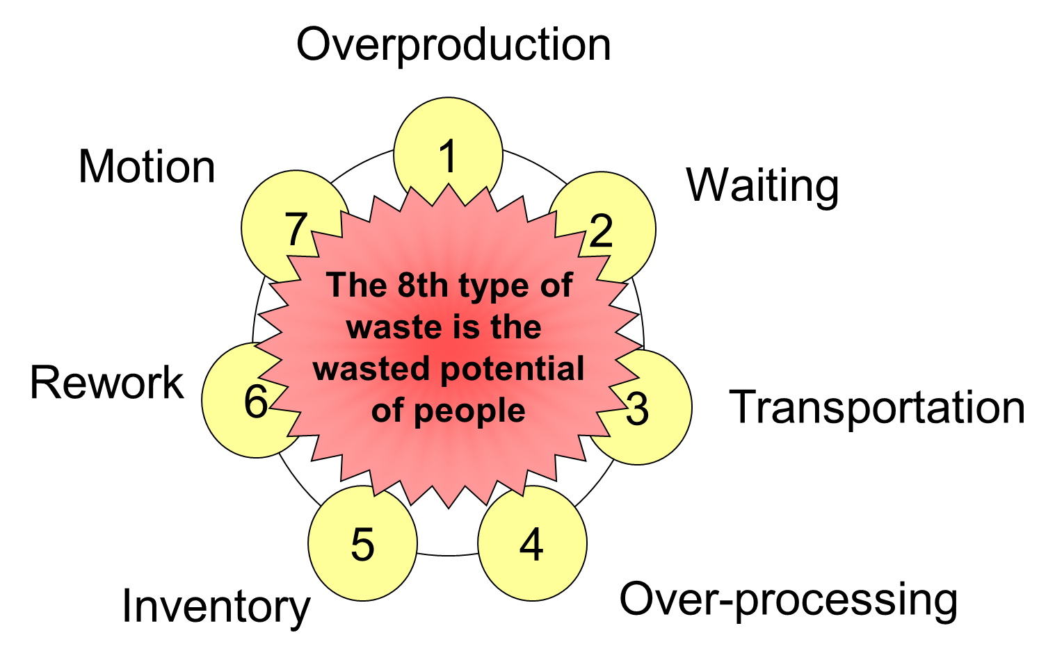
Create a Team Environment to Solve Problems
Problems should be considered opportunities for improvement.
Asking for a crew’s
participation avoids
the 8th Waste –
Underutilized human
resources.
Image courtesy of Romano Nickerson and Boulder Associates Architects
1-27

Slide 28
Discussion
What is the situation?
Is the problem clearly defined?
How did the team approach solving the problem?
What are the controlling factors in this problem?
What was the root cause of the problem?
What were the opportunities realized? (better systems on future flights, etc.)
1-28

Slide 29
Taking an Observation Walk
Have to be where the problems are occurring.
Go See (called a Gemba Walk).
But must stop and see.
Ask why and what does that mean?
Look for:
  Waste.
  Efficiency.
  Capacity.
  First Time Quality.
1-29

Slide 30
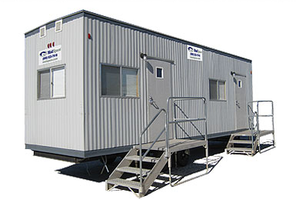
Observation Walk
Efficient &
Effective
Work
Project
Environment
Corporate Culture
Crews
Project Leaders
Company Executives
& Support Staff
Work Face
Resource Management
Information
Tools
Materials
Space
People
Equipment
Figure 1.3
1-30

Slide 31
Brainstorming
Goal is to generate ideas.
Builds teamwork.
Builds trust.
Stimulates creative thought.
Unstructured method allows anybody to contribute an idea at any time.
Structured method controls input by giving everybody an equal chance to contribute.
1-31

Slide 32
Hints on Conducting a Brainstorming Exercise
Ideas recorded.
Quantity of ideas.
No discussion or judgment.
No one opposes outright.
Team leader summarizes.
Everyone supports, even if NOT first choice.
1-32

Slide 33
Brainstorming Causes
Identify as many potential causes as possible.
Use the hints provided.
  Ideas recorded.
  Quantity of ideas.
  No discussion or judgment.
  No one opposes outright.
1-33

Slide 34
How Did It Work?
Were you able to follow the hints?
Did everybody get to contribute?
Did anybody dominate?
What did you do to get everybody to contribute?
Did you have to revert to a structured approach?
1-34

Slide 35
Session 1 Summary
Where traditional problem solving focuses on immediate implementation of action, lean problem solving is a deliberate process to clearly identify the problem and root causes before defining a solution.
Improved trust allows workers to report issues and to avoid problems.
Observation Walks create the opportunity to see operations and identify the source of problems.
A team environment is required to identify all the factors needed to solve problems.
Recognizing root causes of problems requires a search for facts and ideas.
1-35

Slide 36
Session 2: Lean Construction Problem Solving Tools
1-3

Slide 37
Session 2 Learning Objectives
Following this session, you will be able to:
Explain how to use the Plan-Do-Check-Act methodology.
Explain how to define problems.
Identify the use of the 5 Whys for root cause analysis.
2-2

Slide 38
Problems
Firefighting as a last resort not the goal—back to not avoiding problems, make them visible.
How you take past problems and prevent them from happening again. Error-proofing.
2-3

Slide 39
Define the Problem
Obtain history of problem.
Observe process where problem is
occurring (Observation Walk).
Identify place in process where
problem originates.
2-4

Slide 40
Root Cause Analysis:
5 Whys
Question:
Why?
Why?
Why?
Why?
Why?
2-5
Notes:
6/8/2015
40

Slide 41
Root Cause Analysis:
5 Whys
Why did the auto accident happen?
2-6
Notes:
6/8/2015

Slide 42
One Possible Explanation
1. Why was there a rear-end collision?
  A: Snow-covered road
2. Why did the snow on the road cause the accident?
  A: The tires skid on slippery snow
3. Why did the tires skid?
  A: The anti-lock brakes didn’t work right
4. Why didn’t the anti-lock brakes work right?
  A: Hit brakes too fast
5. Why did the driver hit the brakes so fast?
  A: Driving too close for the conditions
2-7

Slide 43
5 Whys Root Cause Analysis
What did you learn from this activity?
2-8

Slide 44
Root Cause Analysis: 5 Whys
Why?
Wasn’t the drywall installed in room 101?
Elec./Comm. conduit not completed.
Did not have material needed to complete work.
Wasn’t the conduit installed?
Why?
Why?
Wasn’t the material available?
Materials ordered late.
Open RFI regarding a discrepancy in plans/specs.
Were materials ordered late?
Why?
Why?
Did the RFI remain open?
RFI submitted late, lack of urgency.
Figure 2.1
Copyright 2011 From Modern Construction: Lean Project Delivery and Integrated Practices
ISBN: 9781420063127 by Lincoln H. Forbes and Syed M. Ahmed. Reproduced by permission
of Taylor and Francis Group, LLC, a division of Informa plc.
2-9
Notes:
6/8/2015
44

Slide 45

First Run Studies
Plan – Do – Check – Act
Figure 2.2
2-10

Slide 46
Plan – D – C - A
Plan
Plan what we are going to do.
Determine:
- Where we are?
- Where we need to be.
- How will we close this gap?
Identify potential solutions.
2-11

Slide 47
Plan – Do – C - A
Do
Test a few solutions (more than one)
2-12

Slide 48
Plan – Do – Check - A
Check
Determine if you have reached where you need to be.
Establish on-going measures of success.
2-13

Slide 49
Plan – Do – Check - Act
Act
Establish Controls / Establish On-going Measurement.
Otherwise complete Cycle #2.
2-14

Slide 50
PDCA in Action
Lean Ball Game Instructions
You are all on the same team.
The ball must travel through the air.
No ball can go to the person next to you on either side.
The starting point is also the finish.
Each round is 2 minutes.
Brainstorming time between rounds is 1 minute.
We will complete 5 rounds
This activity was adapted from the Ball Point Game originally created by Boris Gloger – © borisgloger, 2012 www.borisgloger.com
2-15

Slide 51
Debrief
What happened?
Which round felt best, why?
Were you able to get into a flow/ rhythm?
How were you able to apply PDCA?
2-16

Slide 52
PDCA in Practice
What problem can you focus on?
Determine:
- Where we are.
- Where we need to be.
- How will we close this gap.
Identify potential solutions.
2-17

Slide 53
Session 2 Summary
Obtaining the history of the problem is essential to defining the problem.
Observing the process where it takes place is important for defining the problem.
Using the 5 Whys is useful for identifying the root cause.
PDCA is a powerful approach for structuring the problem-solving process.
2-18

Slide 54
Session 3: Using the Tools

Slide 55
Session 3 Learning Objectives
Following this session, you will be able to:
Explain how to use problem solving tools:
  Value Stream Mapping.
  Spaghetti Diagram.
  Pareto Charts.
  Fishbone diagram.
  Brainstorming.
  A3.
Complete an A3.
3-2

Slide 56
Value Stream Mapping (VSM)
Creates a one-page picture of all company processes.
Depicts flow of information and material.
Shows value-added and non-value added (waste) process steps to help streamline.
3-3
Notes:
6/8/2015

Slide 57
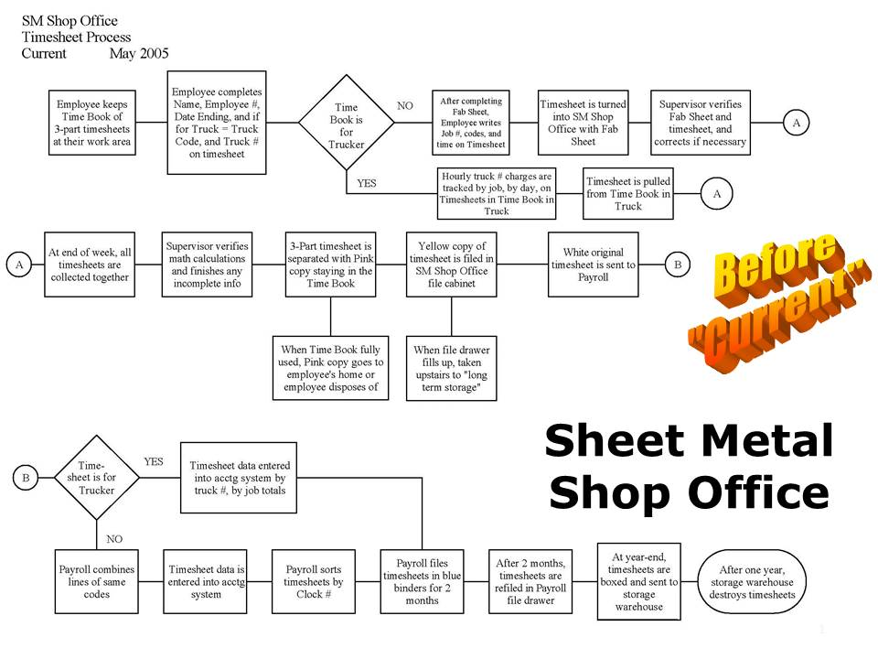
Value Stream Mapping
Figure 3.1
Image courtesy of The Grunau Company, www. Grunau.com
3-4
Notes:
6/8/2015

Slide 58
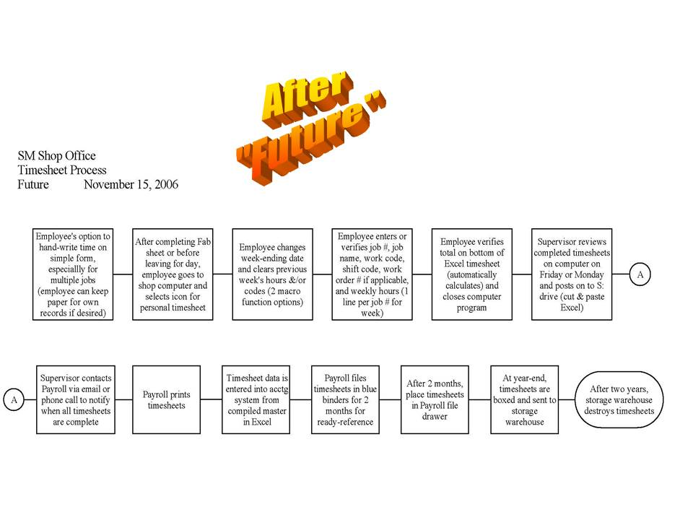
Figure 3.2
Image courtesy of The Grunau Company, www. Grunau.com
3-5

Slide 59
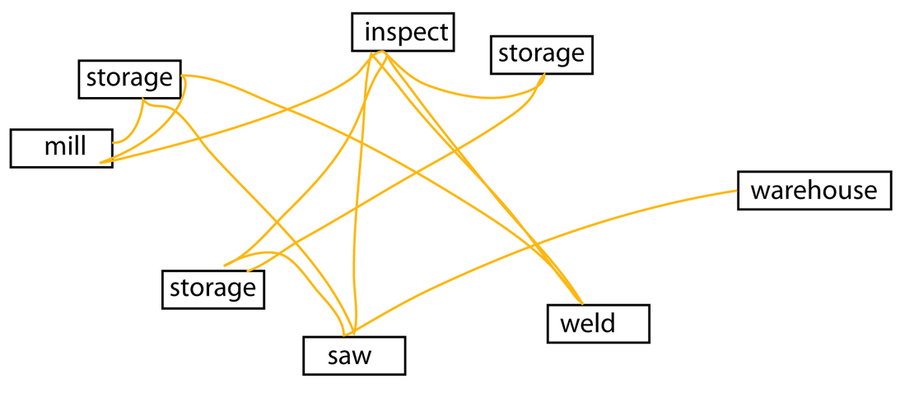
Spaghetti Diagrams
Track path of person/product.
Identify travel distances between key process steps.
Figure 3.3
3-6

Slide 60
Revised Placement and Flow
Inspect
Storage
Weld
Warehouse
Mill
Saw
Figure 3.4
3-7

Slide 61
Pareto Chart
Collected data depicted on a bar graph.
Identifies the most frequent source of problems.
Identifies where team should focus energy.
Identifies major contributing factors to a specific problem.
3-8
Notes:
6/8/2015

Slide 62
Pareto Chart
Reasons Why Planned Work is Not Done
Figure 3.5
Image courtesy of the Lean Construction Institute, www.leanconstruction.org
3-9
Notes:
6/8/2015

Slide 63
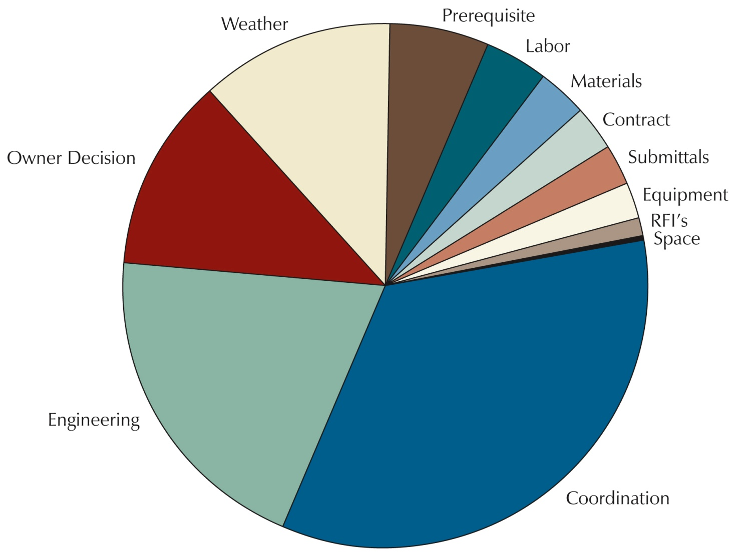
Measured Variations
Figure 3.6
Gottschalk, K., & Abdelhamid, T. 2003. Implementing Last Planner as a
diagnostic tool on university projects. Unpublished report. East Lansing, MI:
Michigan State University.
3-10

Slide 64
Fishbone Diagram
People
Assessment
Material
Problem or
Desired Solution
Space
Equipment
Methods
Figure 3.7
3-11
Notes:
6/8/2015

Slide 65
Fishbone (Cause & Effect) Diagram
Use when there are many contributing factors.
Organize data into major categories.
Review each category for potential impact on problem.
Use brainstorming process to identify factors.
3-12
Notes:
6/8/2015

Slide 66
A3 Overview
A3 Definition
A3 Process
A3 Standard Format
A3 Questions
A3 Problem Solving Thinking
3-13

Slide 67
What is A3?
11 x 17 paper size.
Problem solving format from 1960s.
Standard format at Toyota.
3-14

Slide 68
What is A3?
Story from left to right.
Entire plan layout.
Standardized communication method.
3-15

Slide 69
What Makes a Good A3 Good?
Deceptively simple…
Blank sheet of paper.
One page memo.
KIS.
3-16

Slide 70
A3 Process
A3 standard process:
Makes easier to
  Engage others.
  Understand others.
Encourages communication.
Develops thinking problem-solvers.
3-17

Slide 71
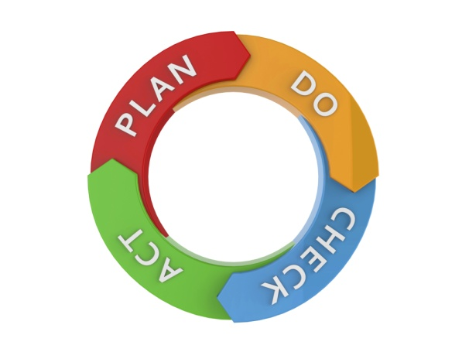
A3 Process
Links problems ➔ countermeasures.
Serves as organizational learning tool.
Effective countermeasures and solutions based on facts/data.
Encourages PDCA (Plan➔Do➔Check➔Act).
3-18

Slide 72
A3 Process
Creates discussion structure.
Fosters understanding, agreement.
Engages thinking.
3-19

Slide 73
Creating Problem Statements
Problem Statement = What is happening
  The pipes are leaking
Goal Statement = What should be happening
  The pipes don’t leak
3-20

Slide 74

A3 Thinking Steps
What is the problem… REAL problem? (2)
Why addressed now?
Who owns problem?
What is root cause? (4)
3-21

Slide 75

A3 Thinking Steps
What are possible countermeasures? (5)
How do we choose which countermeasures?
How do we get agreement among everyone?
3-22

Slide 76

A3 Thinking Steps
What is implementation plan? Timetable? (6)
Constraints to implementation?
How ensure follow-up? (7)
Continuous improvement?
3-23

Slide 77
Image courtesy of The Grunau Company, www. Grunau.com
3-24

Slide 78
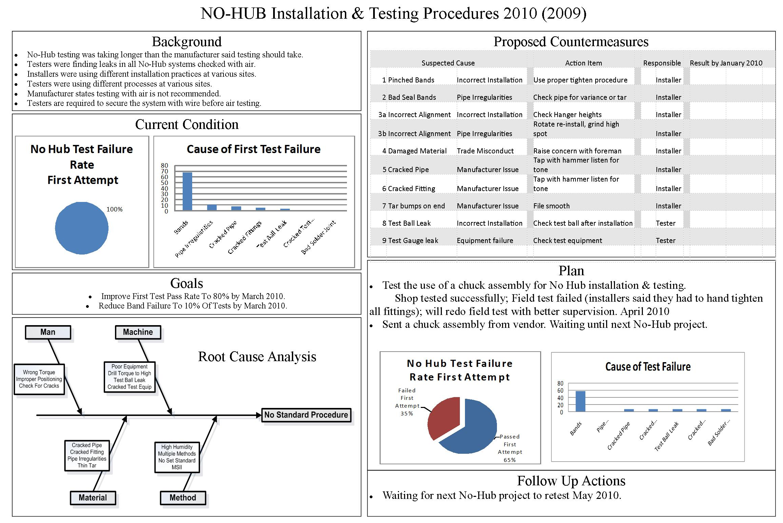
Image courtesy of The Grunau Company, www. Grunau.com
3-26

Slide 79
Example A3s
3-25

Slide 80
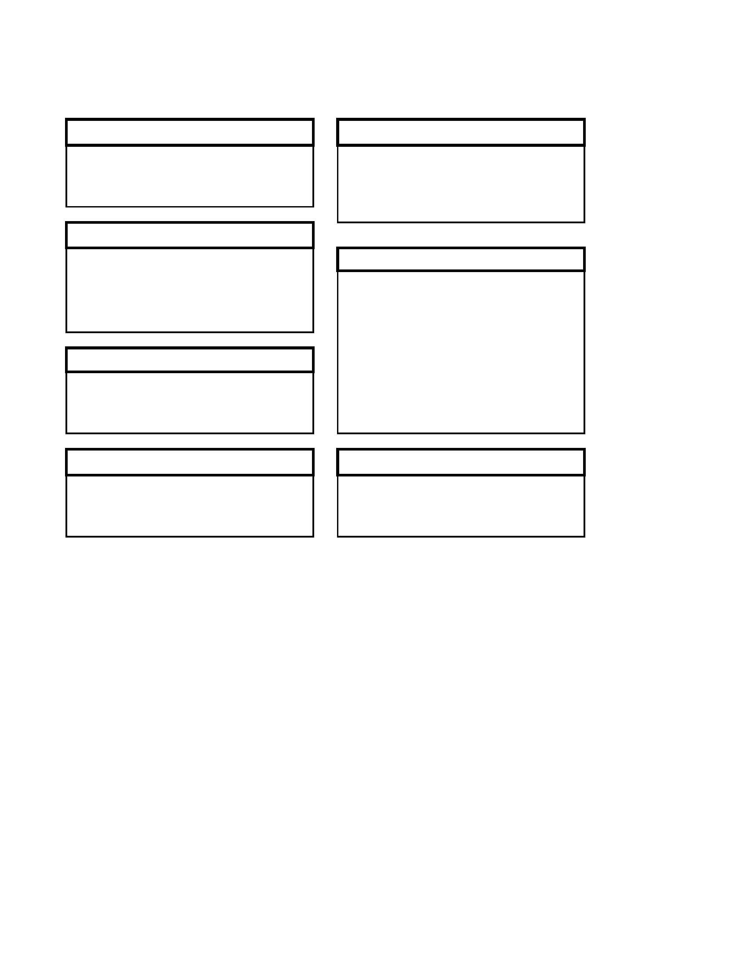
TITLE
Background
Countermeasures
Current Conditions
Plan
Goals / Targets
Analysis
Follow-Up
1-3
Figure 3.8
3-27

Slide 81
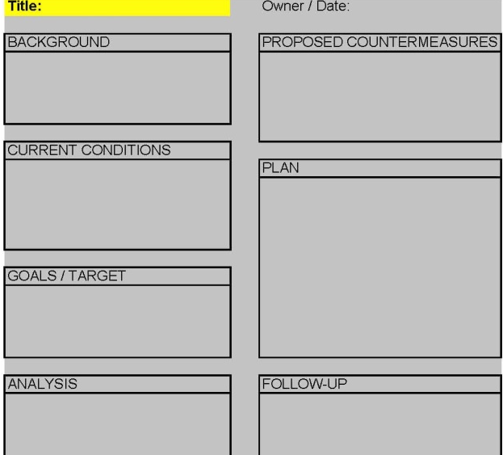
A3 Detail
Title / Theme:
What changes or improvements
are you talking about?
3-28

Slide 82
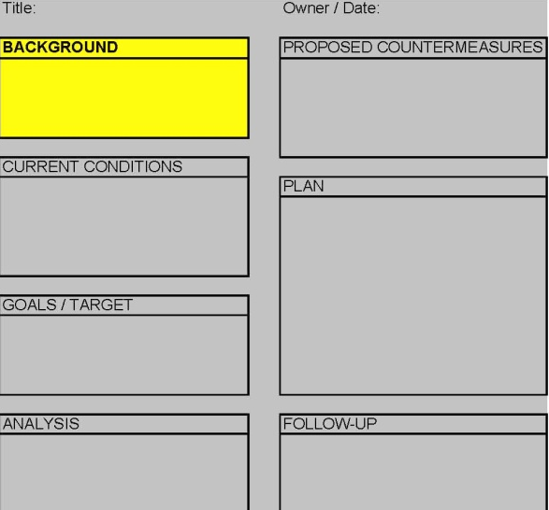
A3 Detail
Background (1):
What are you talking about & why?
Purpose: What is business reason?
3-29

Slide 83
Participants Complete
Title.
Box 1.
Share their A3 with their neighbor.
3-30

Slide 84
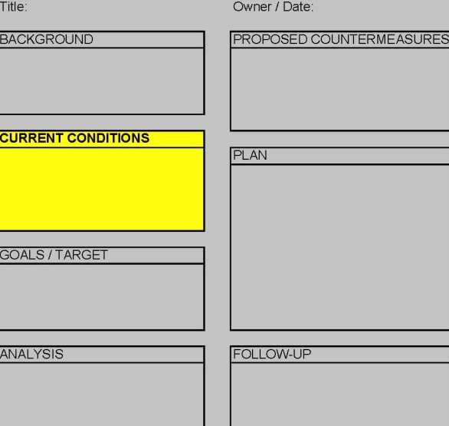
A3 Detail
Current Conditions (2):
Where do things stand now?
What is problem or need, gap?
What is happening vs. needs to happen?
State the problem in one concise statement.
3-31

Slide 85
Participants Complete
Box 2.
Share their A3 with their neighbor.
3-32

Slide 86
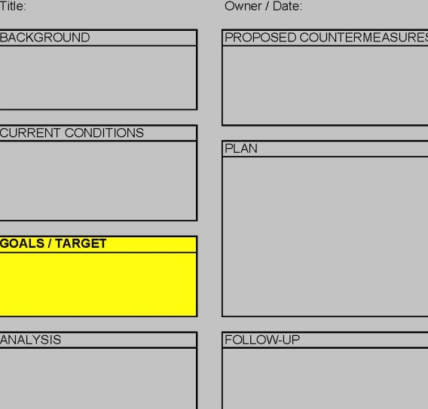
A3 Detail
Goals / Target (3):
What specific outcome required?
What specific improvement needed?
Must be measurable.
3-33

Slide 87
Participants Complete
Box 3.
Share their A3 with their neighbor.
3-34

Slide 88
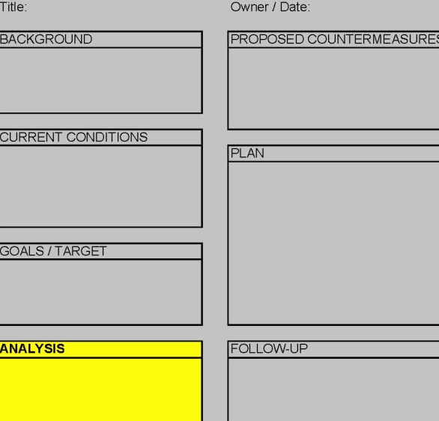
A3 Detail
Analysis (4):
Why problem exists?
What indicates gap, need exists?
What prevents goals?
Use simple problem solving tools.
3-35

Slide 89
Participants Complete
Box 4.
Share their A3 with their neighbor.
3-36

Slide 90
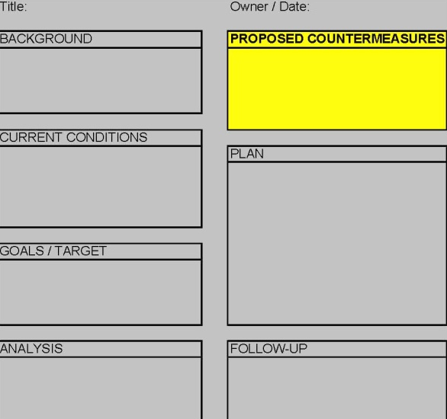
A3 Detail
Countermeasures (5):
Must fix root cause (Box 4).
Must address gaps and improve.
Compare effectiveness.
Which option recommended and why.
3-37

Slide 91
Participants Complete
Box 5.
Share their A3 with their neighbor.
3-38

Slide 92
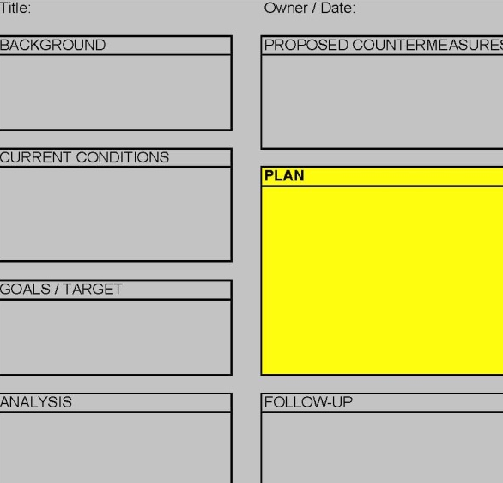
A3 Detail
Plan (6): (A Construction Schedule)
Specifically, how implement?
  What.
  Who.
  When.
  Constraints.
3-39

Slide 93
Participants Complete
Box 6.
Share their A3 with their neighbor.
3-40

Slide 94
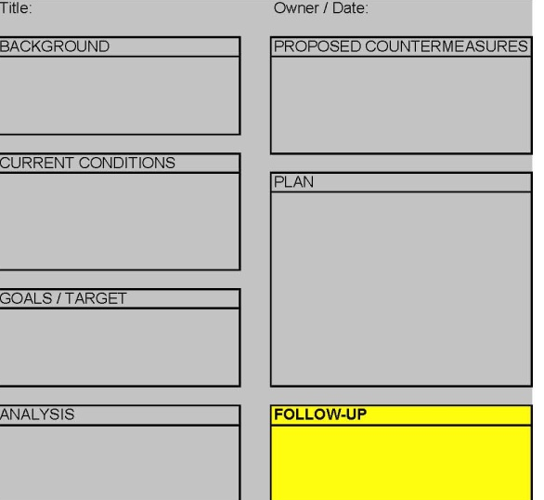
A3 Detail
Follow-Up (7)
Apply PDC A.
Focus on continuous improvement.
Share learning.
3-41

Slide 95
Participants Complete
Box 7.
Share their A3 with their neighbor.
3-42

Slide 96
Presentation of an A3
Solving Your Problem
Presentation of a problem just documented on an A3.
3-43

Slide 97
Session 3 Summary
  Problem solving tools include:
    Value Stream Mapping.
    Spaghetti Diagrams.
    Pareto Charts.
  Fishbone diagram.
The A3 captures all the information about a problem and supports the decision making process.
  The A3 encourages communication and develops thinking problem-solvers.
3-44

Slide 98
Course Summary
Lean problem solving is a deliberate process to clearly identify the problem and root causes before defining a solution.
Improved trust allows workers to report issues and to avoid problems.
Observation Walks create the chance to see operations to identify the source of problems.
A team environment is essential to solve problems.
Recognizing root causes of problems requires a search for facts and ideas.
The 5 Whys provide one means to finding the root cause.
The A3 is a powerful tool that
  Develops thinking problem solvers.
  Clearly and concisely presents a problem and its solution.
3-45

Slide 99
Course Summary
Plan-Do-Check-Act is a powerful approach for solving problems.
Problem solving tools include:
  Value Stream Mapping
  Pareto Charts.
  Fishbone diagram
The A3 structures the problem solving process.
The A3 develops thinking problem-solvers.
Any other questions?
3-46

Slide 100
Closing Activities
Plus/delta review.
Please be sure to go online and fill out your Unit 7: Problem-solving Principles and Tools Participant’s Registration and Evaluation Form at www.agc.org/LCEP/Evaluation.
  This form must be completed for you to obtain credit for attending this course.
Learn more about AGC’s Lean Construction efforts at www.agc.org/LCEP and www.agcleanforum.org.
3-47

