Slide 1
August 6, 2021
U.S. Construction Outlook:
Pandemic Impacts, Policy Initiatives, Project Implications
Ken Simonson
Chief Economist, AGC of America
ken.simonson@agc.org
©2021 The Associated General Contractors of America, Inc.

Slide 2
Total Nonfarm & Construction Employment, Feb. 2020-July 2021
cumulative change (seasonally adjusted)
Change to 7/21 from:
2/20
7/20
Residential Construction
2.0%
6.0%
Total Nonfarm
-3.7%
5.2%
Nonresidential Construction
-6.1%
1.2%
2/20
3/20
4/20
5/20
6/20
7/20
8/20
9/20
10/20
11/20
12/20
1/21
2/21
3/21
4/21
5/21
6/21
7/21
Source: BLS current employment statistics, https://www.bls.gov/ces/
©2021 The Associated General Contractors of America, Inc.

Slide 3
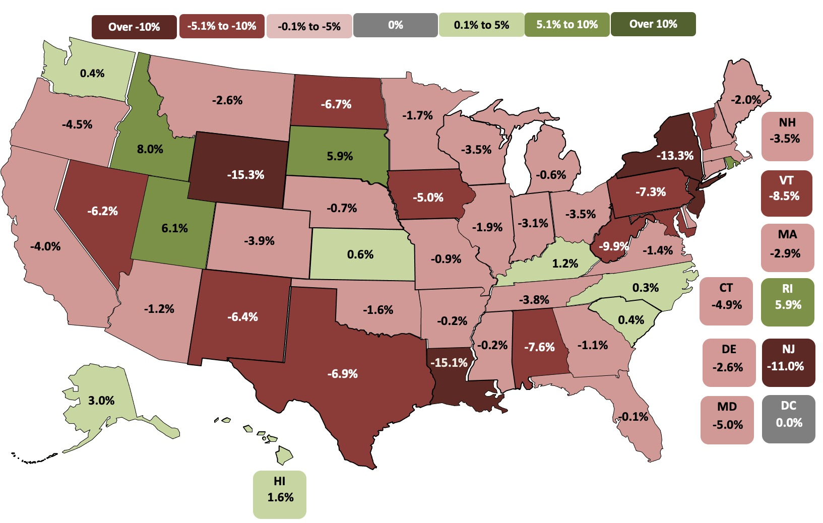
State construction employment change, Feb. 2020-June 2021
11 states up, 39 states down and DC flat (U.S.: -3.1%)
Top 5
Idaho | 8.0%
Utah | 6.1%
Rhode Island | 5.9%
South Dakota | 5.9%
Alaska | 3.0%
Bottom 5
Wyoming | -15.3%
Louisiana | -15.1%
New York | -13.3%
New Jersey | -11.0%
West Virginia | -9.9%
Note: Shading based on unrounded numbers Source: BLS state and area employment, www.bls.gov/sae
©2021 The Associated General Contractors of America, Inc.

Slide 4
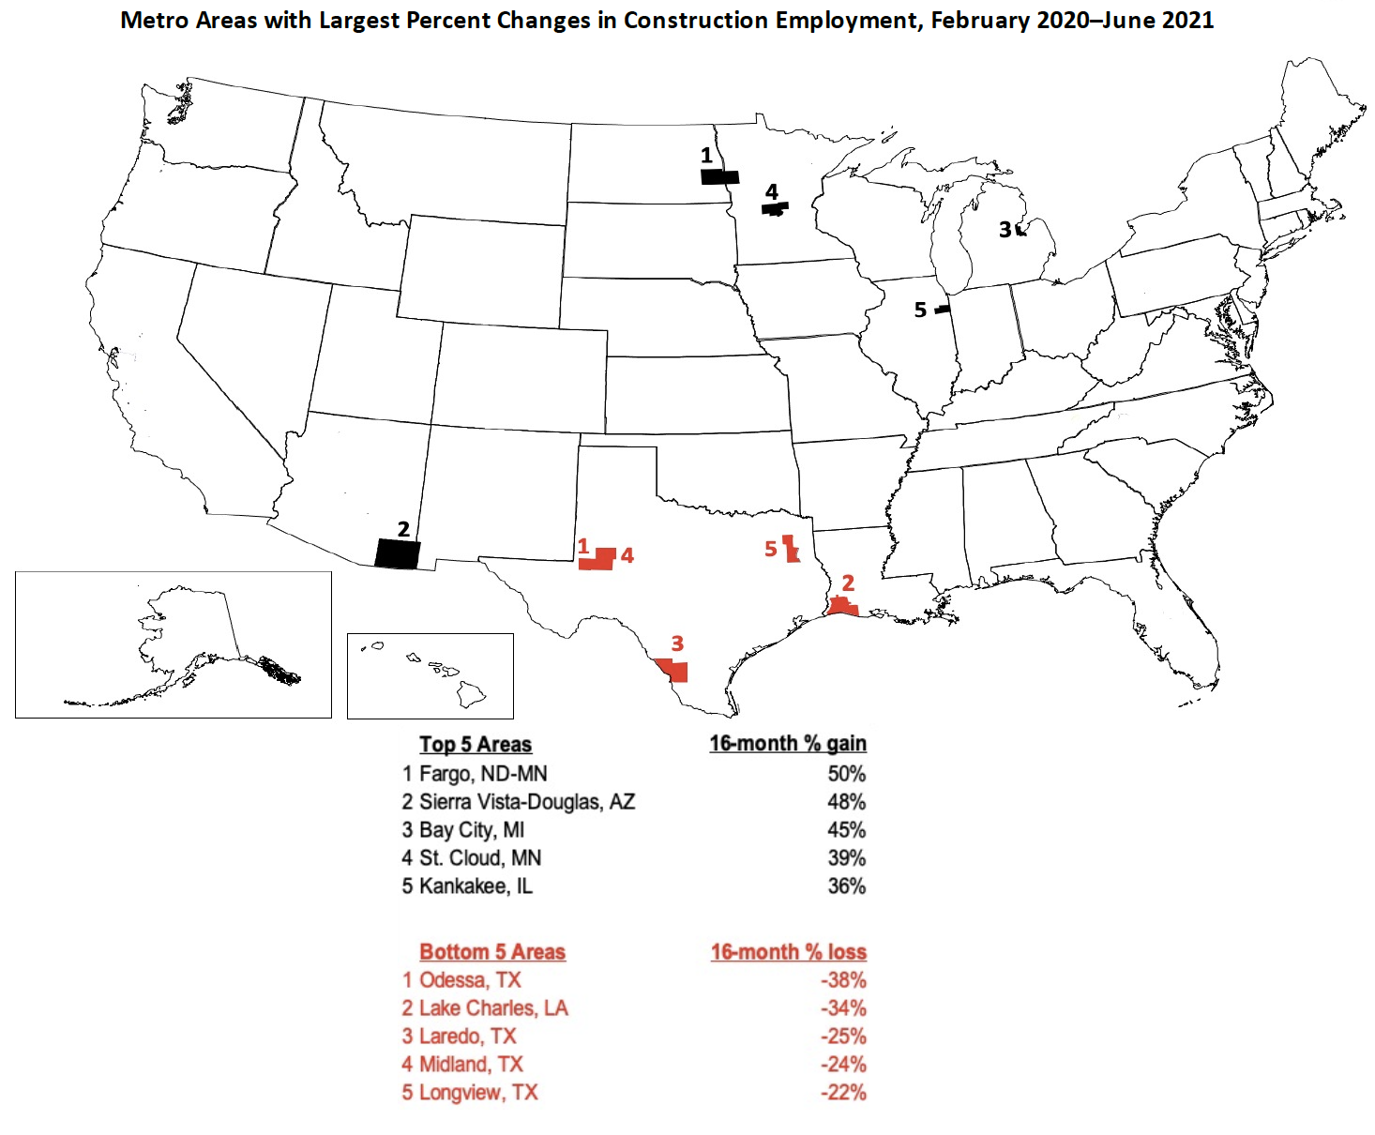
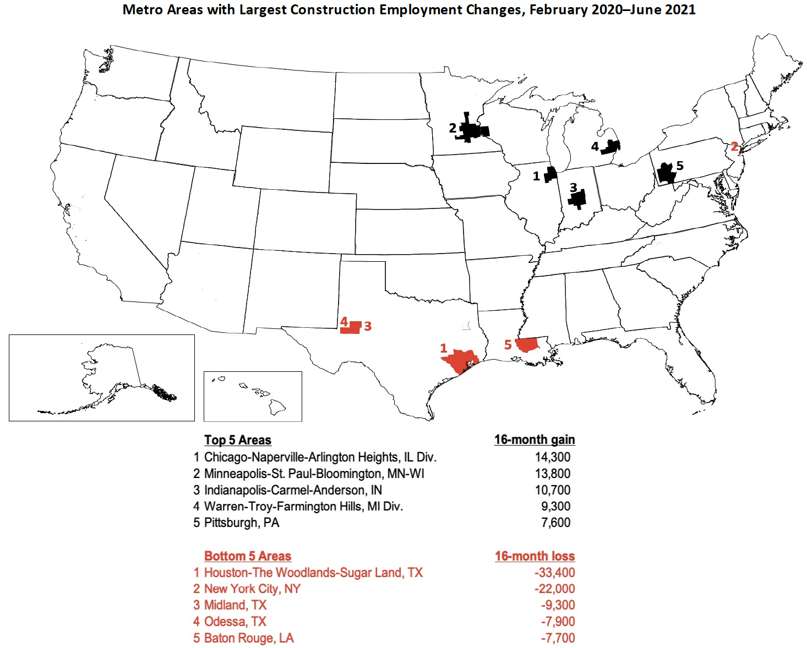
Metro construction employment change, Feb. 2020-June 2021
257 metros up, 21 metros unchanged, 80 metros down (U.S.: 4.3%)
Note: Shading based on unrounded numbers Source: BLS state and area employment, www.bls.gov/sae
©2021 The Associated General Contractors of America, Inc.

Slide 5
Year-to-date construction spending: Jan-May 2021 vs. Jan-May 2020
(not seasonally adjusted)
Total 5%; private residential 25% (single-family 36%; multi 19%); private nonres -9%; public -7%
Largest segments (in descending order of 2021 year-to-date spending)
Power -6% (electric -3%; oil/gas fields & pipelines -14%)
Education -11% (primary/secondary -7%; higher ed -18%)
Commercial -6% (warehouse 8%; retail -22%)
Office -12%
Highway and street -6%
Mfg. -5% (chemical 6%; transp. equip. 5%; food/beverage/tobacco 11% electronic/electric -19%)
Transportation -7% (air -12%; freight rail/trucking -5%; mass transit 5%)
Health care -3% (hospital 3%; medical building -8%; special care -5%)
Lodging -27%
Source: U.S. Census Bureau, construction spending, www.census.gov/constructionspending
©2021 The Associated General Contractors of America, Inc.

Slide 6
Construction input and ‘bid price’ producer price indexes (PPIs)
cumulative change in PPIs, June 2020 -June 2021 (not seasonally adjusted)
Inputs to construction June 20-June 21: 26.3%
‘Bid price’ (new nonres building construction) June 20-June 21: 3.4%
6/20
7/20
8/20
9/20
10/20
11/20
12/20
1/21
2/21
3/21
4/21
5/21
6/21
Source: Bureau of Labor Statistics, producer price indexes, www.bls.gov/ppi
©2021 The Associated General Contractors of America, Inc.

Slide 7
PPIs for construction and selected inputs
cumulative change in PPIs, June 2020 -June 2021 (not seasonally adjusted)
% change
June 2020-
June 2021:
Lumber and plywood
101%
Steel mill products
88%
Copper and brass mill shapes
61%
Aluminum mill shapes
33%
Plastic construction products
22%
Gypsum products
18%
‘Bid price’ (new nonres building construction)
3.4%
6/20
7/20
8/20
9/20
10/20
11/20
12/20
1/21
2/21
3/21
4/21
5/21
6/21
Source: Bureau of Labor Statistics, producer price indexes, www.bls.gov/ppi
©2021 The Associated General Contractors of America, Inc.

Slide 8
Cost squeeze on contractors can last two years or more
Difference between year-over-year change in materials costs vs. bid prices, Jan 2006-June 2021
= period when change in costs exceeded change in bid price
2006
2007
2008
2009
2010
2011
2012
2013
2014
2015
2016
2017
2018
2019
2020
2021
Source: Bureau of Labor Statistics, www.bls.gov/ppi, producer price indexes for goods inputs to nonresidential construction (material costs) and new warehouse construction (bid prices)

Slide 9
AGC’s responses to material cost
and supply-chain issues
Construction Inflation Alert: https://www.agc.org/learn/construction-data/agc-construction-inflation-alert
ConsensusDocs Price Escalation Resource Center: https://www.consensusdocs.org/price-escalation-clause/
Recording of webinar on “Soaring Material and Supply-Chain Costs and Delays”: https://store.agc.org/Store/CSI/Store/Product_List_WebEds.aspx
Presentations to government contracting officials and owner groups
Lobbying for tariff relief on lumber, steel, aluminum, and products
- Presentation to National Economic Council, VP’s chief economist, Commerce chief economist
- Presentations in coalitions to counselor to Commerce secretary, Senate & House trade staff
Source: Author
©2021 The Associated General Contractors of America, Inc.

Slide 10
Forward-looking indicators
Indicator | Latest date | Current value | Year-ago value
Architecture Billings Index (ABI) | June | 57.1 | 40.7
Dodge Momentum Index (DMI) | June | 166 | 118
Multifamily permits (year-to-date) | Jan-June | 250,700 | 207,500
Source: American Institute of Architects (ABI), Dodge Data & Analytics (DMI), Census Bureau (New Residential Construction)
©2021 The Associated General Contractors of America, Inc.

Slide 11
Medium-term impacts as recovery begins
Economic recovery looks more certain but virus risks remain
Construction workers have especially low vaccination rates and high hesitancy
Slower rebound than for other sectors as owners, investors/lenders, institutions, and public agencies face uncertainty about future demand, project costs, and completion times
Continuing cost and supply challenges may lead to more project deferrals
Best private prospects: remodeling, local distribution centers, data centers, restaurants
Less demand than pre-crisis for retail, offices, higher ed, lodging & travel-related
Less near-term demand for sports, entertainment, cultural facilities
Best public prospects: K-12 schools
Unclear how states and localities will spend added tax revenue and federal dollars
Source: Author
©2021 The Associated General Contractors of America, Inc.

Slide 12
Long-run construction outlook (post-pandemic)
Slower population growth means slower demand growth for most construction
Permanent shift from retail to e-commerce/distribution structures
More specialized and online healthcare facilities; fewer hospitals, nursing homes
More wind, solar, battery storage and charging facilities, and related manufacturing
Less oil drilling, pipelines, gas stations, auto repair(?)
Continuing demand for K-12 but much less for higher ed construction
Not clear if offices will decentralize or remain in less demand
No sign of change yet in urban/rural or state-to-state trends
Source: Author
©2021 The Associated General Contractors of America, Inc.

Slide 13
Population change by state, July 2019–July 2020 (U.S.: 0.35%)
Decrease
0-0.49%
0.5-0.99%
1.0-1.49%
1.5%+
1.0%
2.1%
Top 5
ID | 2.1%
AZ | 1.8%
NV | 1.5%
UT | 1.5%
TX | 1.3%
1.0%
0.3%
0.6%
0.2%
0.3%
NH 0.4%
0.1%
-0.6%
VT
-0.1%
0.4%
0.6%
-0.2%
-0.2%
1.5%
0.1%
-0.1%
MA
-0.02%
1.5%
0.3%
-0.6%
-0.03%
0.9%
0.4%
-0.6%
0.04%
0.2%
0.4%
CT -0.3%
RI -0.1%
0.1%
Bottom 5
NY | -0.6%
IL | -0.6%
HI | -0.6%
WV | -0.6%
MS | -0.4%
1.8%
0.9%
0.3%
0.5%
0.8%
DE 1.0%
NJ -0.1%
1.3%
0.3%
1.2%
-0.4%
0.3%
0.8%
MD
0.01%
DC
0.6%
AK
-0.3%
-0.3%
1.1%
HI -0.6%
Source: U.S. Census Bureau, Dec. 2020 estimates, www.census.gov/popest
©2021 The Associated General Contractors of America, Inc.

Slide 14
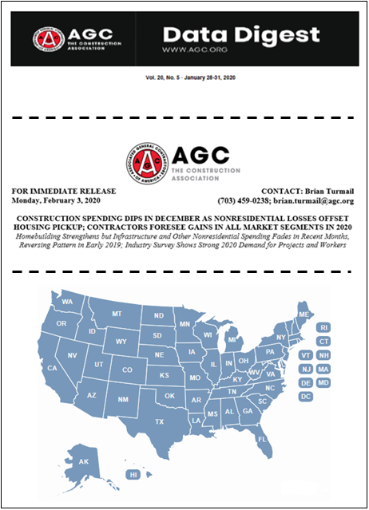
AGC economic resources
(email ken.simonson@agc.org)
The Data DIGest: weekly 1-page email (subscribe at http://store.agc.org)
Construction Inflation Alert:
https://www.agc.org/learn/construction-data/agc-construction-inflation-alert
ConsensusDocs Price Escalation Resource Center: https://www.consensusdocs.org/price-escalation-clause/
Surveys, state and metro data, fact sheets: www.agc.org/learn/construction-data
Monthly press releases: construction spending; producer price indexes; national, state, metro employment with rankings
Source: Author
©2021 The Associated General Contractors of America, Inc.

