Slide 1
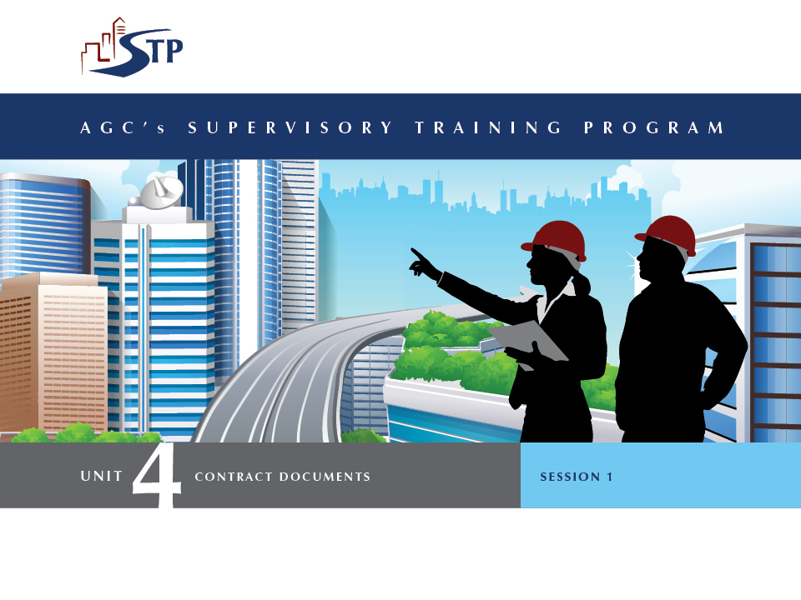

Slide 2
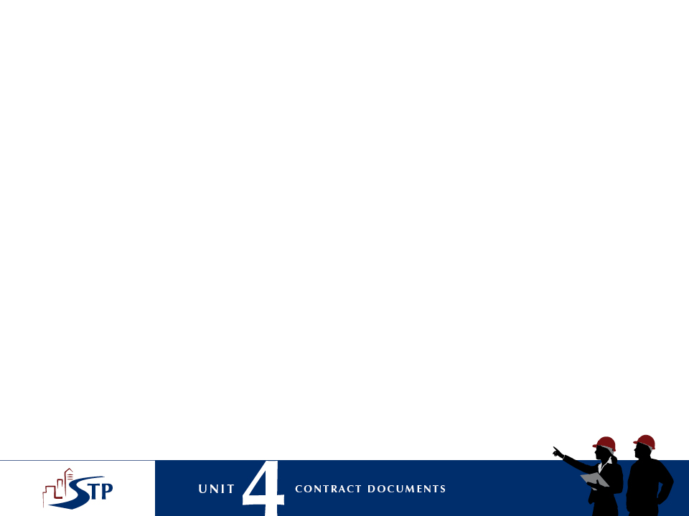
Getting Acquainted
1-2

Slide 3
Unit 4 Themes
Understanding and reinforcing the rights and responsibilities of each party involved in a project.
Understanding and reinforcing the rights and responsibilities of the construction supervisor.
Solving problems and resolving issues.
Creating a win-win situation for all parties.
1-3

Slide 4
Unit 4 Objectives
Understand critical information about contract documents and construction law to help recognize the various roles and responsibilities of all contracting parties.
Understand how contract documents and construction law can be helpful to solve problems, resolve issues and remedy conflicts.
Know how to develop jobsite processes that are consistent with contract documents and construction law to maintain positive relationships among contractors, architects, engineers, and owners.
Know how to create a productive, respectful environment on the jobsite.
1-4

Slide 5
Session 1: Learning Objectives
Describe the importance of contract documents and construction law as they apply to construction supervisors.
Define key legal terms associated with contracts and contract documents.
Describe common contract documents.
Describe how a contract is formed and define basic legal terms used in construction documents.
Describe the contractual relationships among various parties to a construction contract.
1-5

Slide 6
Contract Documents: Drawings
Drawings graphically provide:
  Arrangements
  Materials
  Dimensions
  Configurations
  Other
1-6

Slide 7
Contract Documents: Specifications
Specifications provide:
  Written instructions that detail project requirements.
  Information that is not easily shown on drawings.
1-7

Slide 8
Contract Documents:
Other Key Documents
Other key documents:
  Contract
  Subcontract
  General conditions
  Supplemental conditions
  Addenda and change orders
  Purchase orders
  Request for information (RFI)
1-8

Slide 9
Elements of Contract Documents
Common elements of a contract include:
  Mutual consent
  Offer and acceptance
  Exchanging something of value
  Operating in good faith
  Delivering and performing
  No violations of public policy
1-9

Slide 10
Using on the Job What You Learned Today
Summary: first key concept
  Recognize various contract documents, how they relate to each other, and their importance in providing information pertinent to successful job completion.
1-10

Slide 11
Using on the Job What You Learned Today
Summary: second key concept
  Define a contract, understand terms common to construction contracts, and recognize the importance of following contractual obligations.
1-11

Slide 12
Using on the Job What You Learned Today
Summary: third key concept
  Understand the various roles contractual parties have, how they interact, and the importance of cultivating positive relationships between contractual parties.
1-12

Slide 13


Slide 14
Review the Jobsite Assignment
2-2

Slide 15
Learning Objectives
Differentiate between various contractual relationships.
Describe the roles and responsibilities of contractual parties.
Explain the supervisor’s role in different contractual relationships.
Describe potential dispute situations.
Describe positive practices for dispute avoidance.
Explain the Alternative Dispute Resolution (ADR) process.
2-3

Slide 16
Types of Construction Contracts
Lump-Sum (Fixed-Price) Contract
Unit-Price Contract
Negotiated Contract
2-4

Slide 17
Contractual Relationships
Owner and Architect/Engineer
Owner and General Contractor/Subcontractor
Owner and Prime Contractor
Owner and Construction Manager (CM)
Owner and Design/Build
2-5

Slide 18
Roles and Responsibilities
Search ConsensusDocs 200 for your answers.
Next to each answer, write the article and section number where you found the answer.
2-6

Slide 19
The Supervisor’s Role in Contractual Relationships
The construction supervisor represents the contractor.
Knowing relationships, roles, and responsibilities will help you avoid disputes and create a positive team process.
2-7

Slide 20
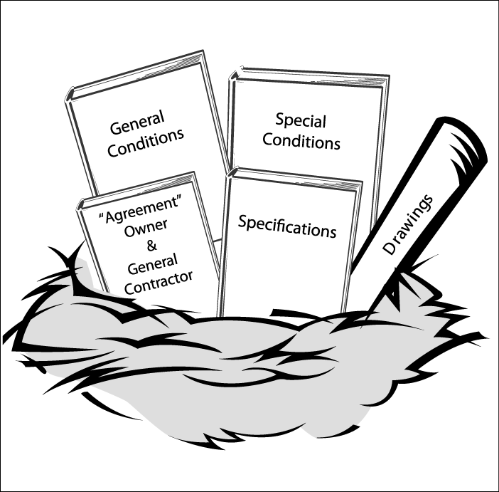
Nested Documents
All contract documents are related.
2-8

Slide 21
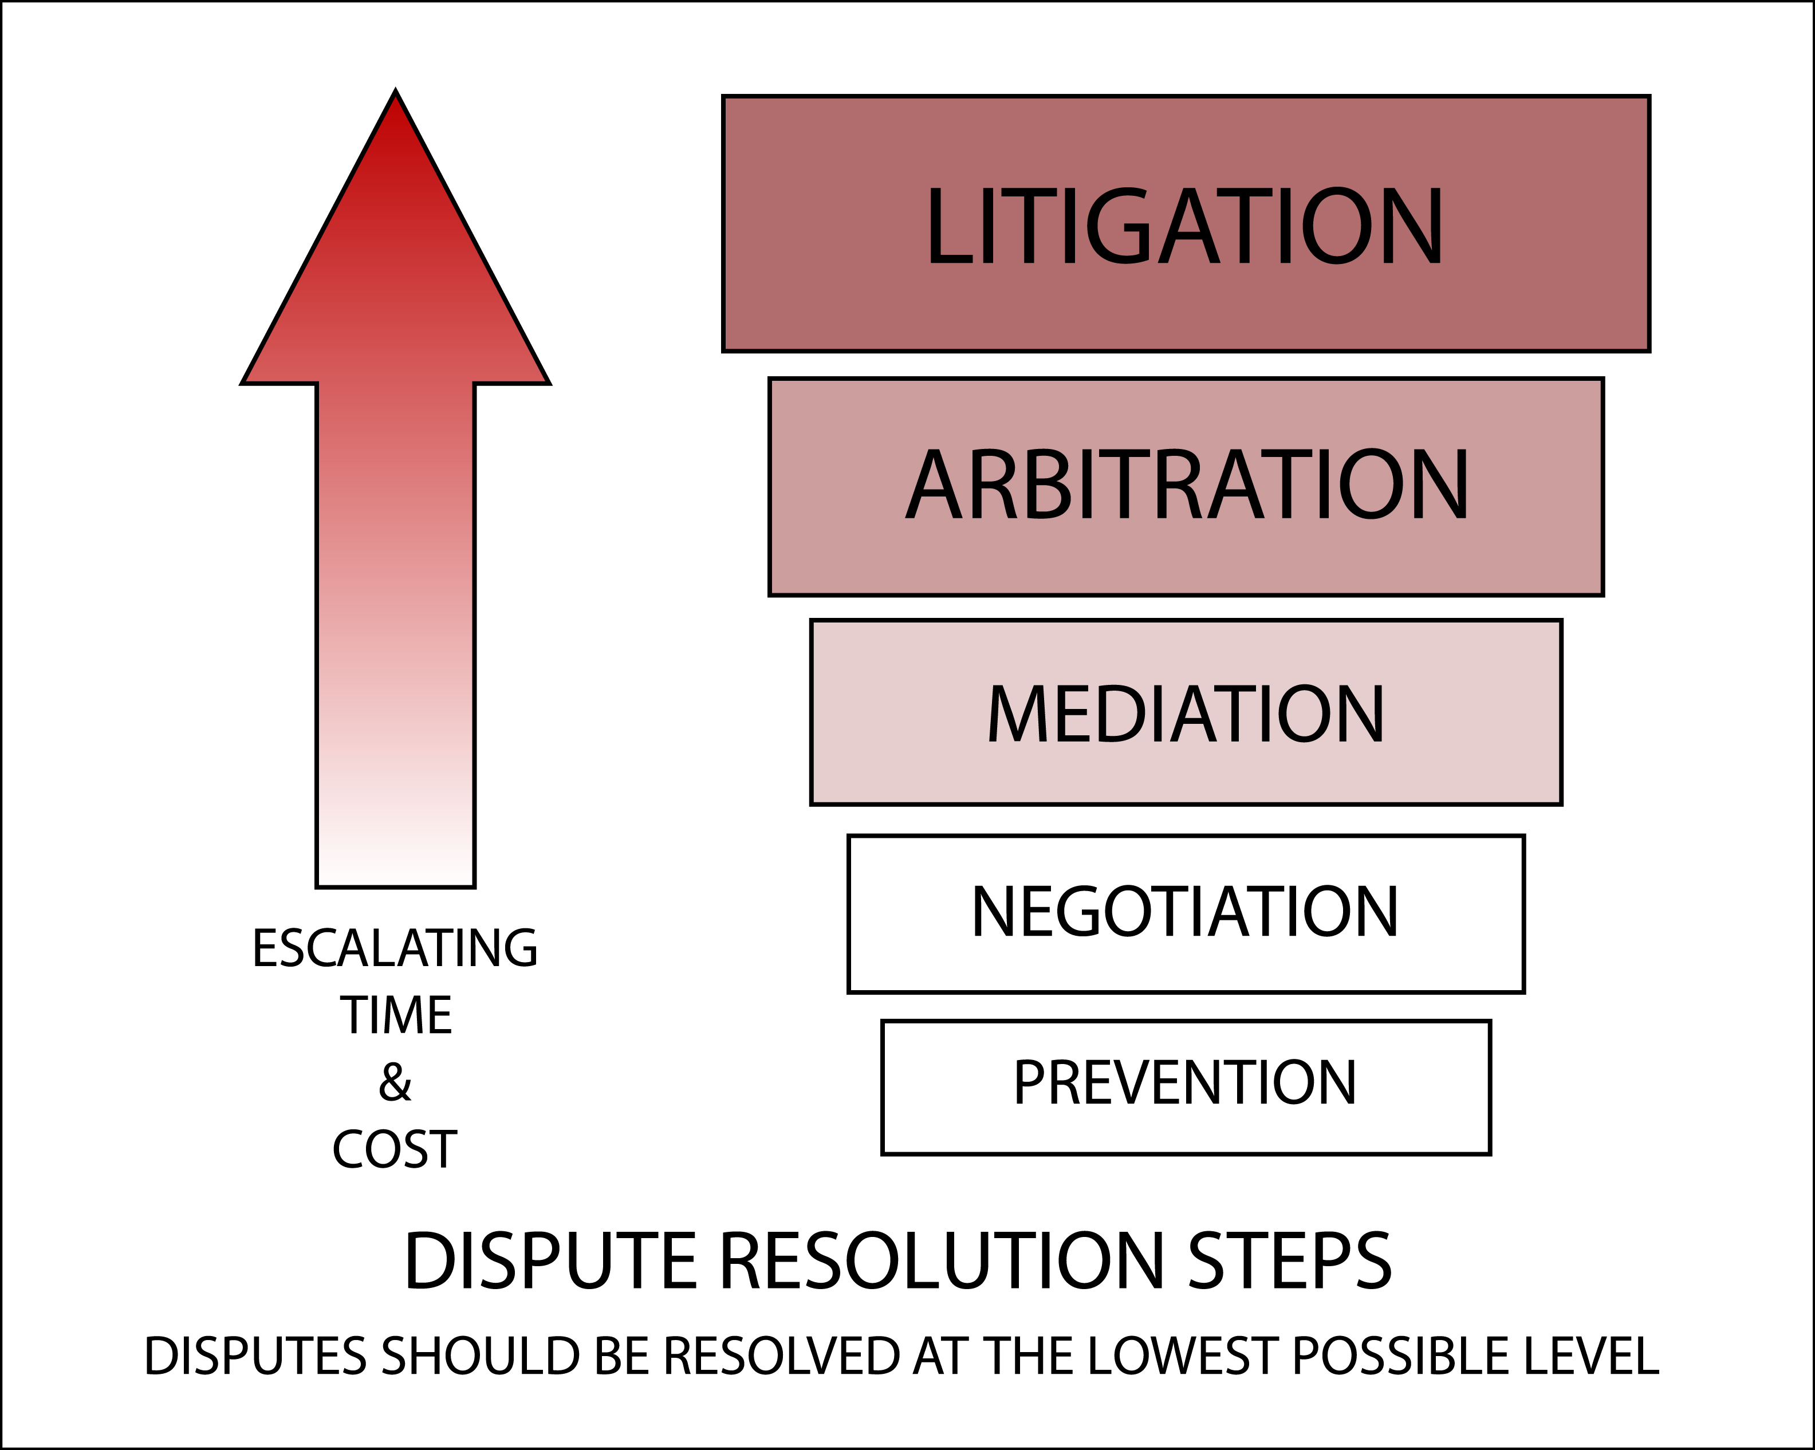
Alternative Dispute Resolution
2-9

Slide 22

Using on the Job What
You Learned Today
Summary: first key concept
  Understand the importance of creating and maintaining a positive workplace.
2-10

Slide 23
Using on the Job What
You Learned Today
Summary: second key concept
  Recognize the benefits of building trust between contractual parties.
2-11

Slide 24
Using on the Job What
You Learned Today
Summary: third key concept
  Understand how good communication practices help to avoid disputes.
2-12

Slide 25


Slide 26
Review the Jobsite Assignment
3-2

Slide 27
Learning Objectives
Identify forms and documents commonly used by professional associations and governmental agencies.
Describe design/build, construction management, and subcontractor contracts.
Explain federal, state, and local regulatory issues concerning human resources, the environment, and safety.
Describe liens, bonds, and insurance requirements.
3-3

Slide 28
Standard Forms, Contracts, and Documents
Standardized forms are prepared by:
  AGC
  AIA
  EJCDC
  CSI
  Federal Government
3-4

Slide 29
Standardized Contracts: a Worksheet
Use the following ConsensusDocs:
200
500
280
415
420
3-5

Slide 30
Government Regulatory Issues
AGC Principle 1
  Readily identified and well-defined classes of people in our society have systematically been excluded from full participation in the benefits of our society.
3-6

Slide 31
Government Regulatory Issues
AGC Principle 2
  All persons in our society have an equal right to employment, which is fundamentally a social right in itself.
3-7

Slide 32
Government Regulatory Issues
AGC Principle 3
  The “system” is obligated to correct discrimination and requires affirmative action to overcome the effects of past discriminations as well as to modify future employment patterns.
3-8

Slide 33
Worksheet:
Liens, Bonds, and Insurance
Identify the type of insurance that probably would cover the loss indicated by each situation.
Write the answer in the space provided.
3-9

Slide 34
Using on the Job What
You Learned Today
Summary: first key concept
  Identify the common standard form contracts and documents developed by various agencies; realize these documents impact various supervisory activities.
3-10

Slide 35
Using on the Job What
You Learned Today
Summary: second key concept
  Recognize your role as defined in design/build, construction management, and subcontractor agreements.
3-11

Slide 36
Using on the Job What
You Learned Today
Summary: third key concept
  Develop practices and attitudes that ensure equal opportunity, protect the environment and produce safe work conditions.
3-12

Slide 37
Using on the Job What
You Learned Today
Summary: fourth key concept
  Recognize that liens, bonds, and insurance requirements can affect successful completion of a project.
3-13

Slide 38


Slide 39
Review the Jobsite Assignment
4-2

Slide 40
Learning Objectives
Locate the articles that affect the important aspects of managing general conditions.
Recognize the roles and responsibilities identified by the contract.
Determine levels of decision-making authority.
Evaluate the supervisor’s role and responsibilities as an agent of the contractor.
Describe project close-out procedures.
4-3

Slide 41
The General Conditions Contract
The General Conditions:
  Establish a common basis for relationships on a project.
  Classify and clarify duties.
  Help to avoid disputes.
  Guide contractors in the execution of the project.
4-4

Slide 42
Terms of the General Conditions
Using ConsensusDocs 200, find the article and section numbers that affect aspects of managing general conditions.
4-5

Slide 43
Supplementary Conditions
Supplementary Conditions:
  Provide information that is specific to a project.
  Immediately follow the General Conditions.
  Are also referred to as Special Conditions.
  Should be reviewed and discussed prior to starting a project.
4-6

Slide 44
Responsibilities
Using ConsensusDocs 200, read the information contained in your assigned article.
Briefly list and describe the responsibilities as determined by the article subparagraph.
4-7

Slide 45
Using General Conditions Documents for Making Decisions
Determine the basis of authority for:
The Owner
The Architect/Engineer
The Contractor
The Subcontractor
4-8

Slide 46
The Supervisor as Agent of the Contractor
Authority
Responsibility
Personnel relations
The public image
Dealing with the owner
Dealing with subcontractors
Keeping records
4-9

Slide 47
Closing Out the Job
Closing out a job is like selling it to a satisfied customer.
4-10

Slide 48
Using on the Job What
You Learned Today
Summary: first key concept
  The General Conditions contract identifies the roles and responsibilities of the parties involved in a construction project.
4-11

Slide 49
Using on the Job What
You Learned Today
Summary: second key concept
  The supervisor can use the contract documents to determine the levels of decision-making authority.
4-12

Slide 50
Using on the Job What
You Learned Today
Summary: third key concept
  Use a closing out control program to close out a project.
4-13

Slide 51


Slide 52
Role Play Exercise
Cast of characters
Mike – the superintendent
Earl – a laborer
Inspector
Tom – the carpenter foreman
2 laborers
Mike’s assistant
5-2

Slide 53
Learning Objectives
Describe the importance and necessity of documentation.
Manage a documentation system.
Identify various types of documentation practices.
Develop a model for a sound documentation system.
Develop a win-win environment.
5-3

Slide 54
Review Jobsite Assignment
5-4

Slide 55
What is Field Documentation?
Documentation includes:
  A complete record of the project.
  All contract documents.
  Records of circumstances.
  Daily reports.
  Meeting minutes.
5-5

Slide 56
Documentation Systems
Documentation is:
  A systematic process for keeping regular, accurate, complete and legible records of daily activities, actual circumstances, and unusual events on a project.
5-6

Slide 57
Why Documentation is
So Important
Good documentation can:
  Identify issues
  Resolve conflicts
  Settle disputes
  Avoid litigation
  Provide tangible proof
5-7

Slide 58
Good Documentation Practices
Good documentation must be:
  Accurate
  Objective
  Complete
  Uniform
  Credible
  Timely
5-8

Slide 59
How to Document
Documentation Tools
  Computers
  Photographs
  Video cameras
  Audio recorders
  Written reports
  Daily logs
5-9

Slide 60
Meetings: a Simulation
5-10

Slide 61
Job Diary vs. Job Log
Job diary: a personal account of all significant events that occur on a jobsite.
Job log: a record that tracks reports and forms that are created, sent or received at a jobsite.
5-11

Slide 62
Role Play Review:
Writing the Report
5-12

Slide 63
Using on the Job What
You Learned Today
Summary: first key concept
  Develop a documentation system that keeps regular, accurate, complete and legible records of daily events, actual circumstances, and unusual activities on the project.
5-13

Slide 64
Using on the Job What
You Learned Today
Summary: second key concept
  Understand the various record keeping methods, including cameras, camcorders, tape recorders, company written forms, logs, diaries, etc.
5-14

Slide 65
Using on the Job What
You Learned Today
Summary: third key concept
  It is important to record information in an accurate and timely fashion.
5-15

Slide 66


Slide 67
Review Jobsite Assignment
6-2

Slide 68
Learning Objectives
Describe the three major causes of cost overruns.
Explain the importance of the Changes Provision.
List and define different types of changes.
Identify notice and other contract requirements to recover for changes.
Explain how to handle differing site conditions change requests.
6-3

Slide 69
Cost Overruns
Common factors of cost overruns
  Inaccurate estimates
  Differing site conditions
  Inadequate supervision or management
6-4

Slide 70
The Changes Clause
...allows both the owner and the contractor to make changes in the scope of a project without having to negotiate a new contract.
6-5

Slide 71
Revisions to Contract Documents
A supervisor should never:
  Proceed with work that differs from requirements stated in the contract documents.
  Implement any change to any contract requirements without first obtaining a properly signed change order.
6-6

Slide 72
Change Orders, Field Orders, and Change Directives
Categories requiring change orders
  Owner’s requested change
  Designer’s requested change
  Contractor’s requested change
  Recommendations by subcontractors or material suppliers
  Requirements by building inspectors or fire marshal
6-7

Slide 73
Using on the Job What
You Learned Today
Summary: first key concept
  Know the three major causes of cost overruns and identify how they can be avoided.
6-8

Slide 74
Using on the Job What
You Learned Today
Summary: second key concept
  Identify different types of changes and know how they should be handled.
6-9

Slide 75
Using on the Job What
You Learned Today
Summary: third key concept
  Understand ways that time impacts can affect a project, and which of them can be recovered according to the contract documents.
6-10

Slide 76


Slide 77
Review Jobsite Assignment
7-2

Slide 78
Learning Objectives
Find and identify time-related references in the contract documents.
Identify consequences of accelerations, delays, suspensions and disruptions.
Describe a process for managing requested extensions.
Analyze the effects of time-related issues on the construction project.
7-3

Slide 79
Construction Schedules
Time impacts include:
  Accelerations — speed up the current process of work.
  Delays — delays to the progress; can be excusable or non-excusable.
  Suspensions — interruptions resulting in work stoppage.
  Disruptions — interruptions causing delays.
7-4

Slide 80
Time Impacts
Accelerations
Delays
  Non-excusable
  Excusable
7-5

Slide 81
Excusable Delays
Compensable
Non-compensable
7-6

Slide 82
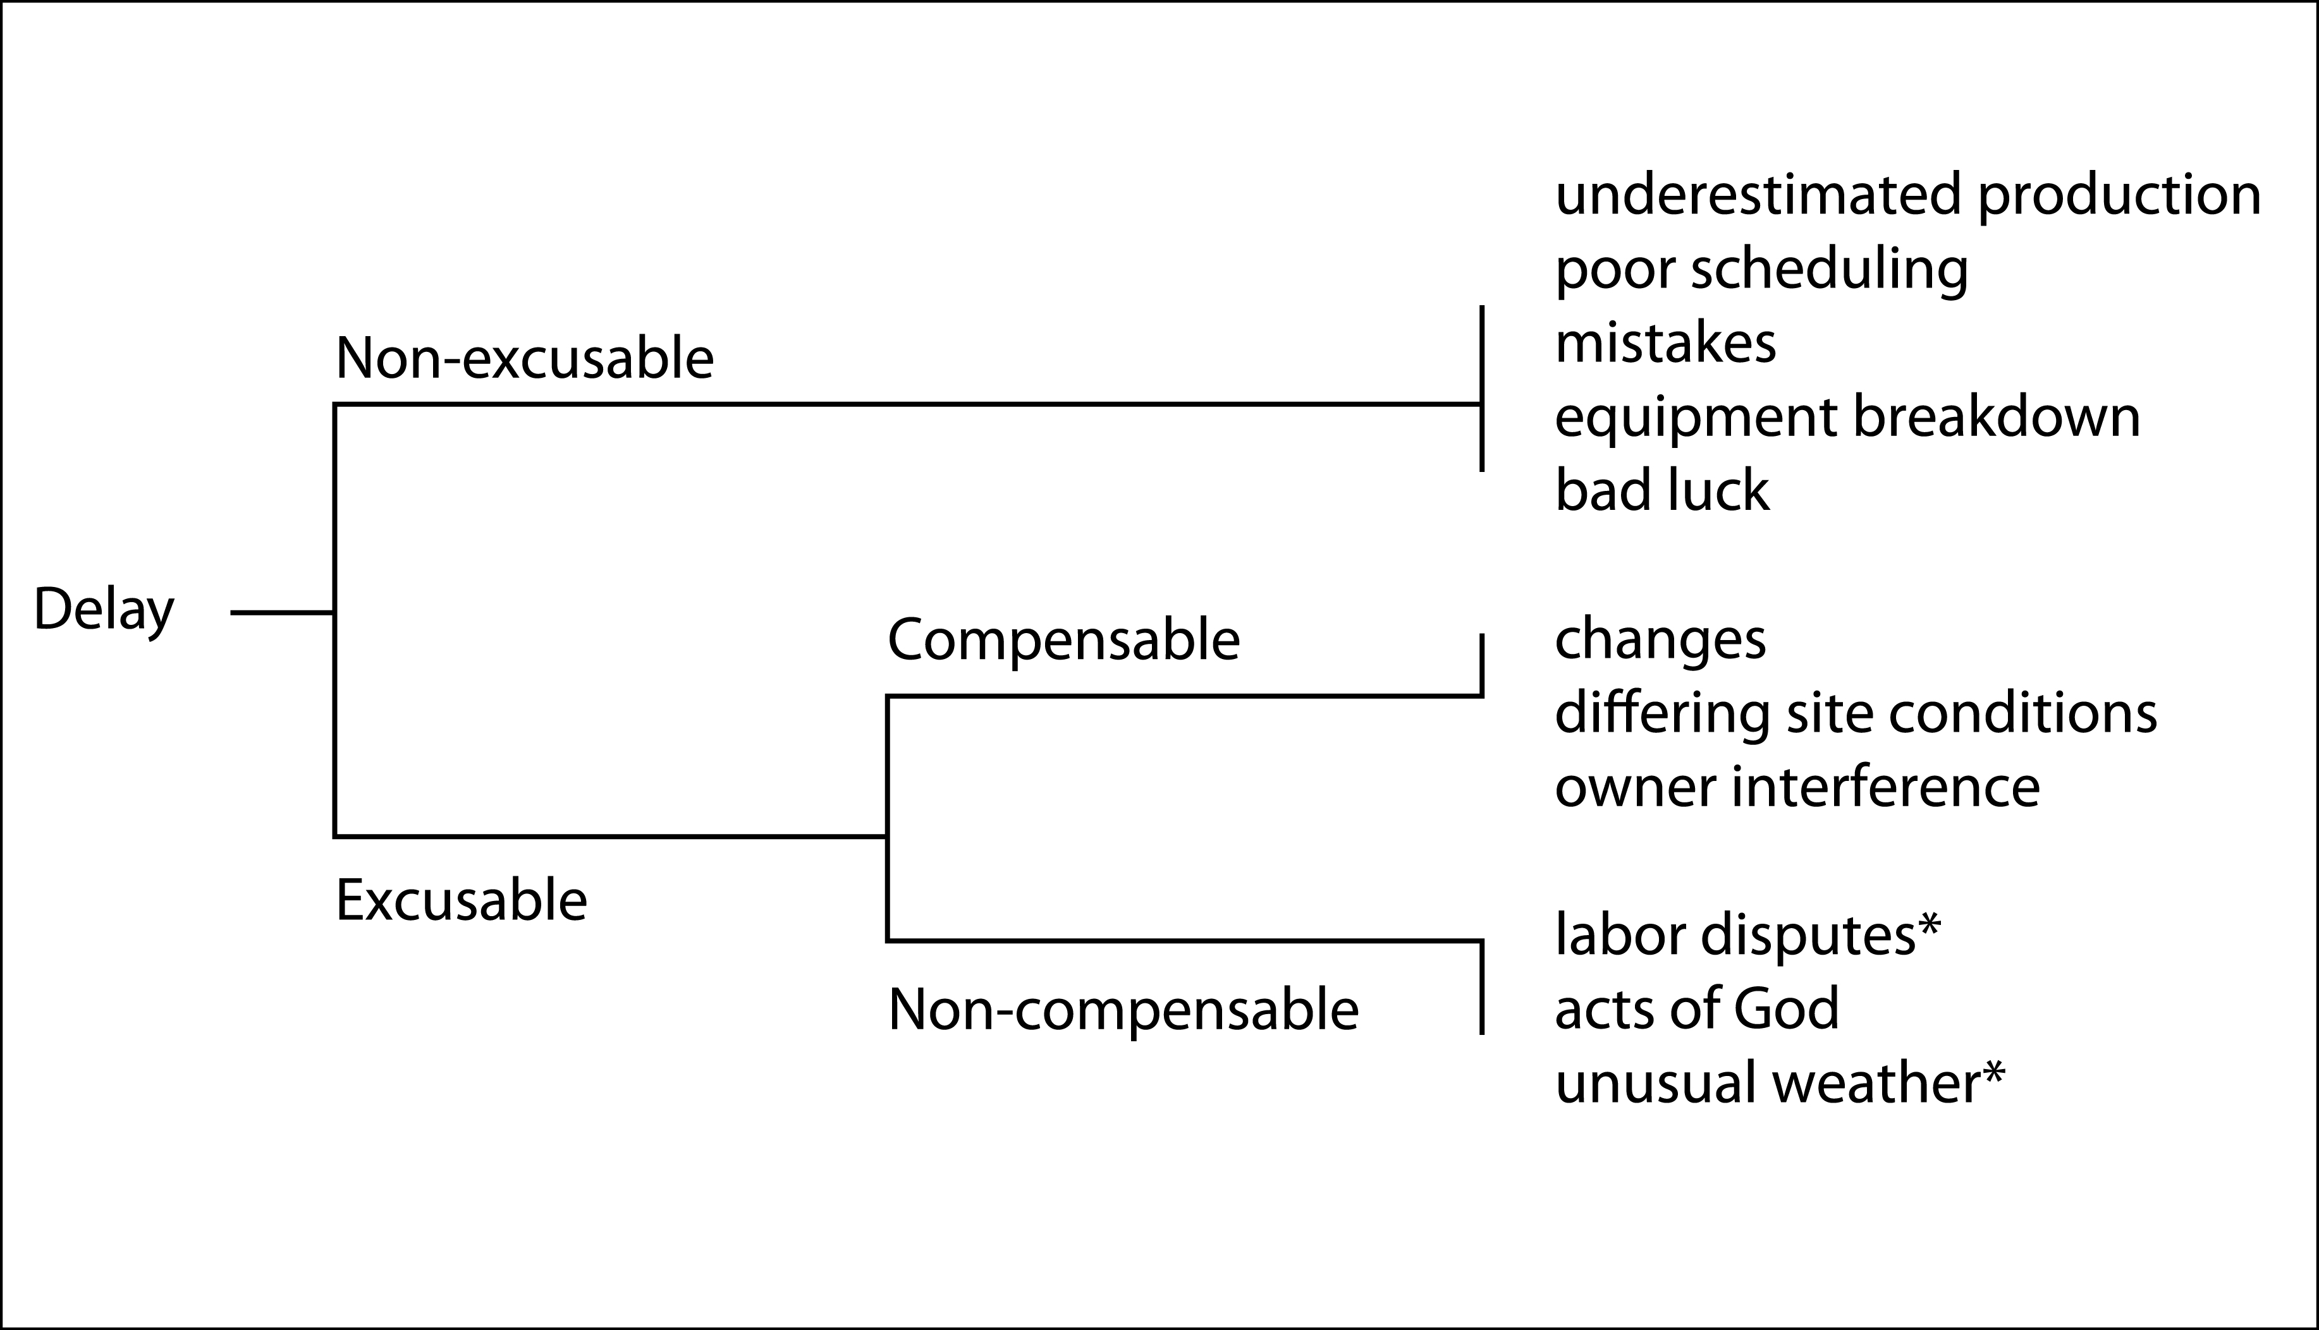
Types of Delays
7-7

Slide 83
Time Impacts
7-8

Slide 84
Consequences of Time-Related Issues
Principal types of damage claims
  Liquidated damages
  Compensatory damages
  Delay damages
  Claims for latent defects
7-9

Slide 85
Using on the Job What
You Learned Today
Summary: first key concept
  Various time impacts on the work can result in compensable or non-compensable claims.
7-10

Slide 86
Using on the Job What
You Learned Today
Summary: second key concept
  Contract documents provide a process for requesting extensions of time.
7-11

Slide 87


Slide 88
Review Jobsite Assignment
8-2

Slide 89
Learning Objectives
Identify the steps in the dispute resolution process.
Describe the financial impacts of going to court.
Explain the supervisor’s role in the dispute resolution process.
Describe how to obtain final resolution to disputes that are win-win solutions.
Summarize the key concepts learned in this course.
8-3

Slide 90
Dispute Resolution Process
Steps in Dispute Resolution:
  Prevention and negotiation
  Mediation
  Arbitration
  Dispute Boards
  Litigation
8-4

Slide 91
Dispute Resolution Process
8-5

Slide 92
Using on the Job What
You Learned Today
Summary: first key concept
  Understand the ADR process and recognize that the supervisor is critical to early resolution of problems.
8-6

Slide 93
Using on the Job What
You Learned Today
Summary: second key concept
  Use partnering, direct negotiations, careful documentation and cooperative attitudes to create a win-win solution to potential disputes and claims.
8-7

Slide 94
Using on the Job What
You Learned Today
Summary: third key concept
  Legal services are important to the project and the contractor.
8-8

Slide 95
Using on the Job What
You Learned Today
Summary: fourth key concept
  Rely on company attorneys to provide clear explanations of contract language and advice on resolution processes.
8-9

Slide 96
Closing Activities
Registration and Evaluation
  Register course completion for the STP and database
  Provide feedback
Action Plan
  How you will apply what you have learned?
Award Certificates
8-9

