Slide 1
Lean Construction for Executives

Slide 2
Welcome to [Presentation Name]
Your name
Participant introductions
Your name, company, and position
Lean Construction experience?
What you want attendees to get out of this course?
Q and A after Presentation

Slide 3
Lean Construction
The goal of Lean Construction is create predictable workflow by eliminating:
Workers waiting for work
Work waiting for workers
The way to do this is to:
Reduce variation
Eliminate waste
Improve workflow reliability
The result is maximized value for the entire project team

Slide 4
Benefits of Implementing Lean
Companies that have implemented Lean report:
Improved safety
Higher quality construction
Greater customer satisfaction
Greater productivity
Reduced costs
Source: McGraw Hill 2013

Slide 5
Efficiency Must be Improved
Source: Construction Industry Institute 2004

Slide 6
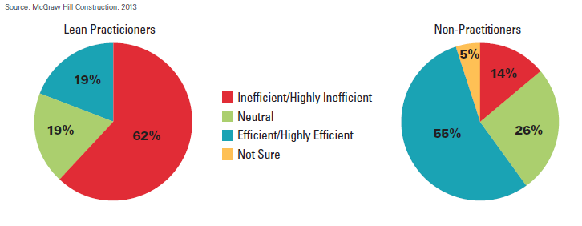
Efficiency of Construction Processes

Slide 7
Compare Traditional and Lean Construction
Focus on speed
Activities are performed as soon as possible
Managers are empowered to be the sole planners
Decisions are made sequentially by specialists
Maintenance and construction react to design
Focus on reliable workflow
Activities are performed at the last responsible moment
The executers of the work are the planners
Downstream workers are involved in upstream decisions
Maintenance and construction inform design

Slide 8
Integrated Project Delivery (IPD)
Lean construction is part of the IPD method
It emphasizes:
Collaboration
Mutual respect
Trust
Bringing stakeholders in earlier at the very beginning
Intensified planning
Technology
Communication

Slide 9
Lean Considerations
[Be careful to not send an unintended message - Lean can only be implemented in an Integrated Project Delivery environment. IPD, as a delivery method, is still rarely used. Many in the audience will see IPD in the same light as unicorns and fairies - mythical at best, not important to my world.]
[What can those in the audience expect when working on CM@R and Design-Build projects? How can elements of the integrated approach still be realized.]

Slide 10
Lean Executives
What should the Executive look for as she/he completes a project/department Gemba walk - to assess how Lean their organization is?
Speaking of back office departments, what advice do you have for implementing Lean for those who support the project delivery?

Slide 11
[Tell your own story]
[Describe your lean journey in as many slides as needed
The presentation is designed to be a personal story that describes your experience with lean construction.
Explain what prompted you to implement Lean
How did you get started?]

Slide 12
[Lean Successes]
[Describe successful use of lean in company projects
Take as many or few slides as you need]

Slide 13
Challenges
Be sure to tell how about challenges your company overcame or struggle to meet
Change can be difficult
Training (staff, subcontractors, owners, etc.)
Developing a new planning/scheduling culture
Personnel resistance
Learning curve]

Slide 14
Course Summary
Should provide a summary to each of the session objectives

Slide 15
Q & A
Presenter and panel discussion

Slide 16
AGC’s Lean Construction Education Program Overview
The overall aims of the LCEP are to:
Develop Lean Construction champions within construction firms
Advance the use of lean practices in construction through development of a consistent nomenclature and practices
Provide an industry-recognized credential that creates a common standard of knowledge

Slide 17
Thank You!
To learn more about AGC’s Lean Construction Education Program visit www.agc.org/lean or email curriculum@agc.org
Be sure to join AGC’s Lean Construction
Forum at www.agcleanforum.org

